Slide 1
8. Natural killer cells, their characteristics and function. Interferons.
9. HLA system (classes, polymorphism, typing).
10. Binding of peptides to MHC. Antigen presentation (function, purpose).
11. T-lymphocytes, ontogenesis, selection, surface markers, subpopulations, functions).
12. Th1 based immune reaction.
13. Th2 based immune reaction.
14. Tc based immune reaction.

Slide 2
NK cells Interferons

Slide 3
NK cells
lymphoid cells which belon to innate immunity
kill cells which have abnormally low MHCgpI expression (some tumor and virus infected cells)
have similar cytotoxic mechanisms as Tc
NK cells activators - IFNα, IFNβ

Slide 4
NK cells receptors
Activating receptors
Some surface lectins
Fc receptor CD16
Inhibitory receptors - recognize MHC gpI
Imunoglobulin family - KIR (killer cell immunoglobulin
like receptors)
C-type lektin family - eg CD94/NKG2

Slide 6
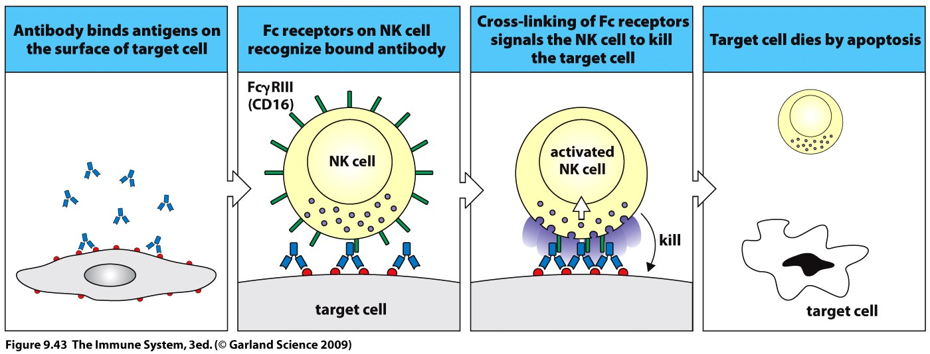
ADCC (antibody-dependent cellular cytotoxicity)
NK cells express CD16 which recognize Fc part of IgG antibodies attached to the surface of a cell, this leads to the activation of NK cell cytotoxic mechanisms

Slide 7
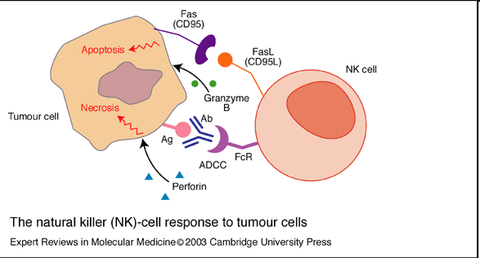
NK cell cytotoxic mechanisms
Cytotoxic granules (perforins and granzymes)
Fas ligand
TNFα

Slide 8
Interferons
IFNα - produced by virus infected lymphocytes, monocytes and macrophages
IFNβ - produced by virus-infected fibroblasts and epithelial cells
IFNα and IFNβ - bind to receptors on the surface of infected and healthy cells and induce in them an antiviral state (synthesis of enzymes that block viral replication in the cell); NK activation, ↑ HLA I expression
IFNγ - produced by T_{H}1 cells, regulatory function, activates macrophages (NO synthase, NADPH oxidase), ↑HLA expression

Slide 9
Interferons

Slide 10
HLA system (MHC glycoproteins)

Slide 11
MHC glycoproteins class I (Major histocompatibility complex)
MHCgpI present peptide fragments from itracellular proteins (which are produced by cell, including viral peptides if are present) on the cell surface for cytotoxic T lymphocytes ( CD8⁺)
Expressed on all nucleated cells
3 isotypes of classical MHC gp. (HLA - A,-B,-C)
3 isotypes non-classical MHC gp. (HLA - E,-F,-G; molecule CD1)

Slide 12
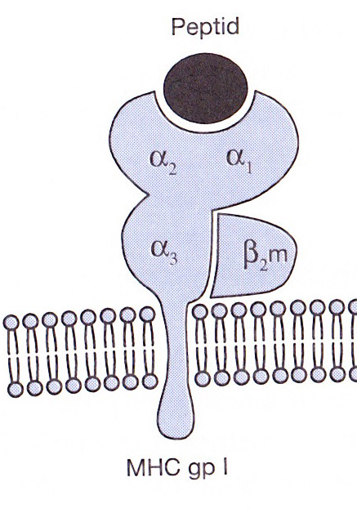
MHC gp I structure
MHC gp class I consists of transmembrane chain α and associated β₂microglobulin
α1, α2 - binding site for peptides
Peptide binding is necessary for a stable conformation of MHC gp

Slide 13
MHC gpI peptide presentation
MHC gp I binds peptides long 8 - 10 amino acids
Certain MHC gp molecule binds peptides sharing identical structural features binding motif
The binding of endogenous peptides occurs in the endoplasmic reticulum during biosynthesis of MHC gp I
These peptides are produced from intracellular proteins that are cleaved by the proteasomes

Slide 14
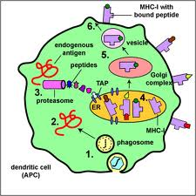
MHC gpI peptide presentation

Slide 15
Non-classical MHC gp I
HLA - E,-F,-G; CD1 molecules
Structurally similar to classical MHC gp
Less polymorphic
Expressed only on some cells
They specialize in binding of specific ligands

Slide 16
Non-classical MHC gp I
HLA-E and HLA-G - expressed on the trophoblast cells
Complexes of HLA-E and HLA-G with peptides are recognized by NK cells inhibitory receptors and contribute to the tolerance of the fetus in utero

Slide 17
MHC glycoproteins class II
MHC gpII present peptide fragments from extracellular proteins on the cell surface for helper T lymphocytes (CD4⁺)
Expressed on the APC (dendritic cells, monocytes, macrophages, B lymphocytes)
3 isotypes of MHC gpII (DR, DQ, DP)

Slide 18
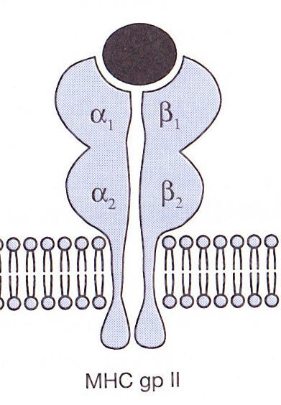
MHC gp II structure
MHC gp II consist of 2 associated transmembrane chains α and β
α1, β1 - binding site for peptide
Peptide binding is necessary for a stable coformation of MHC gp and ensure its long presentation on the cell surface

Slide 19
MHC gp II peptide presentation
MHC gp II binds peptides long 15 - 35 amino acids
Certain MHC gp molecule binds peptides sharing identical structural features –binding motif
Invariant chain blocks the binding site for the peptide
Exogenous peptides binds to MHC gp II in the endosome
Peptide fragments from endocytosed extracellular proteins

Slide 20
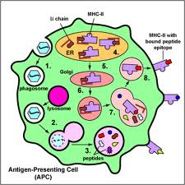
MHC gp II peptide presentation

Slide 21
Antigen prezentation
An antigen-presenting cell (APC) process foreign antigens and present them complexed with MHC‘s on their surfaces to T cells.

Slide 22
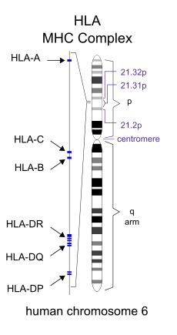
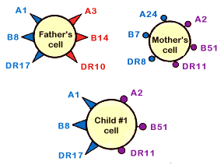
MHC glycoproteins polymorphism
HLA complex is located on chromosome 6
For MHC gp is typical high polymorphism (hundreds of different alelic forms of isotypes)
Codominant inheritance of alelic forms

Slide 23
MHC glycoproteins polymorphism
Increases resistance to disease
Causes complications in the organ transplantation
Association of certain alleles with autoimmune diseases and increased susceptibility to infections

Slide 24
HLA typing (determmination of HLA antigens on the surface of lymphocytes)
Carry out during the testing before transplantation, in paternity determination
Serotyping
Genotyping
PCR-SSP
PCR-SSO
PCR-SBT

Slide 25
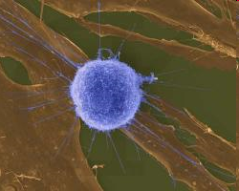
T cells

Slide 26
T cells
Cellular component of antigen-specific mechanisms
Regulation of immune processes and destruction of virus-infected cells or tumor cells
Several subsets of T lymphocytes (T_{H}1, T_{H}2, Treg, T_{C}…)
TCR recognize peptide-MHC complex
T cell are activated by APC

Slide 27
T cell development
T cells originate in bone marrow and then migrate to the thymus where they mature (αβ T lymphocytes), the final differentiation is after the activation by antigen processed and presented by APC
γδ T cells can develop outside the thymus (the minority population)
T cells are stimulated after activation to proliferate and differentiate into effector cells and memory cells

Slide 28
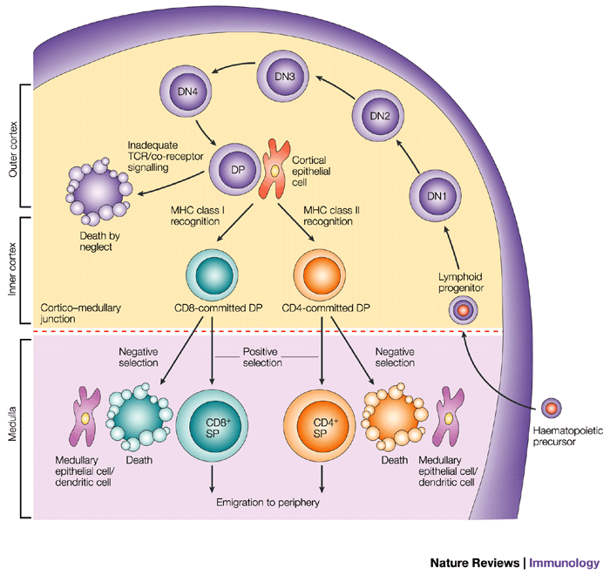
T cell development

Slide 29
T cell development
Pluripotent hematopoietic stem cells
Pro-thymocytes – double negative T cells - are coming from the bone marrow to the thymus, where they begin to rearrange TCRβ genes, express on their surface pre-TCR (Composed of β chain, pre-TCRα and CD3 complex), then begin TCRα genes rearrangement
Cortical thymocytes – double positive T cells - express on their surface TCR (composed of chains α, β and CD3) and CD4 and CD8 co-receptor (double positive T lymphocyte), selection of the cells with dysfunctional TCR and autoreactive cells Medullary thymocytes (mature T cell) - retain the expression of CD4 or CD8, then migrate to the secondary lymphoid organs
Mature T cells (Medullary thymocytes) leave the thymus and migrate to secondary lymphoid organs

Slide 30
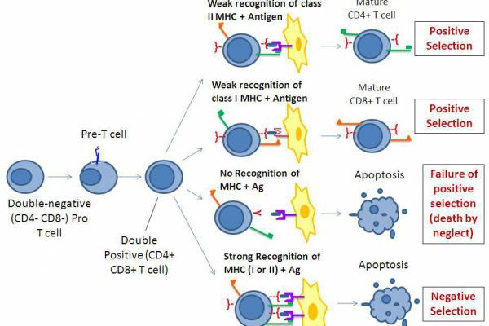
T cell selection
Positive selection - the elimination of cells with dysfunctional TCR, thymocytes that recognize MHC gp with low affinity are positively selected, then maintain the expression of CD4 or CD8 (depending which class of MHC gp binds to the TCR).
Negative selection - the elimination of autoreactive cells, which strongly bind MHCgp with normal peptides (autoantigens) which are expressed on the surface of thymic cells
98% of pro-thymocytes in the thymus during its development dies

Slide 31
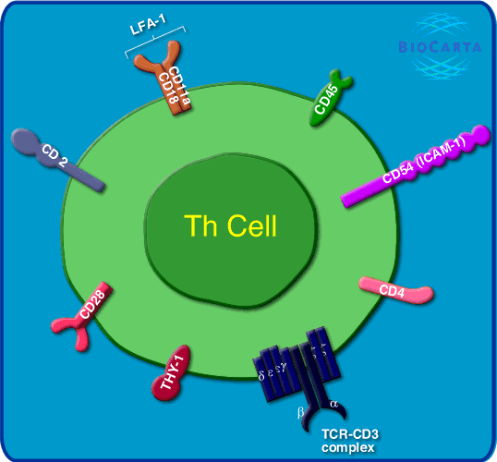
T cell surface markers
TCR - recognizes Ag peptide bound to MHC molecule
CD3 - TCR component, participates in signal transduction
CD4 or CD8 - co-receptors, bind to MHC gp
CD28 - costimulatory receptor, binds to CD80, CD86 on APC
CTLA-4 (CD152) - inhibitory receptor, binds to CD80, CD86

Slide 32
T cell subpopulations
αβ T lymphocytes - have TCRαβ, major type (95-98%), need thymus for development, recognize peptide antigens in the complex with MHC gp
γδ T lymphocytes - (2-5%) may develop outside the thymus, some are able to recognize native Ag, apply in defense of the skin and mucous membranes

Slide 33
CD4⁺ T cells
Express the CD4 coreceptor (co-receptor for MHC class II gp), TCRαβ, precursors of helper T cells (T_{H}), T_{H} differentiate to several subtypes, which secret different cytokines
T_{H}0 - produce a mixture of cytokines such as T_{H}1 and T_{H}2
T_{H}1 - IL-2, IFNγ (activates macrophages )
T_{H}2 - IL-4, IL-5, IL-6, IL-10 (B lymphocytes assistance)
T_{H}3 – TGFβ
Treg - regulatory T cells arise in the thymus from a part of autoreactive lymphocytes, suppress the activity of autoreactive T cell clones (IL-10, TGFβ)

Slide 34
CD8⁺ T cells
Expressing the CD8 co-receptor (co-receptor for MHC gp I), TCRαβ, precursors of cytotoxic T cells (T_{C})
T_{C} – recognize and destroy virus –infected cells or the cells infected with other intracellular parasites and some cancer cells

Slide 35
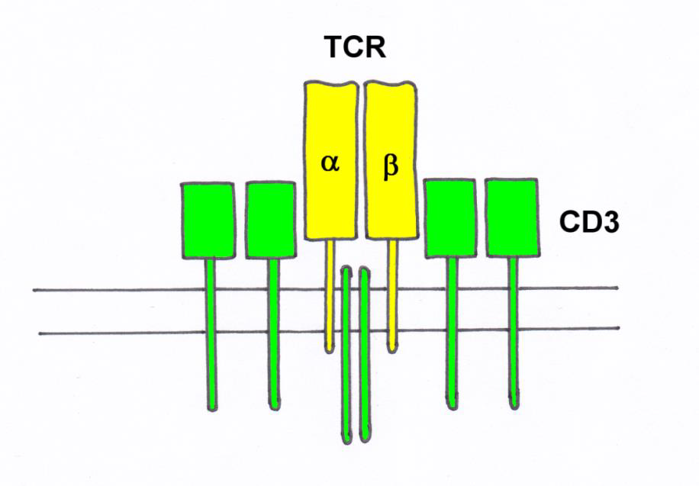
TCR
TCR (T cell receptor) is heterodimer consisting of α and β (γ,δ) chains
associated with CD3 complex, which is necessary for signal transduction
N-terminal parts of α and β (γ,δ) chains form the binding site for Ag

Slide 36
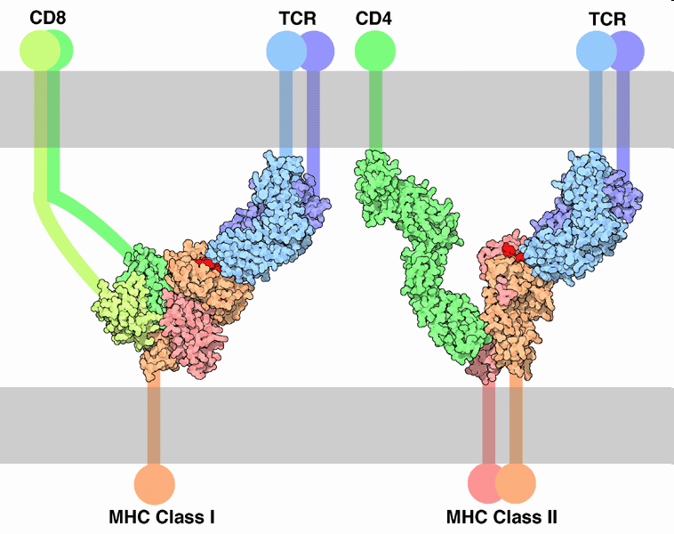
T cell activation
T cell are activated by APC (DC, monocyte, macrophage, B cell)
TCR recognize peptide-MHC complex
TCR cooperate with coreceptors CD4 (binds to MHC gp II) or CD8 (binds to MHC gp I)

Slide 37
T cell activation
Signal: TCR – MHC gp I / II +Ag peptid (APC)
Co-stimulating signal: CD 28 (T lymphocyte) – CD 80, CD 86 (APC)
(Without costimulation, the T cell becomes anergic )

Slide 38
Th1 and Th2 based immune reaction

Slide 39
T_{H}1 based immune response

Slide 40
T_{H}1 based immune response - inflammatory reaction
T_{H}1 cells cooperate with macrophages and activate them (NO production - destroy intracellular parasites)
Activated macrophages secrete some cytokines (IL-1, TNF, ...) that help to stimulate T cells and local inflammation
Interaction between T_{H}1 cells and macrophages is a fundamental mechanism of delayed-type immunopathological reactions (DTH Delayed-type hypersensitivity)

Slide 41
T_{H}1 based immune response
The infected macrophage produces protein fragments derived from intracellular parasites, some of them are presented on the macrophage surface in the complex with MHC gp class II
Macrophages and dendritic cells stimulated by certain microorganisms produce IL-12
T_{H} precursor, which detects the infected macrophage and receives signals via the TCR, CD 28 and receptor for IL-12 proliferates and differentiates into effector T_{H}1 cells that produce IFNγ and IL-2.
IFNγ activates macrophage NO synthase IL-2 is growth factor for T cells

Slide 42
Interaction between APC and T_{H} precursor

Slide 43
T_{H}2 based immune response

Slide 44
T_{H}2 based immune response
T_{H}2 cells cooperate with B lymphocytes (which were stimulated by Ag) by cytokine production (IL-4, IL-5, IL-6, IL-10) and direct intercellular contact (CD 40L)
For stimulation of B lymphocytes is usually necessary cooperation between APC → T_{H}2 cell → B lymphocyte
In minimal model, where the B cell becomes a good APC (CD80, CD86) is sufficient cooperation between T_{H}2 cell → B lymphocyte

Slide 45
T_{H}2 based immune response
T_{H} precursor, which detects the infected macrophage and receives signals through the TCR, CD 28 , IL-4 receptor and IL-2 receptor proliferates and differentiates in the effector T_{H}2, which provide B lymphocytes auxiliary signals via secreted cytokines IL-4, IL-5, IL-6, IL-10 and molecule CD 40L, which bind to the costimulatory receptor on B lymphocytes CD 40

Slide 46
T_{H}2 based immune response
Interaction between CD40 (B lymphocytes) and CD40L (TH2 cells) is essential for the initiation of somatic mutations, izotype switching and formation of memory cells
IL-4, IL-5, IL-6, IL-10: stimulation of B lymphocytes

Slide 47
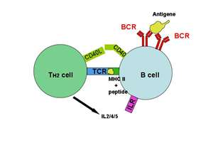
Function of T_{H}2 cells

Slide 48
Mutual regulation of activities T_{H}1versus T_{H}2
Whether the T_{H} precursor cell will develop into T_{H}1 or T_{H}2 decides cytokine ratio of IL-12 and IL-4
IL-12 is produced by macrophages and dendritic cells stimulated by certain microorganisms
IL-4 is produced by activated basophils, mast cells and T_{H}2 cells
T_{H}1 cytokines (mainly IFNγ) inhibit the development of T_{H}2 and stimulate the development of T_{H}1 (IL-2 stimulates also T_{H}2)
Cytokines produced by T_{H}2 (IL-4, IL-10) inhibit the development of T_{H}1 and stimulate the development of T_{H}2

Slide 49
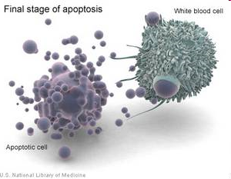
T_{C} based immune response

Slide 50
Cytotoxic T lymphocytes stimulation
T_{C} recognize cells infected with viruses or other intracellular parasites, and some tumor cells
Precursor of T_{C}, which recognizes a peptide-MHC gpI complex on the surface of APC via TCR and receives signals via CD 28 proliferates and differentiates to clone mature effector cytotoxic cells (CTL)
For full T_{C} activation is necessary IL-12
CTL are spread by bloodstream into tissues; for activation of cytotoxic mechanisms is sufficient signal via TCR

Slide 51
Professional APC are dendritic cells or macrophages that are infected with virus, or swallowed antigens from dead infected, tumor or stressed cells
In order APC could activate the T_{C} precursor, APC must be stimulated by contact with T_{H}1 cell via CD 40, then the dendritic cell begins to express CD 80, CD86 and secrete cytokines (IL-1, IL-12) = change of resting APC in activated

Slide 52
Tc effector functions
Cytotoxic granules containing perforin, granzymes and granulysin
Fas ligand (FasL) - which binds to the apoptotic receptor Fas (CD95) presented on the surface of many different cells (also on the surface of T_{C})
TNFβ
Activation of effector mechanismus leads to apoptotic death of the target cell.

Slide 53
Tc effector functions

Slide 54
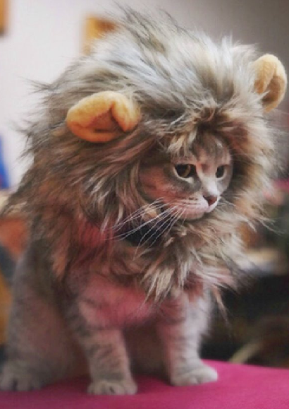
Thank you for your attention

Slide 55
T cell development http://www.youtube.com/watch?v=odLLr6mjaUQ
TLR receptors http://www.youtube.com/watch?v=iVMIZy-Y3f8
MHC II prezentation http://www.youtube.com/watch?v=_8JMVq7HF2Y
MHC I prezentation http://www.youtube.com/watch?v=vrFMWyJwGxw

