Slide 1
Immunodeficiencies, part 1
Martin Liška

Slide 2
Basic immunological terms
Immune system provides 3 basic functions:
Defense against infection
Homeostasis – elimination of old or impaired cells
Immunological surveillance - elimination of mutated cells
Endocrine system
Immune system
Nervous system
Disorders – detectable by laboratory or histological methods, without clinical manifestation
Clinical manifestation – decreased function - immunodeficiencies
- increased function – allergy, autoimmunity

Slide 3
Immunodeficiency
= a disorder of immune system which manifests by impaired ability to carry out basic immunological functions, primarily defence against infection or immunological surveillance

Slide 4
Classification of immunodeficiencies:
Humoral – nonspecific immune system – complement system
specific immune system – immunoglobulins (B cells)
Cellular – nonspecific – phagocytes
specific – T cells
Primary – hereditary, symptoms manifest mostly in early stages
Secondary – acquired, symptoms manifest mostly in any stages of
life
variable etiology (metabolic diseases, malignancies,
immunosupressants, infections, stress etc.)

Slide 5
European registry of primary immunodeficiencies from 2003 (prevalence 1,52/100000)
Disorder | Frequency (%)
Antibody deficiencies | 66,3
T cell deficiencies + combined | 17,6
Defects of phagocytes | 7,4
Complement system defects | 6,2
Other primary immunodeficiencies | 2,5

Slide 6
Various types of primary immunodeficiency in Czech Republic (2003)
Primary immunodeficiency | Frequency (%)
X-linked agamaglobulinaemia | 3,9
CVID | 19,6
HyperIgM syndrome | 0,8
Selective IgA-deficiency | 51,2
Selective deficiency of IgG subclasses | 2,4
SCID | 1,5
DiGeorge syndrome | 4,6
Wiskott-Aldrich syndrome | 0,5
Hereditary angioedema | 10,6
C2 deficiencey | 0,4
C4 deficiency | 0,5
LAD I | 0,2
CGD | 1,8
HyperIgE syndrome | 1,2
Chronic mucocutaneous candidiasis | 0,4
X-linked lymphoproliferative syndrome | 0,4

Slide 7
Phenotypic classification of primary immunodeficiencies (PID)
Immunodeficiencies affecting cellular and humoral immunity (Severe Combined ImmunoDeficiency, HyperIgM Syndrome)
Combined immunodeficiency with associated or syndromic features (diGeorge Syndrome, ataxia teleangiectasia (ATM), Nijmegen breakage sy., Wiskott-Aldrich Syndrome (WAS), HyperIgE Syndrome(HIES), NEMO def.)
Predominantly antibody immunodeficiencies (X-Linked Agammaglobulinaemia (XLA), Common Variable ImmunoDeficiency (CVID), Transient Hypogammaglobulinaemia of Infancy (THI), Selective IgA Deficiency (SIAD), IgG subclasses def.)

Slide 8
Phenotypic classification of primary immunodeficiencies (PID)
Diseases of immune dysregulation (Chediak-Higashi sy., X-linked LymphoProliferative Disease (XLP), Autoimmune LymphoProliferative Syndrome (ALPS), Autoimmune PolyEndocrinopathy with Candidiasis and Ectodermal Dystrophy (APECED), IL-10 def.)
Congenital defects of phagocyte number, function, or both (Severe Congenital Neutropenia, Cyclic Neutropenia, Kostmann Syndrome, Leukocyte Adhesion Deficiency (LAD) syndrome I-III, Chronic Granulomatous Disease (CGD))

Slide 9
Phenotypic classification of primary immunodeficiencies (PID)
Defects of intrinsic and innate immunity (IRAK4 def., MyD88 def., WHIM sy., Chronic Mucocutaneous Candidiasis (CMC))
Auto-inflammatory disorders (Familial Mediterranean Fevere (FMF), HyperIgD Syndrome (HIDS), Muckle-Wells syndrome, CINCA syndrome, Familial Cold Autoinflammatory Syndrome, TRAPS syndrome, BLAU syndrome)

Slide 10
Typical age of immunodeficiency manifestation
Early infancy - severe combined primary immunodeficiencies
6 months – 2 years – severe hereditary antibody deficiencies
3 - 5 years – transitory or selective antibody deficiencies,
secondary immunodeficiencies
15 – 20 years – hormonal instability, thymus involution, lifestyle
changes, some typical infections (EBV), first symptoms
of CVID
Middleage – excessive workload, stress, CVID, autoimmune disease,
malignancies
Advanced/old age – rather symptoms of secondary
immunodeficiencies

Slide 11
Immunodeficiency – the main clinical features
Antibody d. - recurrent microbial infections (capsulated bacteria)
respiratory - pneumonia, sinusitis, otitis
GIT – diarrhea
Complement system d. – microbial infections (pyogenic), sepsis
immunocomplex diseases (SLE)
swellings in HAE – C1-inhibitor deficiency
Combined T cells (+ B cells) d. - bacterial, fungal, viral infections
GIT symptoms – diarrhea
respiratory infections – pneumonia, sinusitis
Phagocytes d.- abscesses, recurrent pyogenic infections of skin,
granulomatous inflammation

Slide 12
The differentiation of pluripotent stem-cell

Slide 13
Immunodeficiency diagnosis
History
Laboratory tests:
- blood cell count, Ig
- FCM
- special tests (lymphocyte functional tests,
phagocytosis, respiratory burst test, IgG subclasses,
specific Ig)
Genetics

Slide 14
10 warning signs of primary immunodeficiency disorder (PID)
≥ 4 new ear infections within 1 year
≥ 2 serious sinus infections within 1 year
≥ 2 months on antibiotics with little effect
≥ 2 pneumonias within 1 year
Failure of an infant to gain weight or grow normally
Recurrent deep skin or organ abscesses
Persistent thrush in mouth or fungal infection on skin
Need for intravenous antibiotics to clear infections
≥ 2 deep-seated infections including septicemia
A family history of PID

Slide 15
Therapy of immunodeficiency
Severe PIDs → HSCT
Other PIDs → gene therapy
Primary & secondary IDs → substitution (IVIG)
→ prophylaxis (ATB)
Mild IDs →immunomodulation

Slide 16
Primary immunodeficiencies

Slide 17
I. Defects of phagocytes
1/ Quantitative defects of phagocytes
a/ neutropenia, granulocytopenia
severe congenital neutropenia (Kostmann sy.)
cyclic neutropenia
reticular dysgenesis sy.

Slide 18
I. Defects of phagocytes
2/ Qualitative defects of phagocytes
impaired ability of phagocytes to phagocyte or kill ingested microbes
a/ Chronic Granulomatous Disease (CGD)
X-linked (60%), event.AR
defect of NADPH oxidase system → impaired ability to produce toxic oxygen metabolites (e.g.H₂O₂) → decreased ability to kill microbes (especially producing catalase: Staph.aureus or Pseudomonas aeruginosa)
Symptoms: onset at early age
formation of granulomas and abscesses in skin and organs
Dg: respiratory burst test (FCM, NBTT)
genetic tests
Th: ATB prophylaxis
in more severe cases BMT or gene therapy

Slide 19
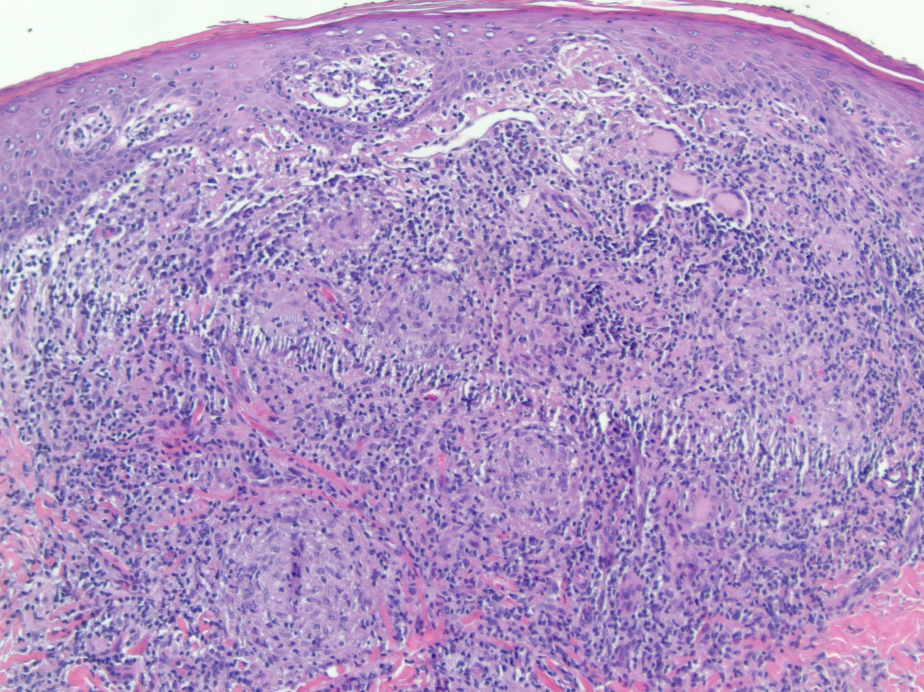
Histological finding of granuloma in CGD

Slide 20
I. Defects of phagocytes
b/ Glucose-6-phosphate dehydrogenase deficiency
similar symptoms like previous + hemolytic anemia
c/ Myeloperoxidase deficiency
susceptibility to infections caused by Staph.aureus or Candida albicans
d/ Chèdiak-Higashi syndrome
recurrent severe pyogenic infections (streptococci, staphylococcci)
neutrophils contain giant lysosomes (disorder of their content release → impaired killing of microbes)
Dg: neutrophils with abnormal chemotaxis and killing
Th: ATB, ev.BMT

Slide 21
I. Defects of phagocytes
e/ adhesion deficiency (LAD syndrome)
defects of neutrophil adhesion molecules expression
LAD I – defect of integrins expression
LAD II – defect of selectins expression
Clin.sympt.: recurrent skin and mucous infections, impaired healing of umbilical cord scar, formation of abscesses (especially in periproctal region) with poor production of pus
Dg: proof of decreased CR3 expression
Th: ATB, transfusion of donor granulocytes
only treatment is BMT

Slide 22
II. Defects of complement system
a/ C1, C2, C3, C4 deficiency
Increased development of systemic immunocomplex diseases (SLE-like), susceptibility to pyogenic infections
b/ C6, C7, C8, C9 deficiency
Susceptibility to pyogenic infections, in C9 deficiency meningococcal infections
c/ MBL deficiency
Mannan Binding Lectin deficiency (lectin pathway of complement system activation), increased frequency of common infections

Slide 23
II. Defects of complement system
d/ Hereditary angioedema (HAE)
absence or functional defect of C1 inhibitor
C1-inhibitor = regulation of complement system, kinin and hemocoagulation cascade → in case of C1-INH deficiency: dysregulation of bradykinin metabolism → swellings
Symptoms: recurrent swellings of skin, mucous membranes of
larynx, gut (mimicking intestinal obstruction)
onset mostly in adolescence
triggering factor most frequently injury, surgery
(e.g.dental), intercurrent infection
Laryngeal swelling could be life-threatening without rescue therapy

Slide 24
II. Defects of complement system
d/ Hereditary angioedema (HAE)
Dg: C1-inhibitor concentration assessment
C4 concentration assessment
functional test of C1-inhibitor
genetics
Th: preventive – androgens (Danazol), antifibrinolytics
(tranexamic acid), C1-inhibitor concentrate
rescue – administration of C1 inhibitor concentrate (Berinert),
selective bradykinin-receptor inhibitor (icatibant –
Firazyr), recombinant C1-inhibitor (Ruconest)
Angioedema can be secondary too

Slide 25
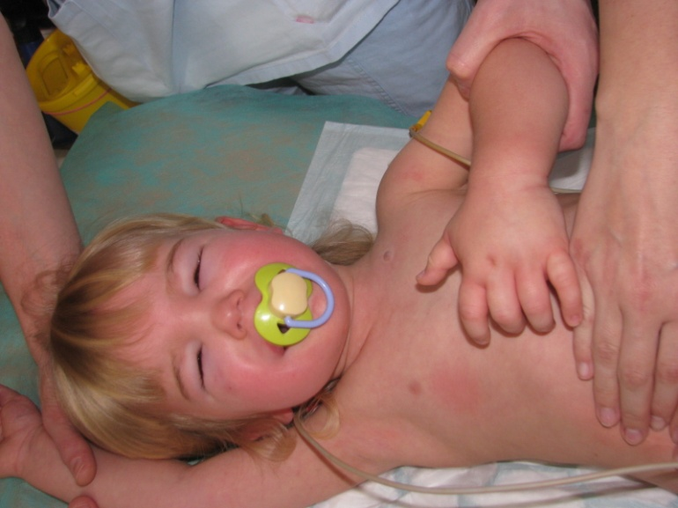
Swellings in HAE

Slide 26
III. Predominantly antibody immunodeficiencies
X-linked (Bruton’s) agammaglobulinemia (XLA)
Mutation of Bruton’s tyrosinkinase gene (Btk)(Xq21.3-22) → block of maturation of pre-B cell into B cell → severely decreased Ig levels and B cell numbers
Most common X-linked form, but rarely forms affecting girls
Symptoms: onset between 6th month and 2nd year of age: recurrent pneumonias,
pyogenic otitis, sinusitis with complications
increased risk of pulmonary fibrosis
Dg: IgG, IgA, IgM levels ˂ 2* SD of age mean
absence of isohemaggulutinins and/or poor seroconversion to vaccination
B cell numbers markedly decreased or absent
genetic tests
Th: life-long Ig replacement (SCIG, IVIG)

Slide 27
III. Predominantly antibody immunodeficiencies
Common Variable Immunodeficiency (CVID)
Heterogenous group of diseases manifested by markedly decreased serum IgG and IgA (IgM) levels (˃2* SD of age mean)
Similar to XLA, but symptoms onset usually at 2nd – 3rd decade of life (not earlier than at 4th year of age)
Symptoms: recurrent infections of respiratory tract – pneumonia, sinusitis, bronchitis
(Pneumococci, Haemophilus, Branhamella, Mycoplasma, Pseudomonas)
meningitis, chronic diarrhea (Giardia), arthritis
complications: tumors or autoimmune diseases, e.g.hemolytic anemia,
fibrosis, endocrinopathies, lymphoproliferations, bronchiectasies

Slide 28
Comorbidities in patients with CVID
Disease | Number of patients (%)
Severe/frequent infections | 242 (90)
Chronic lung affection | 68 (27)
Autoimmune disorders | 55 (22)
Hepatitis | 27 (11)
Granulomatous disease | 21 (8)
IBD | 16 (6)
Malignancies | 38 (16)
Cunningham-Rundles C and Bodian C, Clin Immunol 1999

Slide 29
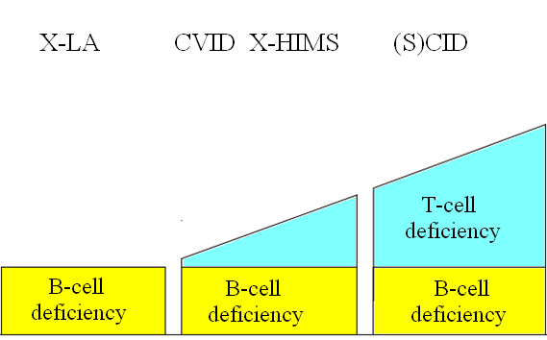
Clinical manifestation of isolated and combined disorder of B cells
Clinical severity

Slide 30
III. Predominantly antibody immunodeficiencies
Common Variable Immunodeficiency (CVID)
Dg: markedly decreased serum IgG and IgA (IgM) levels (˃2* SD of age mean)
poor seroconversion to vaccination
B cells normal or slightly decreased (decreased number of isotype switched
memmory B cells)
genetics (mutation of ICOS, BAFF, CD19, CD20 or others)
Ter: life-long Ig replacement (IVIG or SCIG)
long-term follow-up

Slide 31
III. Predominantly antibody immunodeficiencies
Transient hypogammaglobulinemia of infancy (THI)
Delayed onset of antibody production → decreased levels of Ig (esp.IgG), get normal until app. 3 years of age
More frequent infections, esp.of respiratory tract
B cell numbers normal
Th: symptomatic, event.transiently IVIG

Slide 32
III. Predominantly antibody immunodeficiencies
Selective IgA deficiency (SIAD)
Impaired function of B cells
The most common X the mildest PID
Symptoms: recurrent respiratory infections X very often without any
symptoms
Dg: IgA ˂ 0,07 g/l at age of ≥ 4 years, levels of IgG and IgM normal
Th: no treatment
patients with SIAD are not allowed to be vaccinated with live oral
vaccines; in case of blood transfusion, the should get autotransfusion or
properly washed erythrocytes

Slide 33
III. Predominantly antibody immunodeficiencies
IgG subclasses deficiency, specific Ig deficiency
Impaired production of some IgG subclass or specific IgG (e.g. against Pneumococci or tetan)
Symptoms manifest usually during childhood, most commonly respiratory infections caused by capsulated bacteria (H. influenzae, Pneumococci)
Th: symptomatic
in some cases, IVIG substitution necessary

Slide 34
III. Predominantly antibody immunodeficiencies
WHIM syndrome
Warts, Hypogammaglobulinaemia, Immunodeficiency, Myelokathexis
AD inheritance
Defect of CXCR4 → permanent activation of the receptor → retention of blood cells in bone marrow due to dysfunction of receptor

Slide 35
Immunoglobulin replacement therapy
Immunoglobulin concentrates are made from human plasma pooled from thousands of donors
Donors are tested for infectious diseases (HIV, hepatitis), inactivating procedures to minimize the risk of transmitting infection
Ig concentrates contain only IgG, content of IgA is minimal
Preparates for i.v. (Gammagard, Octagam) or s.c. administration (Hizentra, Gammanorm, HyQvia)

Slide 36
Indications for Ig replacement therapy
Primary antibody deficiencies (IVIG) – life-long in XLA or CVID, transiently in combined immunodeficiencies (SCID)
IgG subclasses or specific Ig deficiency is sometimes also indication
Secondary antibody deficiencies – typically B cell leukemia (CLL), multiple myeloma

Slide 37
Dosage of Ig concentrates
Agammaglobulinemia – i.v. imunoglobulins 400-600 mg/kg/month
Regular administration in day-care centres every 3 or 4 weeks
Last years, „home therapy“ is frequently used - administration of subcutaneous Ig by infusion pump (cca every 5 to 7 days, more comfortable for patient, less adverse effects)

Slide 38
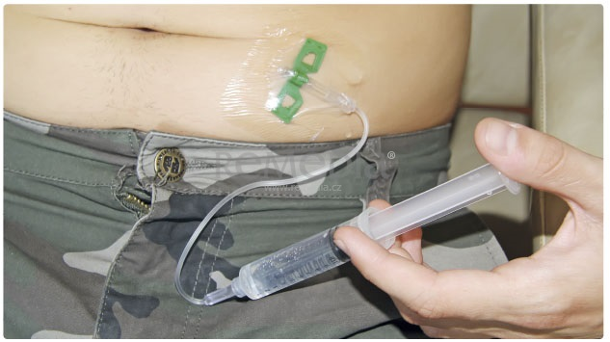
Administration of subcutaneous Ig by infusion pump

Slide 39
Adverse effects of the treatment
Allergic reactions, anaphylaxis
In less severe reactions (shivers, headache), slowing down the infusion is usually sufficient
Sometimes, premedication with intravenous corticosteroids is necessary
Change of preparate (lower content of IgA)

