Slide 1
9. Natural killer cells, their characteristics and function. Interferons.
10. HLA system (classes, polymorphism, typing).
11. Binding of peptides to MHC. Antigen presentation (function, purpose).
12. T-lymphocytes, ontogenesis, selection, surface markers,
subpopulations, functions).
13. Th1 based immune reaction.
14. Th2 based immune reaction.
15. Tc based immune reaction.
16. Physiological mechanisms of regulation of the immune system.
Cytokines (classification according to the function).

Slide 2
NK cells
Interferons

Slide 3
NK cells
lymphoid cells which belon to innate immunity
kill cells which have abnormally low MHCgpI expression
(some tumor and virus infected cells)
have similar cytotoxic mechanisms as Tc
NK cells activators - IFNα, IFNβ

Slide 4
NK cells receptors
Activating receptors
    Some surface lectins
    Fc receptor CD16
Inhibitory receptors - recognize MHC gpI
      Imunoglobulin family - KIR (killer cell immunoglobulin
like receptors)
      C-type lektin family - eg CD94/NKG2

Slide 5
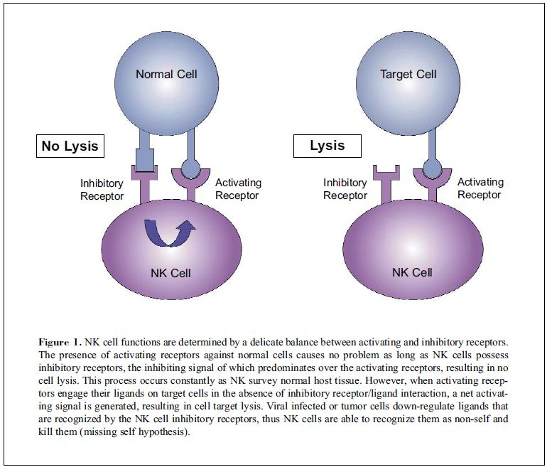

Slide 6
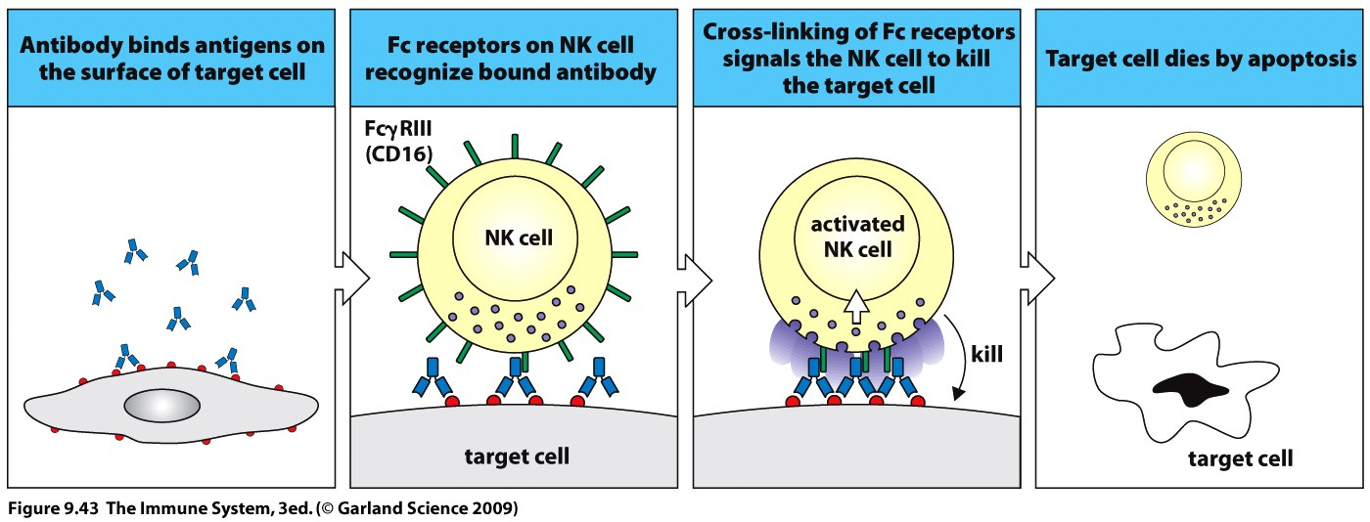
ADCC
(antibody-dependent cellular cytotoxicity)
NK cells express CD16 which recognize Fc part of IgG antibodies attached to the surface of a cell, this leads to the activation of NK cell cytotoxic mechanisms

Slide 7
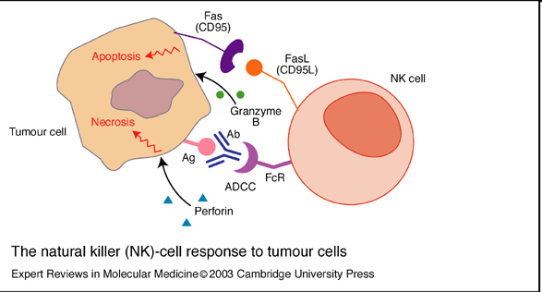
NK cell cytotoxic mechanisms
Cytotoxic granules (perforins and granzymes)
Fas ligand
TNFα
https://www.youtube.com/watch?v=HNP1EAYLhOs

Slide 8
Interferons
IFNα - produced by virus infected lymphocytes, monocytes and macrophages
IFNβ - produced by virus-infected fibroblasts and epithelial cells
IFNα and IFNβ - bind to receptors on the surface of infected and healthy cells and induce in them an antiviral state (synthesis of enzymes that block viral replication in the cell); NK activation, ↑ HLA I expression
IFNγ - produced by T_{H}1 cells, regulatory function, activates macrophages (NO synthase, NADPH oxidase), ↑HLA expression

Slide 9
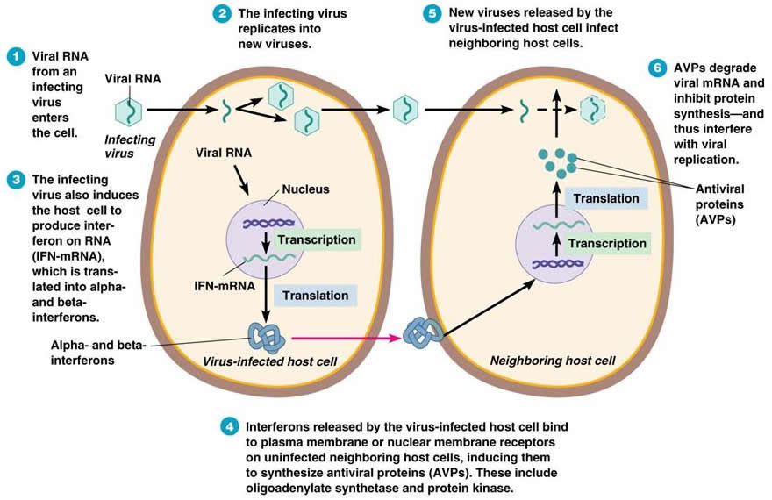
Interferons

Slide 10
HLA system
(MHC glycoproteins)

Slide 11
MHC glycoproteins class I
(Major histocompatibility complex)
MHCgpI present peptide fragments from itracellular proteins (which are produced by cell, including viral peptides if are present)
on the cell surface for cytotoxic T lymphocytes ( CD8⁺)
Expressed on all nucleated cells
3 isotypes of classical MHC gp. (HLA - A,-B,-C)
3 isotypes non-classical MHC gp. (HLA - E,-F,-G; molecule CD1)

Slide 12
Non-classical MHC gp I
HLA - E,-F,-G; CD1 molecules
Structurally similar to classical MHC gp
Less polymorphic
Expressed only on some cells
They specialize in binding of specific ligands
HLA-E and HLA-G - expressed on the trophoblast cells
Complexes of HLA-E and HLA-G with peptides are recognized by NK cells inhibitory receptors and contribute to the tolerance of the fetus in utero

Slide 13
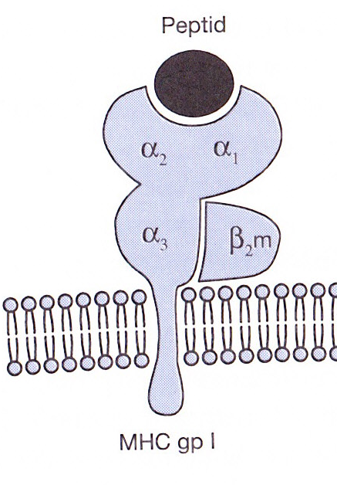
MHC gp I structure
MHC gp class I consists of transmembrane
chain α and associated β₂microglobulin
α1, α2 - binding site for peptides
Peptide binding is necessary for a stable conformation of MHC gp

Slide 14
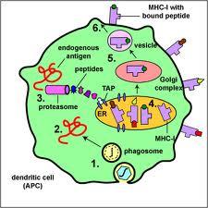
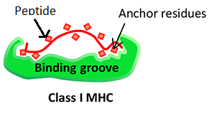
MHC class I presentation endogenous pathway
MHC class I binds peptides long 8 - 10 amino acids
Certain MHC gp molecule binds peptides sharing
identical structural features - binding motif
The binding of endogenous peptides in the endoplasmic reticulum during biosynthesis of MHC class I protein
Peptides are produced from intracellular proteins degradated
by the proteasome
https://www.youtube.com/watch?v=hzET2XMMW28

Slide 15
MHC glycoproteins class II
MHC gpII present peptide fragments from extracellular proteins on the cell surface for helper T lymphocytes (CD4⁺)
Expressed on the Antigen presenting cell APC
(dendritic cells, monocytes, macrophages, B lymphocytes)
3 isotypes of MHC gpII (DR, DQ, DP)

Slide 16
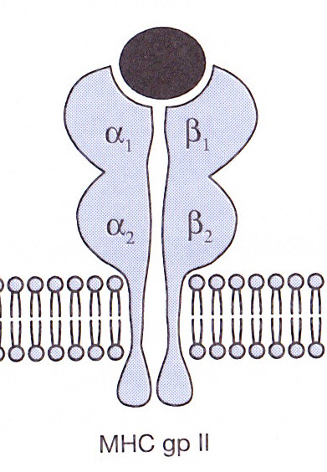
MHC gp II structure
MHC gp II consist of 2 associated
transmembrane chains α and β
α1, β1 - binding site for peptide
Peptide binding is necessary for a stable coformation of MHC gp and ensure its long presentation on the cell surface

Slide 17
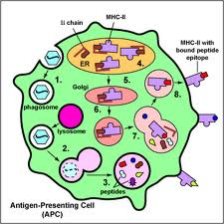
MHC class II presentation
MHC class II binds peptides long 15 - 35 amino acids
Certain MHC gp molecule binds peptides sharing identical structural features –binding motif
Invariant chain blocks the binding site for the peptide
The antigenic peptides are derived from extracellular proteins
Exogenous peptides binds to MHC class II in the endosome
https://www.youtube.com/watch?v=8krIaGVR6Gk

Slide 18
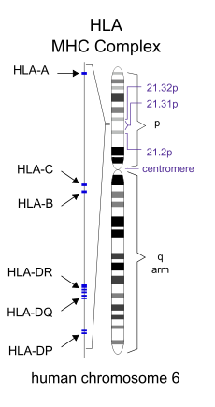
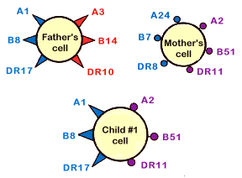
MHC glycoproteins polymorphism
HLA complex is located on chromosome 6
For MHC gp is typical high polymorphism
(hundreds of different alelic forms of isotypes)
Codominant inheritance of alelic forms

Slide 19
MHC glycoproteins polymorphism
Increases resistance to disease
Causes complications in the organ transplantation
Association of certain alleles with autoimmune diseases
and increased susceptibility to infections

Slide 20
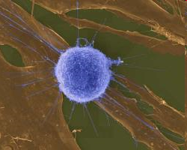
T cells

Slide 21
T cells
Cellular component of antigen-specific mechanisms
Regulation of immune processes and destruction
of virus-infected cells or tumor cells
Several subsets of T lymphocytes (T_{H}1, T_{H}2, Treg, T_{C}…)
TCR recognize peptide-MHC complex
T cell are activated by APC

Slide 22
T cell development
T cells originate in bone marrow and then migrate to the thymus where they mature (αβ T lymphocytes), the final differentiation
is after the activation by antigen processed and presented by APC
T cells are stimulated after activation to proliferate
and differentiate into effector cells and memory cells
γδ T cells can develop outside the thymus (the minority population)

Slide 23
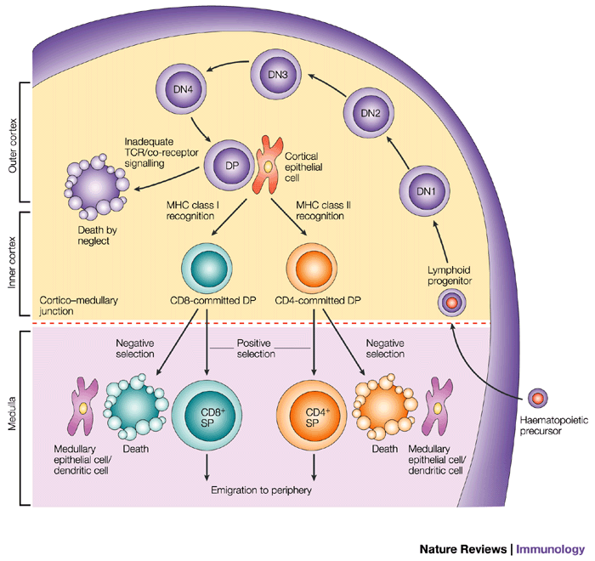
T cell development
Pluripotent hematopoietic stem cells
Lymphoid progenitors - are coming from the bone marrow
to the thymus
Pro-thymocytes – double negative T cells - begin to rearrange TCRβ genes, express on their surface
pre-TCR (Composed of β chain, pre-TCRα and CD3 complex),
then begin TCRα genes rearrangement
Cortical thymocytes – double positive T cells - express on their surface TCR and CD4 and CD8
co-receptor (double positive T lymphocyte),
T cell selection
Medullary thymocytes - single positive T cells - retain the expression of CD4 or CD8, then migrate
to the secondary lymphoid organs
Mature T cells (Medullary thymocytes) leave the thymus and migrate to secondary lymphoid organs

Slide 24
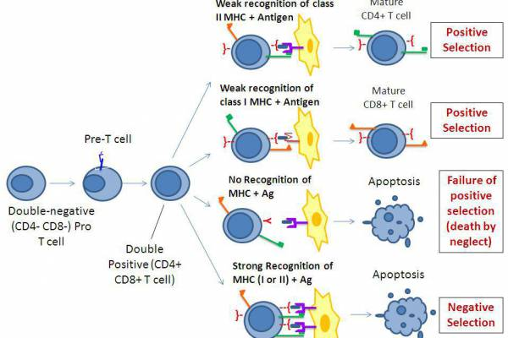
T cell selection
Positive selection - the elimination of cells with dysfunctional TCR,
thymocytes that recognize MHC gp with low affinity are positively selected, then maintain the expression of CD4 or CD8 (depending which class of MHC gp binds to the TCR).
Negative selection - the elimination of autoreactive cells, which strongly bind MHCgp with normal peptides (autoantigens) which are expressed on the surface of thymic cells
98% of pro-thymocytes in the thymus
during its development dies
https://www.youtube.com/watch?v=9E_UxnC_L2o

Slide 25
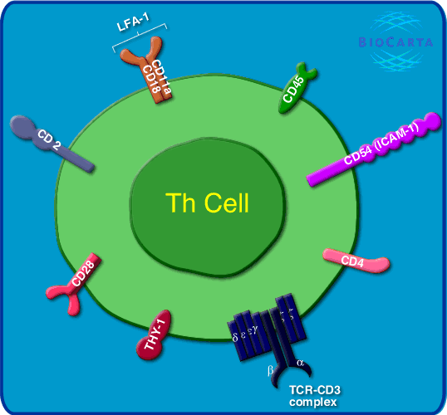
T cell surface markers
TCR - recognizes Ag peptide bound to MHC molecule
CD3 - TCR component, participates in signal transduction
CD4 or CD8 - co-receptors, bind to MHC gp
CD28 - costimulatory receptor, binds to CD80, CD86 on APC
CTLA-4 (CD152) - inhibitory receptor, binds to CD80, CD86

Slide 26
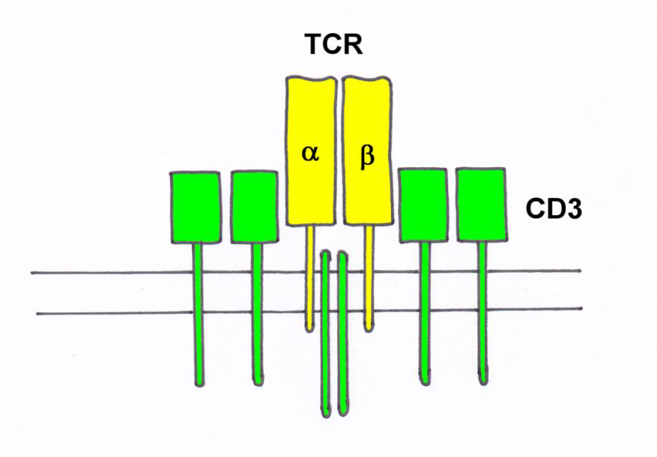
TCR
TCR (T cell receptor) is heterodimer
consisting of α and β (γ,δ) chains
associated with CD3 complex, which is necessary for signal
transduction
N-terminal parts of α and β (γ,δ) chains form the binding site for Ag

Slide 27
T cell subpopulations
αβ T lymphocytes - have TCRαβ, major type (95-98%), need thymus for development, recognize peptide antigens in the complex with MHC gp
γδ T lymphocytes - (2-5%) may develop outside the thymus, some are able to recognize native Ag, apply in defense of the skin and mucous membranes
NK-T cells – recognize CD1 complexes with lipids and glycolipids

Slide 28
αβ CD4⁺ T cells
Precursors of helper T cells (T_{H}), T_{H} differentiate to several subtypes, which secret different cytokines
T_{H}1 - IL-2, IFNγ; macrophages activation
T_{H}2 - IL-4, IL-5, IL-6, IL-10; protection against extracellular parasites
T_{H}17 - IL-17; proinflammatory, participation autoimmune diseases
Tfh - (follicular helper T cells); B cells assistance
Treg – (regulatory T cells) suppress the activity of others
T cells, especially autoreactive T cells; produce IL-10 and TGFβ
regulatory T cells arise in the thymus from a part of autoreactive lymphocytes

Slide 29
αβ CD8⁺ T cells
Precursors of cytotoxic T cells (T_{C})
T_{C} – recognize and destroy cells infected with viruses
or the cells infected with other intracellular parasites
and some cancer cells

Slide 30
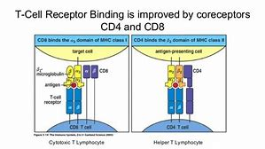
T cell activation
T cell are activated by APC (Antigen presenting cell)
TCR recognize peptide-MHC complex
TCR cooperate with coreceptors CD4 (binds to MHC gp II) or CD8 (binds to MHC gp I)

Slide 31
T cell activation – professional APC
Dendritické buňky
Monocytes, macrophages
Dendritic cells (cross-presentation)
B cells
Express HLA II, CD 80 a CD 86, HLA I
APC are necessary for T cell activation

Slide 32
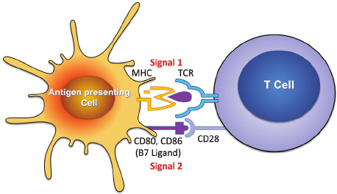
T cell activation
Signal: TCR – MHC gp I / II +Ag peptid (APC)
Co-stimulatory signal: CD 28 (T lymphocyte) – CD 80, CD 86 (APC)
(Without costimulation the T cell becomes anergic )
Activation via TCR and CD28 results in proliferation and differentiation in effector
or memory cells
https://www.youtube.com/watch?v=JPh9P1aEfMI

Slide 33
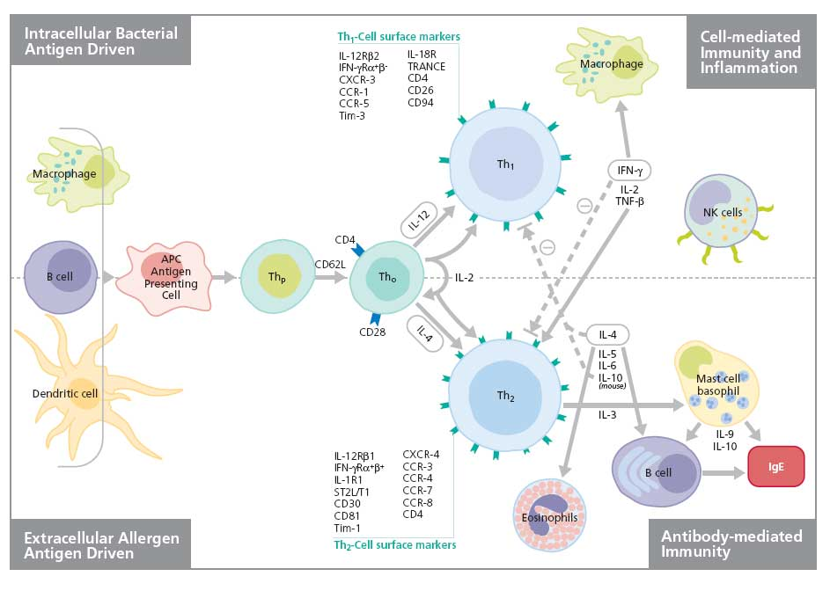
Th1 and Th2 based immune reaction
http://www.youtube.com/watch?v=iVMIZy-Y3f8

Slide 34
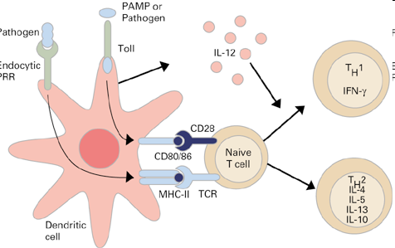
T_{H}1 based immune reaction
T_{H}1 cells are involved in the defense against intracellular parasites
T_{H}1 cells cooperate with macrophages and support
the differentiation of cytotoxic T lymphocytes
Macrophages and dendritic cells stimulated by some
micro-organisms produce IL-12
A T_{H} precursor that recognizes an infected macrophage and receives signals via TCR, CD28 and the IL-12 receptor proliferates
and differentiates into effector T_{H}1 cells
T_{H}1 cells produce IFNγ and IL-2

Slide 35
T_{H}1 based immune reaction
IFNγ activates macrophages (↑ antigen presentation and lysosomal activity, activates inducible NO synthase)
IL-2 is essential for the proliferation and differentiation of T lymphocytes
Activated macrophages produce cytokines (IL-1, TNF ...) that stimulate
T cells and stimulate local inflammation to suppress infection
Interaction of TH1 cells and macrophages is a fundamental mechanism of delayed-type hypersensitivity (DTH; hypersensitivity rection type IV)

Slide 36
29. Th2 based immune reaction

Slide 37
Th2 based immune reaction
The basic function of T_{H}2 cells is protection against extracellular parasites
T_{H}2 cells cooperate with basophils, mast cells and eosinophils
T_{H}2 cells helps B lymphocytes in IgE production
T_{H} precursor, which recognize antigen on APC and receives signals via TCR, CD28, IL-4 receptor and IL-2 receptor proliferates and differentiates in effector TH2
Th2 produces IL-4, IL-5, IL-6, IL-10

Slide 38

Mutual regulation of activities T_{H}1versus T_{H}2
Whether the T_{H} precursor cell will develop into T_{H}1 or T_{H}2 decides cytokine ratio of IL-12 and IL-4
IL-12 is produced by macrophages and dendritic cells stimulated by certain microorganisms
IL-4 is produced by activated basophils, mast cells and T_{H}2 cells
T_{H}1 cytokines (mainly IFNγ) inhibit the development of T_{H}2 and stimulate the development of T_{H}1 (IL-2 stimulates also T_{H}2)
Cytokines produced by T_{H}2 (IL-4, IL-10) inhibit the development of T_{H}1 and stimulate the development of T_{H}2

Slide 39
Tfh – B cell assistance

Slide 40
Tfh – B cell assistance
The Tfh cells promotes B cell maturation, the help is mediated by cytokines (IL-21, IL-4…) and direct intracellular contact (CD40L)
The T_{H} precursor, which receives from APC signals through the TCR, CD 28 and receives a signal from the B cell via the ICOS molecule, then differentiates in the Tfh cell
For stimulation of B cells, there is usually a need for cooperation between APC → Tfh cell → B lymphocyte
In the case of the minimal model, it is sufficient cooperation between Tfh cell
and B lymphocyte

Slide 41
Tfh – B cell assistance
Specific direct help for B cells:
The Tfh cell helps to B cells stimulated with the same Ag
Tfh cell needs for the cytokine secretion signal via TCR
(B cells must present the appropriate Ag peptide - HLA II that recognizes the TCR; signal via costimulatory CD28 receptor is no longer required)
Interaction between CD40 (B lymphocyte) and CD40L (Tfh cell) is essential for initiation of somatic mutations, isotype switching, and memory cells formation

Slide 42
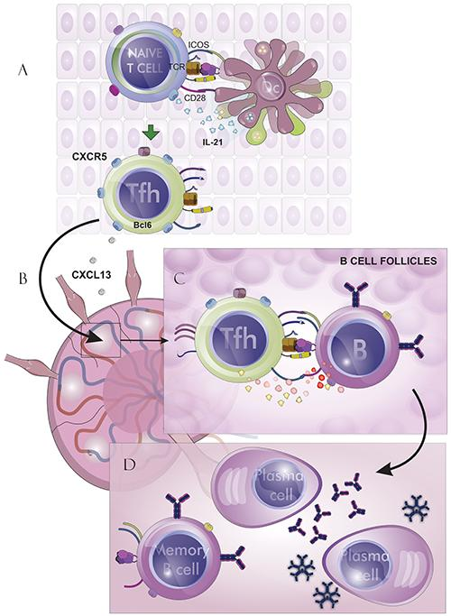
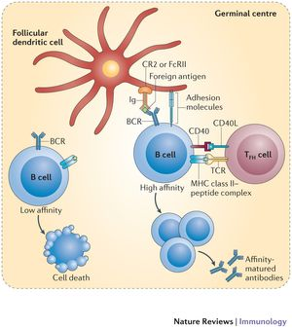
Tfh – B cell assistance

Slide 43
30. Tc based immune reaction

Slide 44
Cytotoxic T cells activation
T_{C} recognize cells infected with viruses or other intracellular parasites, and some tumor cells
Professional APC are dendritic cells or macrophages that are infected with virus, or phagocyted antigens from dead, infected, tumor or stressed cells
In order APC could activate the T_{C} precursor, APC must be stimulated by contact with T_{H}1 cell via CD 40, then the dendritic cell begins to express CD 80, CD86 and secrete cytokines (IL-1, IL-12); IFNγ increase expression of HLA molecul = change of resting APC in activated

Slide 45
Cytotoxic T cells activation
T_{C} precursor which recognizes a peptide-MHC gpI complex
on the surface of APC via TCR and receives signals via CD 28 proliferates and differentiates to clone mature effector cytotoxic cells (CTL)
For full T_{C} activation is necessary IL-12 and IL-2
CTL are spread by bloodstream into tissues; for activation of cytotoxic mechanisms is sufficient signal via TCR

Slide 46
CTL effector functions
Cytotoxic granules containing perforin, granzymes and granulysin
Fas ligand (FasL) - which binds to the apoptotic receptor Fas (CD95) presented on the surface of many different cells (also on the surface of T_{C})
TNFβ
Activation of effector mechanismus leads to apoptotic death of the target cell.
https://www.youtube.com/watch?v=WdCiaIS2LV4
https://www.youtube.com/watch?v=iQoY4RprTxo

Slide 47
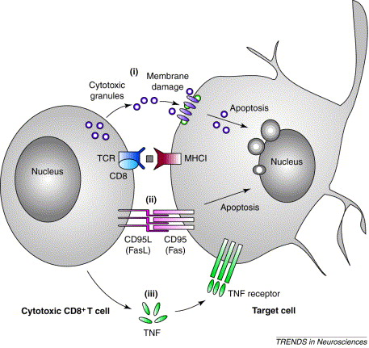
CTL effector functions
https://www.youtube.com/watch?v=Va1jaBGwoT8

Slide 48
Physiological mechanisms
of regulation of the immune system

Slide 49
Regulation by antigen
Induce immune response and extinction
Affinity maturation of B lymphocytes
Maintaining immunological memory
Antigenic competition
Threshold density of the complexes HLA II- Ag on APC

Slide 50
Regulation by antibodies
Antibodies compete with the BCR for antigen
(negative regulator of B cell stimulation)
IgG immune complexes bind to the BCR and FcγR on B cells → blocking of B cell activation
Regulation via idiotypic network

Slide 51
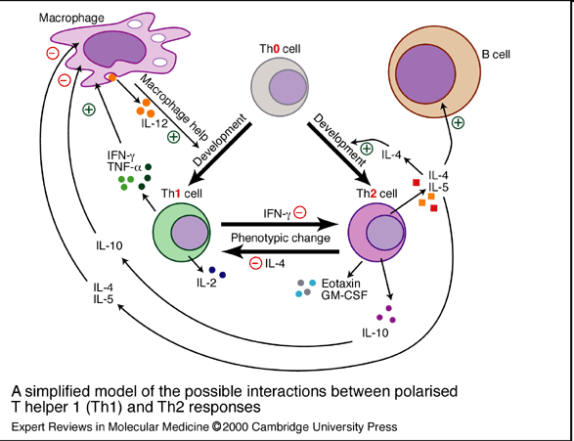
Regulation by cytokines and cellular contact
Interaction APC - T lymphocyte
Interaction T_{H}1 – macrophages
Interaction Tfh - B lymphocytes
Mutual regulation of activity T_{H}1 versus T_{H}2
Development of leukocyte subpopulations

Slide 52
Negative regulation of effector cells
CTLA-4 - T cell inhibitory receptor, binds ligands CD80 and CD86
Self-destruction interaction of the apoptotic receptor Fas with ligand FasL on the surface of activated T cells
nhibitory receptors of NK cells

Slide 53
Suppression mediated by T cells
Clonal elimination or anergy of T lymphocytes after contact with antigen on the surface of other cells than APC
Regulatory T cells (Treg, Tr1, Th3 - CD 4⁺) help to maintain tolerance to autoantigens; produce TGFβ, IL-10

Slide 54
Factors influencing the outcome of the immune response
The same antigen can induce an active immune response or an active state of tolerance, the result of response depends on many factors:
State of the immune system
Properties of antigen
Dose of antigen
Route of antigen administration

Slide 55
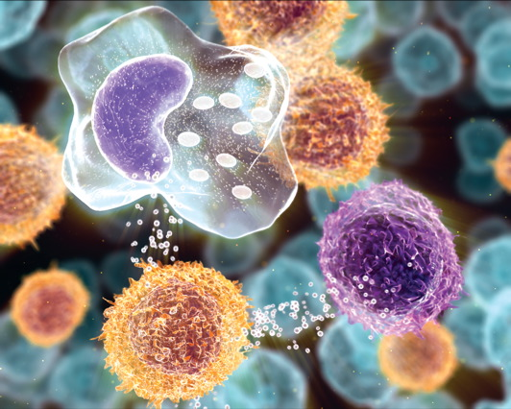
Cytokines
(Tissue hormones)

Slide 56
Cytokines
Regulatory proteins and glycoproteins produced by leukocytes and other cells
Are known as interleukins (IL-1…IL-38)
(except: TNF, lymphotoxin, TGF, interferons, CSF and growth factors)
Essential regulators of the immune system
Apply also in angiogenesis, tissue regeneration, carcinogenesis, treatment of many brain functions, embryonic development ...

Slide 57
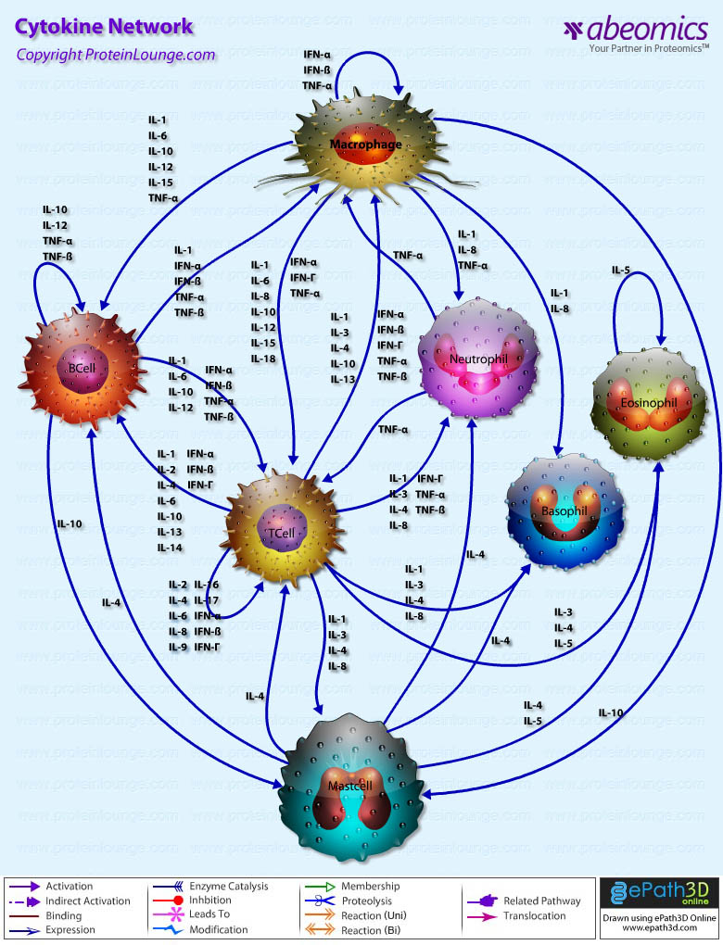
Cytokines
Effects of cytokines - autocrine
- paracrine
- endocrine
Cytokines - secreted
- membrane (CD 80, CD86, CD40L, FasL ..)

Slide 58
Overview of the most important cytokines
Cytokine | Produced | Function
IL-1 | MF, N | T cell costimulation, induction of TNF and IL-8, pyrogen
IL-2 | Th1 | Growth factor for T cells
IL-4 | Th2, basophils | Th2 differentiation, B cell stimulation, isotype switching to IgE and IgG4, Th1 inhibition
IL-5 | Th2, eosinophils | B cell stimulation, growth factor for eosinophils
IL-6 | Th2, MF, N | T and B cell stimulation, stimulation of Ig production, induction of acute phase proteins synthesis, pyrogen
IL-8 | MF, other cells | Granulocyte activation and chemotaxis (primarily neutrophils)
IL-10 | Th2,M, Treg | Th1 and MF inhibition, B cell differentiation to plasma cell
IL-12 | MF, DC, B | Th1 differentiation, NK stimulation
TNF | M, MF, NK | Induction of local inflammation, endothelium activation, induction of apoptosis
TGFβ | T, MF, platelets | The anti-inflammatory effect (control of lymphocyte proliferation, control of Ig production, control MF activity), stimulation of fibroblasts and osteoblasts, gain production of extracellular matrix
IFNα | L, M, MF | Inhibition of viral replication
IFNβ | Fibroblasts, epithelial cells | Inhibition of viral replication
IFNγ | Th1, NK | MF activation, stimulation of MHC gp. expression, Th2 inhibition
MF – macrophages; M – monocytes; N – neutrophils; DC – dendritic cells; NK – natural killers; L – lymphocytes; B – B cell; T – T cell
Notes:
58

Slide 59

Clasification of cytokines by functions
Proinflammatory cytokines (IL-1, IL-6,IL- 8,IL- 12,IL- 18, TNF)
Antiinflammatory cytokines (IL-4, IL-10, TGFβ)
Cytokines with the activity of hematopoietic cells growth factor
(IL-2, 3, 4, 5, 6, 7, 9, 11, 14, 15, CSF, SCF, LIF, EPO)
Cytokines applying in T_{H}2 humoral immunity (IL-4, 5, 9, 13)
Cytokines applying in the cell-mediated immunity T_{H}1
(IL-2, 12, IFNγ, GM-CSF, lymphotoxin)
Cytokines with anti-viral effect (IFN-α, IFN-β, IFN- γ)

Slide 60
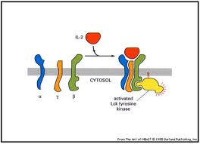
Cytokine receptors
Consist of 2 or 3 subunits
One subunit binds cytokine, other are associated with cytoplasmic signaling molecules (protein kinases)
Signaling subunit is shared by several different cytokine receptors - called receptor family
Signaling through these receptors may lead to proliferation, differentiation, activation of effector mechanisms or blocking the cell cycle and induction of apoptosis

Slide 61
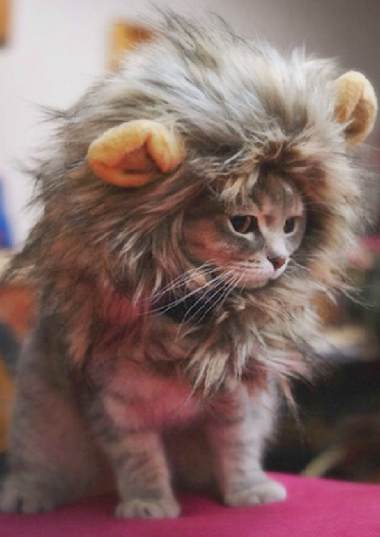
Thank you for your attention

