Slide 1
http://uia.fnplzen.cz/

Slide 2
Immune system and its importance for homeostasis.
Component parts of the immune system and their cooperation.
Barrier functions of the human body and defense mechanisms.
Non-specific cellular and humoral immune mechanisms.
Specific cellular and humoral immune mechanisms.
Phagocytosis and its importance for immunity.
Neutrophils, their ontogenesis and function.
Natural killer cells. Interferons. Characteristics and function.

Slide 3
Immune system and its importance for homeostasis.
Component parts of the immune system and their cooperation.
Barrier functions of the human body and defense mechanisms.
Non-specific cellular and humoral immune mechanisms.
Specific cellular and humoral immune mechanisms.
Phagocytosis and its importance for immunity.
Neutrophils, their ontogenesis and function.
Natural killer cells. Interferons. Characteristics and function.

Slide 4
Functions of the immune system
Defense (infections) (immunodeficiencies)
Immune surveillance (tumors)
Autotolerance (autoimmunity)
Correct function (allergy)

Slide 5
Immune system and its importance for homeostasis.
Component parts of the immune system and their cooperation.
Barrier functions of the human body and defense mechanisms.
Non-specific cellular and humoral immune mechanisms.
Specific cellular and humoral immune mechanisms.
Phagocytosis and its importance for immunity.
Neutrophils, their ontogenesis and function.
Natural killer cells. Interferons. Characteristics and function.

Slide 6
Barrier functions
skin
mucosa
mucus
tears
enzymes
pH
flushing of fluids
vomiting
diarrhea

Slide 7
Immune system and its importance for homeostasis.
Component parts of the immune system and their cooperation.
Barrier functions of the human body and defense mechanisms.
Non-specific cellular and humoral immune mechanisms.
Specific cellular and humoral immune mechanisms.
Phagocytosis and its importance for immunity.
Neutrophils, their ontogenesis and function.
Natural killer cells. Interferons. Characteristics and function.

Slide 8
non-specific specific
Cellular granulocytes T lymphocytes
monocytes-macrophages
DC, NK cells
Humoral complement antibodies
IFN
other proteins (CRP,MBL..)

Slide 9
Immune system and its importance for homeostasis.
Component parts of the immune system and their cooperation.
Barrier functions of the human body and defense mechanisms.
Non-specific cellular and humoral immune mechanisms.
Specific cellular and humoral immune mechanisms.
Phagocytosis and its importance for immunity.
Neutrophils, their ontogenesis and function.
Natural killer cells. Interferons. Characteristics and function.

Slide 10
Specific immunity
Adaptive – in response to antigens (e.g. infectious agents)
Is not innate
T and B lymphocytes, immunoglobulins
Immunological memory

Slide 11
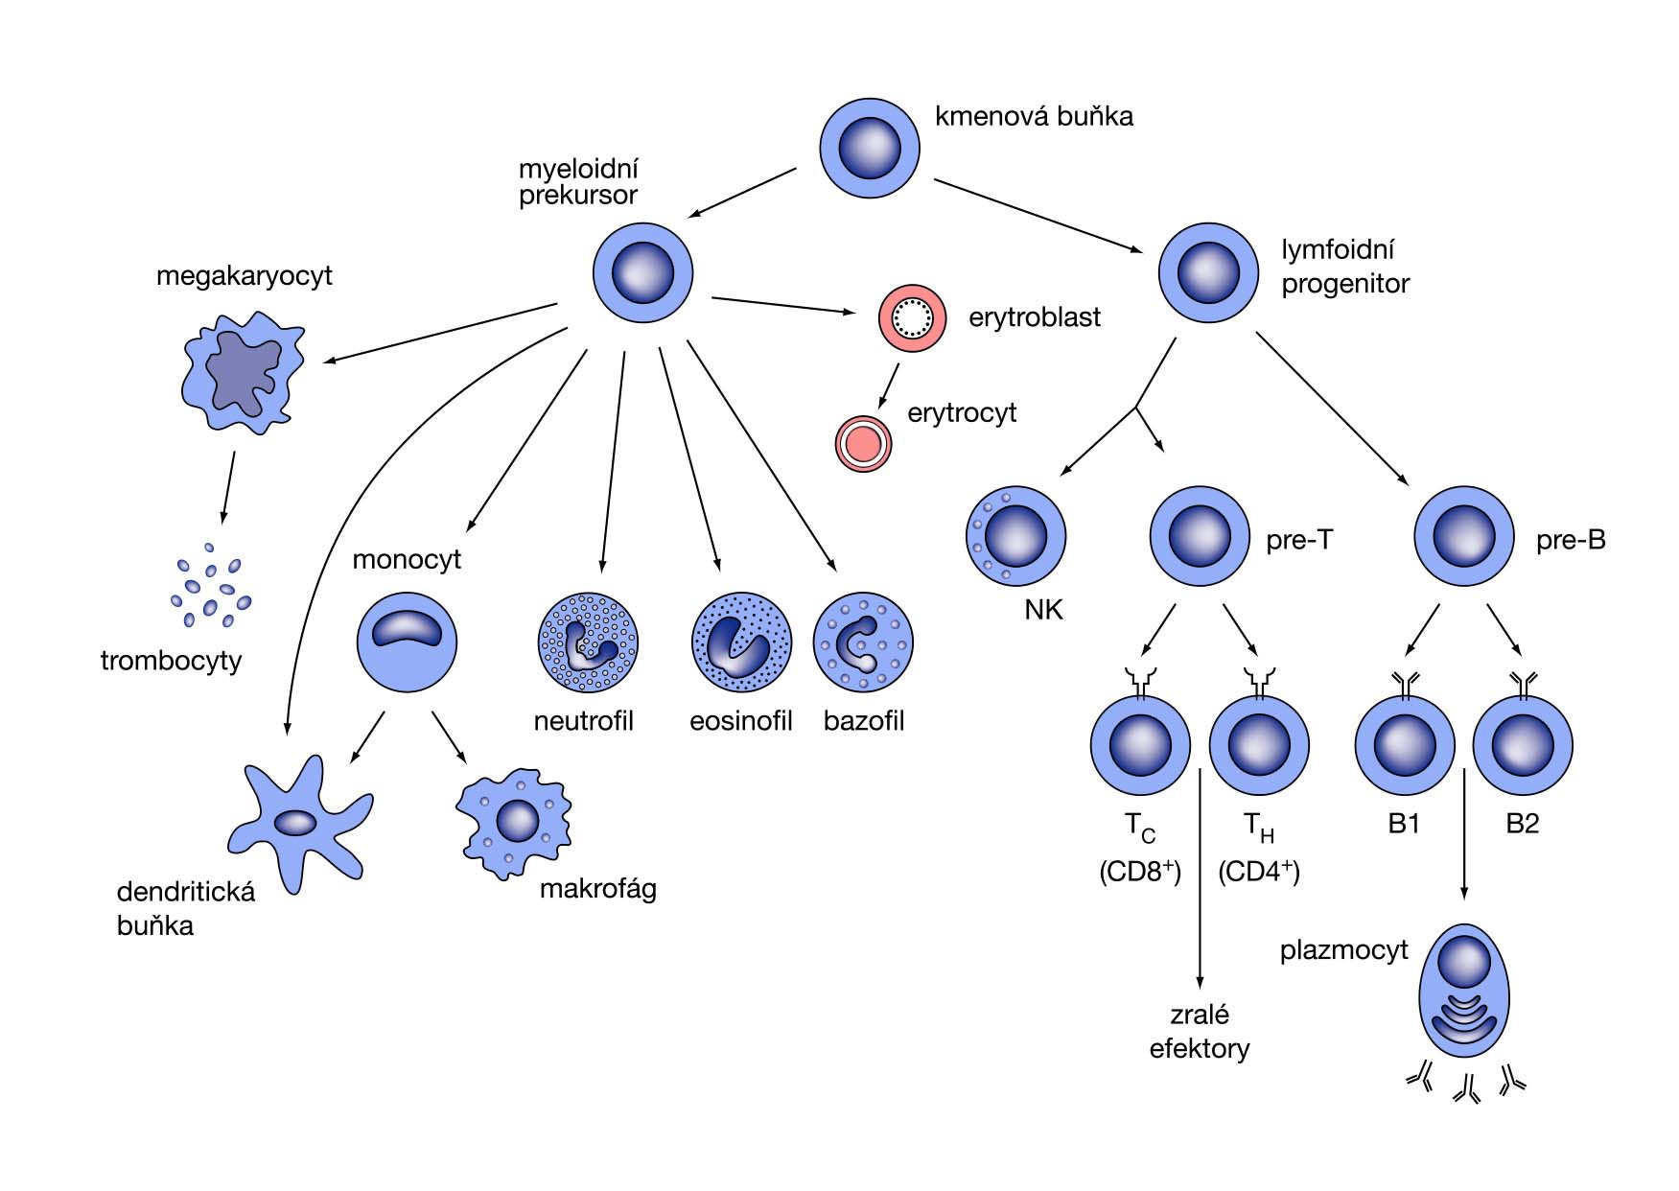

Slide 12
Cooperation between specific and non-specific immunity

Slide 13
Immune system and its importance for homeostasis.
Component parts of the immune system and their cooperation.
Barrier functions of the human body and defense mechanisms.
Non-specific cellular and humoral immune mechanisms.
Specific cellular and humoral immune mechanisms.
Phagocytosis and its importance for immunity.
Neutrophils, their ontogenesis and function.
Natural killer cells. Interferons. Characteristics and function.

Slide 14
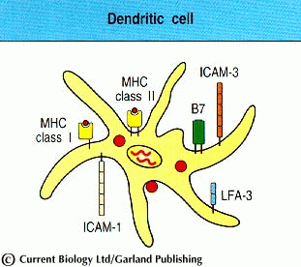
Phagocyting cells

Slide 15
Process of phagocytosis
Migration - diapedesis, chemotaxis
Recognition - PAMP, TLR, opsonization (FcR, CR)
Ingestion
Intracellular degradation
(Antigen presentation)

Slide 16
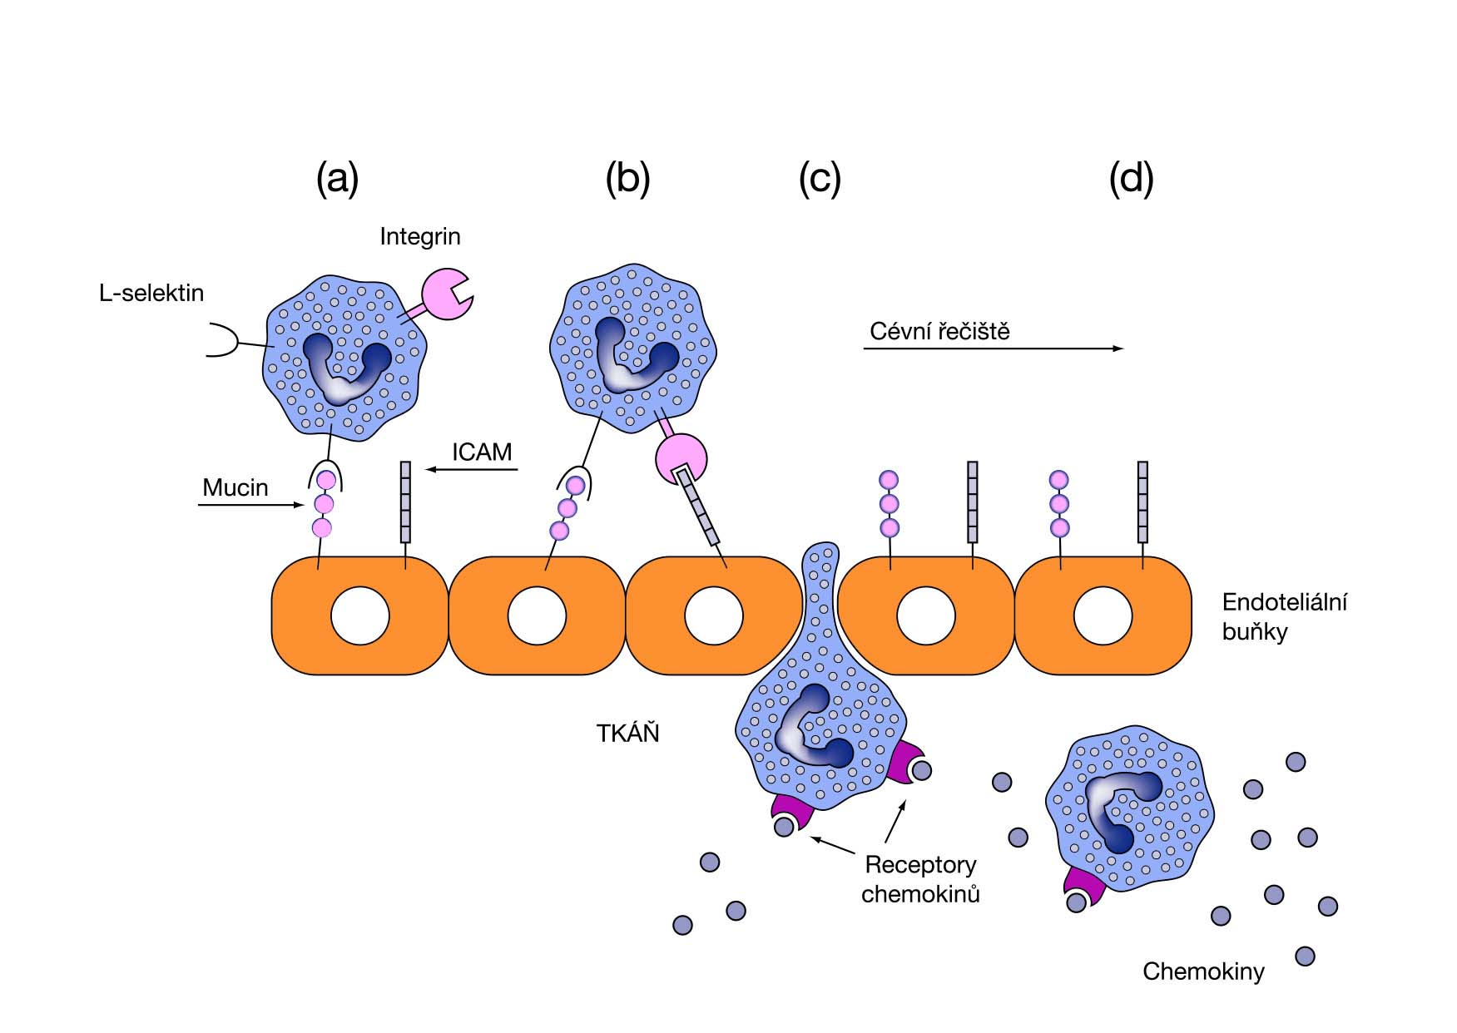
Example of adhezive interactions – diapedesis of neutrophils
obr.4

Slide 17
Process of phagocytosis
Migration - diapedesis, chemotaxis
Recognition - PAMP, TLR, opsonization (FcR, CR)
Ingestion
Intracellular degradation
(Antigen presentation)

Slide 18
Immune system and its importance for homeostasis.
Component parts of the immune system and their cooperation.
Barrier functions of the human body and defense mechanisms.
Non-specific cellular and humoral immune mechanisms.
Specific cellular and humoral immune mechanisms.
Phagocytosis and its importance for immunity.
Neutrophils, their ontogenesis and function.
Natural killer cells. Interferons. Characteristics and function.

Slide 19
Neutrophils
The most prevalent leukocytes (cca 70%)
Granulocytes
Staining with H&E – pink gray
Segmented nucleus (2-5 seg.), granules in cytoplasm
Active in defense against extracellular microbes

Slide 20
Neutrophils
Half-life in circulation cca 12 h.
After activation - margination (movement close to vessel wall) → rolling (selectins) → adhesion to endothelium (integrins) → diapedesis (integrins) → chemotaxis (movement to the site of inflammation against the concentration gradient of chemotaxins - IL-8, IFN-γ, C5a) → binding to the foreign particle

Slide 21
Neutrophils - phagocytosis
Interaction with molecules on the surface of microbes (PAMPs, lectin interactions, TLR binding to some microbial surface structiures)
Opsonization (= enhancement of binding of phagocytes to the microbe) – with help of Ig, complement components, CRP, MBL

Slide 22
Neutrophils - phagocytosis
Engulfing of the microorganism → formation of a vesicle (phagosome) → fuse with lysosome → phagolysosome
Formation of phagosome depends on activity of contractile cytoplasmic proteins

Slide 23
Neutrophils – intracellular destruction of microorganisms
1/ Oxygen independent systems
Substances contained in granules
Cathepsin, lysozym → hydrolyse of the cell wall of microorganisms
Defensins → formation of perforations in the microbial membrane

Slide 24
Neutrophils – intracellular destruction of microorganisms
2/ Oxygen dependent systems
Oxidative burst
NADPH oxidase system → formation of highly reactive oxygen radicals (hydrogen peroxide, superoxide anion, singlet oxygen, hydroxyle radicals)
Defect of this system - CGD

Slide 25
Neutrophils – intracellular destruction of microorganisms
2/ Oxygen dependent systems
Myeloperoxidase – catalyses peroxidation of the surface molecules of moicroorganosms in presence of toxic oxygen metabolites

Slide 26
Macrophages
Intracellular destruction of microorganisms mainly by means of NO syntethase (the system is stimulated by IFN-γ and TNF)
Production of: lysozym, some complement components, oxygen metabolites (H₂O₂, NO), regulators of cellular function (IL-1, IFN-α), arachidonic acid metabolites, endogenous pyrogens

Slide 27
Immune system and its importance for homeostasis.
Component parts of the immune system and their cooperation.
Barrier functions of the human body and defense mechanisms.
Non-specific cellular and humoral immune mechanisms.
Specific cellular and humoral immune mechanisms.
Phagocytosis and its importance for immunity.
Neutrophils, their ontogenesis and function.
Natural killer cells. Interferons. Characteristics and function.

Slide 28
Natural killers (NK cells)
Subset of granular lymphocytes different from T- and B-lymphocytes
Cytotoxic for tumor cells and virally infected cells
Important in defense against some bacteria, fungi and parasites
Participate in antibody dependent cellular cytotoxicity reactions (ADCC)
Non MHC restricted (= NK cells need not recognize MHC molecules on the target cell)

Slide 29
Natural killers
Kill the target cell after contact with help of perforins (perforate the membrane, abnormal ion influx, depolarization, leakage of metabolites, destruction of the target cell)
NK cells are protected against the effect of perforins by means of protectin which is present in their membrane

Slide 30
Interferons
Proteins inducing anti-viral activity of cells
2 basic types:
a/ type I: IFN-α (macrophages etc.)
IFN-β (fibroblasts)
b/ type II: IFN-γ (T-lymphocytes)

Slide 31
Function of interferons
Induction of enzymes with anti-viral effects (proteinkinases, oligonukleotidpolymerases - interference with viral mRNA translation)
Activate T-lymphocytes
Activate macrophages
Enhance cytotoxic activity of NK cells

Slide 32
Proteins of the accute phase of inflammation
C-reactive protein (CRP)
MBL (manose binding lectin)
Orosomucoid
Alfa-2-macroglobulin
Synthetized in liver in response to proinflammatory cytokines (IL-1,6,TNF)
Opsonins
Markers of accute inflammation

