Slide 1
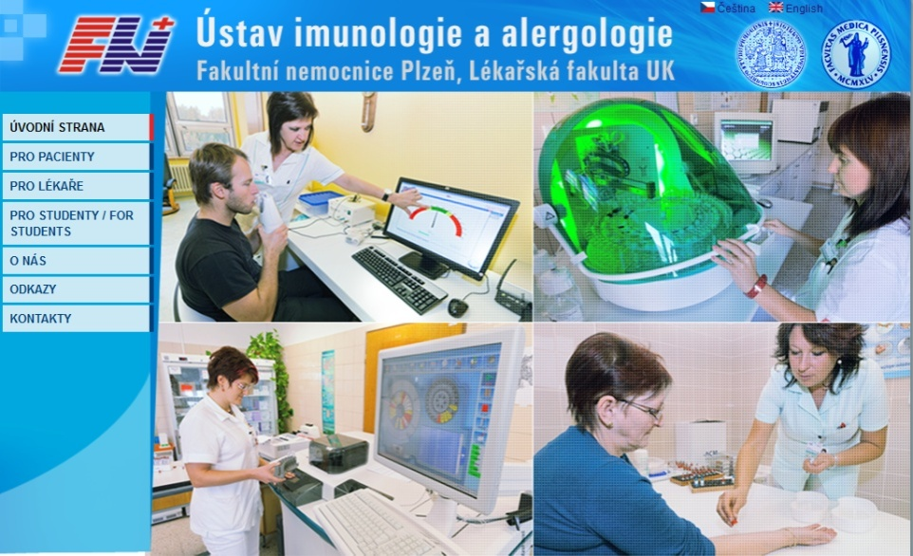
http://uia.fnplzen.cz/

Slide 2
1. Immune system and its importance for homeostasis. Components of the immune system and their cooperation.
2. Barrier functions of the human body and defense mechanisms.
3. Non-specific cellular and humoral immune mechanisms.
4. Specific cellular and humoral immune mechanisms.
5. Phagocytosis and its importance for immunity.
6. Neutrophils, their ontogenesis, and function.
7. Natural killer cells. Interferons. Characteristics and function.

Slide 3
The immune system and its importance for homeostasis
The main functions of the immune system
Defense
Autotolerance
Immune surveillance

Slide 4
Components of the immune system
Lymphoid tissues and organs
Cells of the immune system
Molecules of the immune system

Slide 5
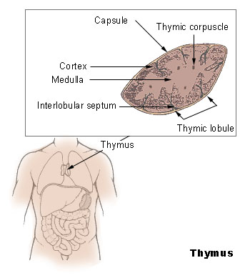
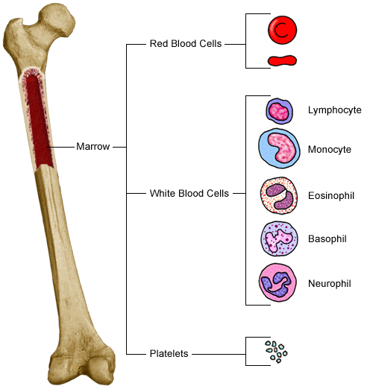
Primary lymphoid tissues and organs
Bone marrow, thymus
Maturation and differentiation of immunocompetent cells
Immature lymphocytes acquire here their antigenic specificity

Slide 6
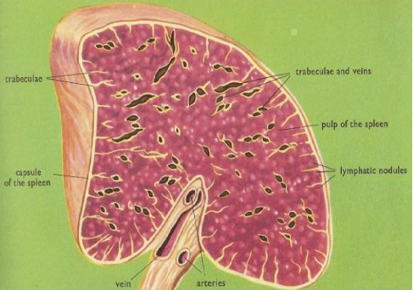
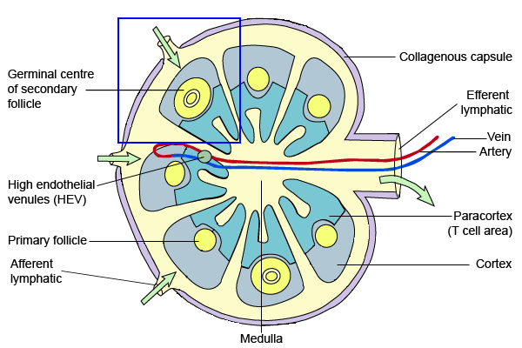
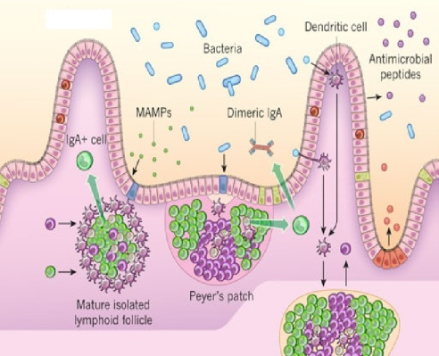
Secondary lymphoid tissues and organs
Meeting place of immunocompetent cells with Ag
Spleen
Lymph nodes and their organized clusters (tonsils, appendix, Peyer patches)
MALT
https://www.youtube.com/watch?v=oqpqZpluOag
https://www.youtube.com/watch?v=cCPyWFK0IKs

Slide 7
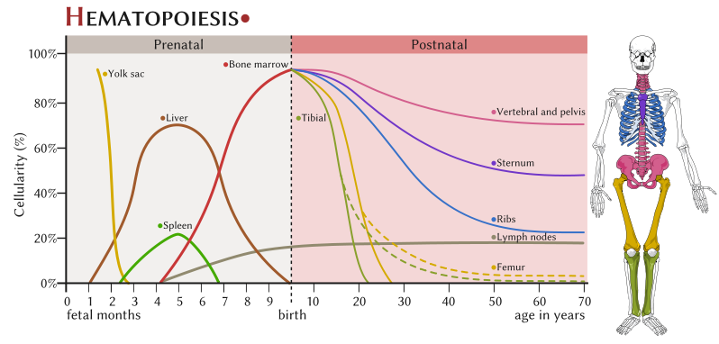
Cells of the immune system
Locations of haematopoiesis: yolk sack (developing embryos), then travels to fetal liver and spleen (3 to 7 month of gestation), then bone marrow has the main hematopoietic function
All blood cells arise from a pluripotent hematipoetic stem cell (CD 34)
Haematopoiesis is regulated by cytokines

Slide 9
Barrier functions
Mechanical bariers: intact skin, mucosa, coughing, sneezing, vomiting, diarrhea, flushing of fluids
Chemical bariers: antimicrobial peptides (defensins), enzymes (lysozyme), acid pH
Microbial barier: commensal microoranisms
Other factors: body temperature 37ºC, tissue oxygen tension
https://www.youtube.com/watch?v=3tssjxk5Wxg

Slide 10
Non-specific cellular and humoral immune mechanisms
Non-adaptive, innate
Evolutionarily older
No immunological memory
In the presence of pathogens react quickly, in minutes (based on molecules and cells which are in the body prepared in advance)
Cellular components – granulocytes (neutrophils, eosinophils, basophils, mast cells), monocytes (macrophages, DC), NK cells
Humoral components - complement, interferons, lectins and other serum proteins

Slide 11
Specific cellular and humoral immune mechanisms
Adaptive, antigen-specific
Evolutionarily younger
Have immunological memory
Development of a full-specific immune response takes several days even weeks
Cellular component - T lymphocytes (TCR)
Humoral component - antibodies

Slide 12
Cooperation between nonspecific and specific immune mechanisms
APC – T cell
T_{H}1 – macrophage
IgG, IgM – complement activation
IgG, IgA – opsonization
…

Slide 13
Phagocytosis and its importance for immunity

Slide 14
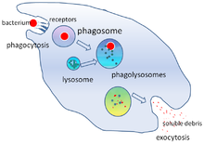
Phagocytosis
= ability to absorb particles from the surroundings
https://www.youtube.com/watch?v=iZYLeIJwe4w

Slide 15
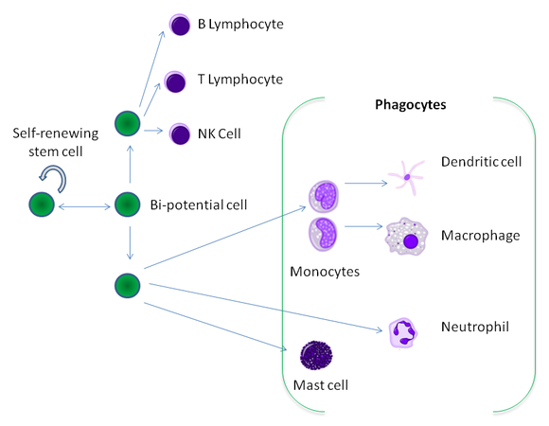
Professional phagocytes
Protect the body by ingesting harmful foreign particles, bacteria, and dead cells
Neutrophils
Monocytes, macrophages
DC

Slide 16
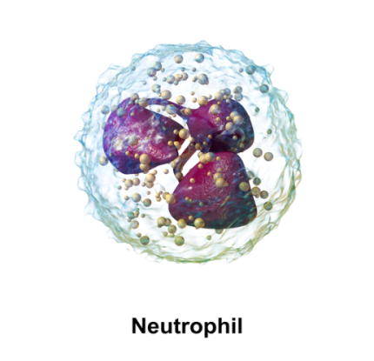
Neutrophils
The most prevalent leukocytes (cca 70%)
Active in defense against extracellular microbes
Granulocytes
Staining with H&E – pink gray
Segmented nucleus (2-5 seg.)
Granules in cytoplasm: primary (azurophilic) granules – myeloperoxidase, defensins, lysozyme… secondary (specific) granules – lysozyme, lactoferrin, proteolytic enzymes

Slide 17
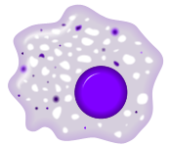
Macrophages
Remove dying or dead cells and cellular debris
Defense against some intracellular pathogens
APC
Alveolar macrophages, Kupffer cells, osteoclasts, microglia…
Intracellular destruction of microorganisms mainly by means of NO syntethase (the system is stimulated by IFN-g and TNF)

Slide 18
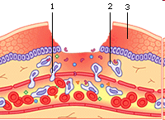
The migration of phagocytes into damaged and infected tissues
7% of peripheral neutrophils and phagocytes 93% neutrophils and phagocytes in the bone marrow Phagocytes are captured on endothelium in the place of damage (due to inflammatory cytokine expression of adhesion molecules is higher)

Slide 19
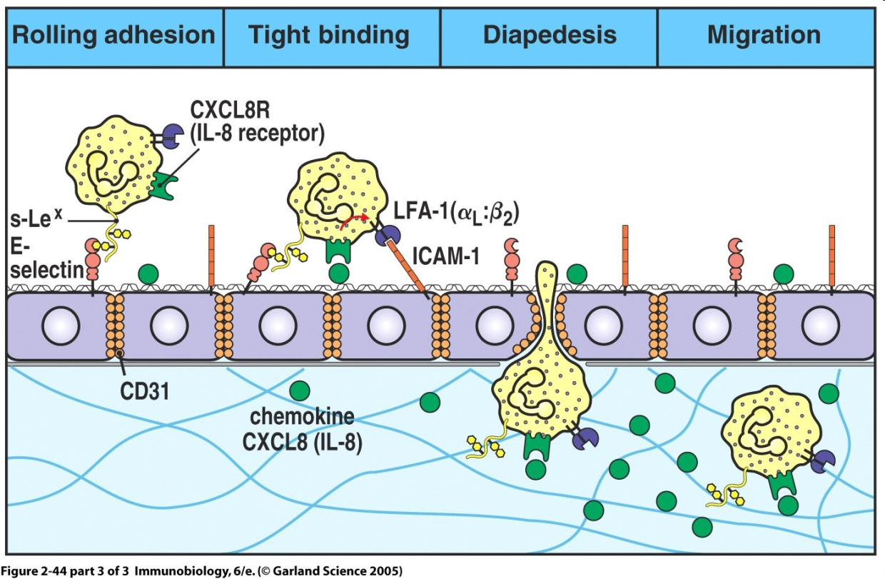
Phagocytosis
selectins, integrins
rolling
diapedesis (or extravasation)
chemotaxis (IL-8, MIP-1α and β, MCP-1, RANTES, C3a, C5a, bacterial products ...)
https://www.youtube.com/watch?v=iVCXRa8FdP0

Slide 20
PRR (pattern recognition receptors)
Recognize PAMPs (pathogen associated molecular patterns) and DAMPs (damage associated molecular patterns)
TLR (Toll-like receptors)
CLR (C-type lectin receptors)
mannose receptor
galactose receptor
CD14 (for bacterial LPS)
scavenger receptors
….

Slide 21
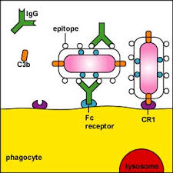
Opsonisation
Enhances phagocytosis of an antigen
Antigen is marked with opsonin
Opsonins - IgG, IgA, C3b, MBL, fibronectin, fibrinogen, CRP, SAP
Fc receptors, complement receptors (for C3b)
https://www.youtube.com/watch?v=oIZwbfvMY5Q

Slide 22
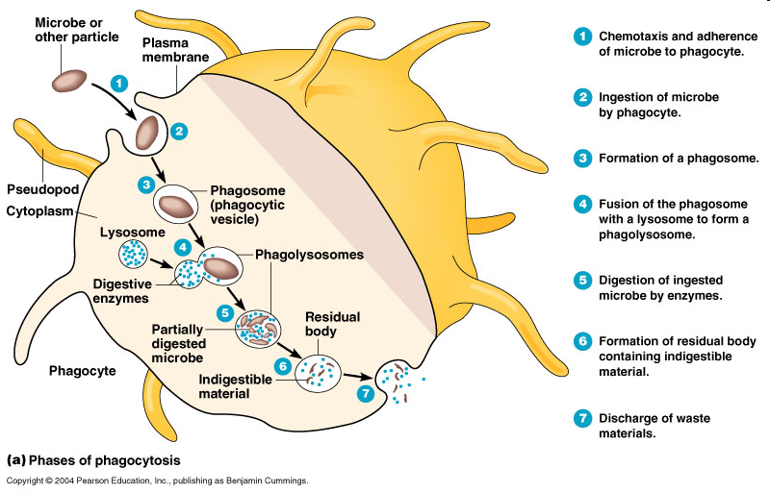
Phagocytosis

Slide 23
Degradation of ingested material
Fagosome fusion with lysosomes - oxygen independent (lysozyme, defensines, serine proteases, myeloperoxidase, acidic pH…)
Activation of membrane NADPH oxidase - oxygen dependent (superoxide, hydrogen peroxide, hypochlorous acid)
Production of nitric oxide (NO) by macophages

Slide 24
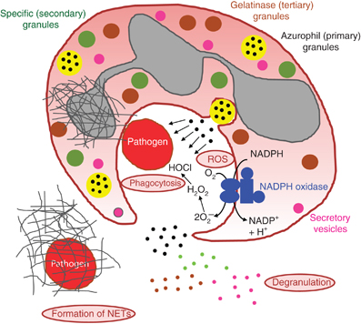
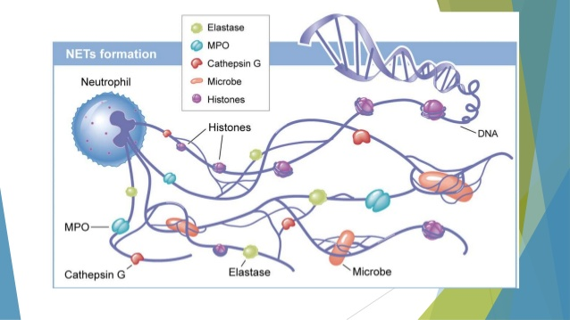
Neutrophils
Neutrophils have three ways of attacking pathogen: phagocytosis, degranulation and the formation of NETs

Slide 25
Phagocyte products
Proinflammatory cytokines (IL-1, IL- 6, TNF, L-8)
Cytokines promoting production of phagocytes (IL-3, GM-CSF)
Cytokines promoting tissue healing (TGFα, TGFβ)
Arachidonic acid metabolites (prostaglandins, prostacyclins, leukotriens and tromboxanes)

Slide 26
NK cells Interferons

Slide 27
NK cells
Lymphoid cells which belon to innate immunity
Kill cells which have abnormally low HLA I expression (some tumor and virus infected cells)
Have similar cytotoxic mechanisms as Tc
NK cells activators - IFNα, IFNβ

Slide 28
NK cells receptors
Activating receptors
Some surface lectins
Fc receptor CD16
Inhibitory receptors - recognize MHC gpI
Imunoglobulin family - KIR (killer cell immunoglobulin
like receptors)
C-type lektin family - eg CD94/NKG2

Slide 30
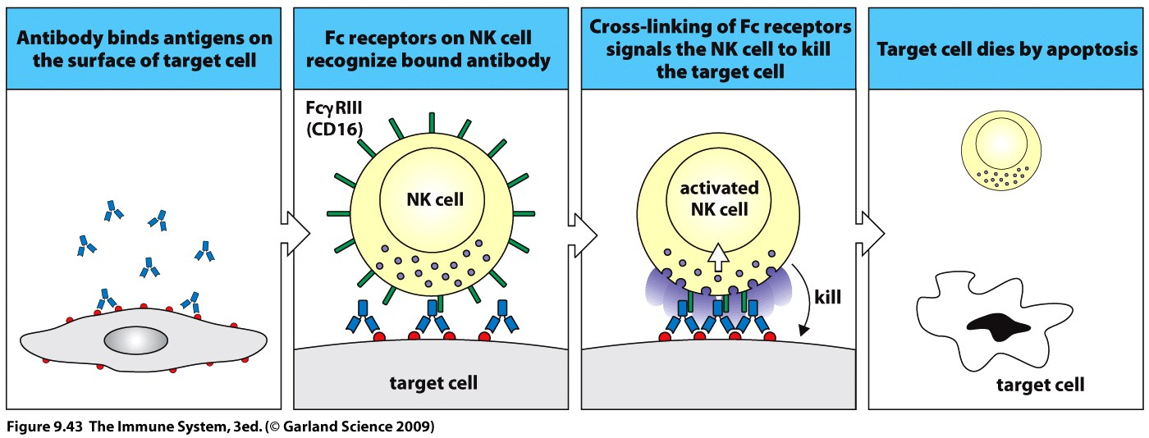
ADCC (antibody-dependent cellular cytotoxicity)
NK cells express CD16 which recognize Fc part of IgG antibodies attached to the surface of a cell, this leads to the activation of NK cell cytotoxic mechanisms

Slide 31
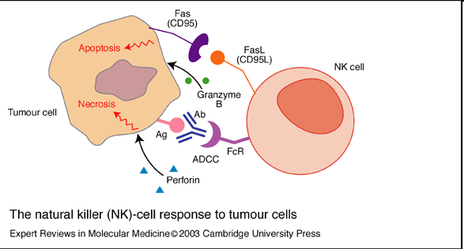
NK cell cytotoxic mechanisms
Cytotoxic granules (perforins and granzymes)
Fas ligand
TNFα
https://www.youtube.com/watch?v=HNP1EAYLhOs

Slide 32
Interferons
IFNα - produced by virus infected lymphocytes, monocytes and macrophages
IFNβ - produced by virus-infected fibroblasts and epithelial cells
IFNα and IFNβ - bind to receptors on the surface of infected and healthy cells and induce in them an antiviral state (synthesis of enzymes that block viral replication in the cell); NK activation, ↑ HLA I expression
IFNγ - produced by T_{H}1 cells, regulatory function, activates macrophages (NO synthase, NADPH oxidase), ↑HLA expression

Slide 33
Interferons
https://www.youtube.com/watch?v=tbK93J6fsa8

Slide 34
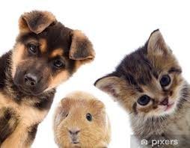
Thank you for your attention

