Slide 1
24. Antigen-presenting cells - types, function.
25. Modes of antigen presentation.

Slide 2
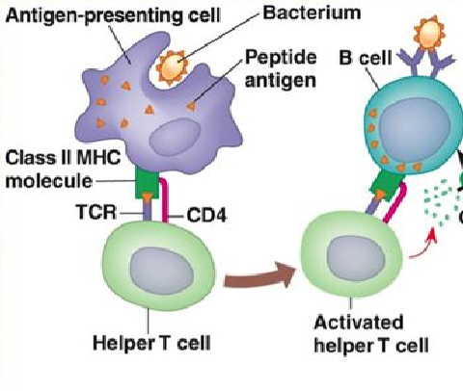
Antigen recognition by T and B cell
BCR recognize native Ag
TCR recognize a peptide antigen bound to an MHC molecule

Slide 3
Antigen presenting cells (APC)

Slide 4
Professional APC
Dendritické buňky
Monocytes, macrophages
Dendritic cells
B cells
Express HLA II, CD 80 a CD 86, HLA I
APC are necessary for T cell activation

Slide 5
MHC (HLA)
MHC class I molecules present peptides from endogenous proteins (viral Ag, tumour Ag…) to cytotoxic T cells (CD8)
MHC class I molecules are expressed on all nucleated cells
MHC class II molecules present the antigens derived from extracellular proteins to helper T cells (CD4)
MHC class II molecules are normally expressed only on APC

Slide 6
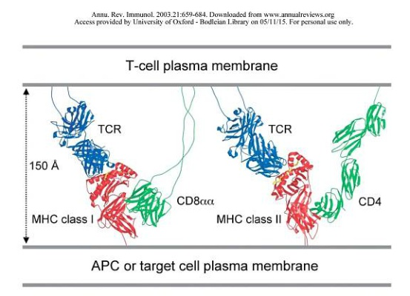
The role of coreceptors CD4 a CD8

Slide 7
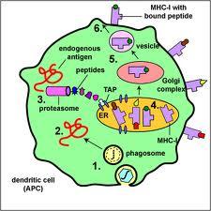
MHC class I presentation endogenous pathway
MHC class I binds peptides long 8 - 10 amino acids
Certain MHC gp molecule binds peptides sharing identical structural features - binding motif
The binding of endogenous peptides in the endoplasmic reticulum during biosynthesis of MHC class I protein
Peptides are produced from intracellular proteins degradated
by the proteasome
https://www.youtube.com/watch?v=hzET2XMMW28

Slide 8
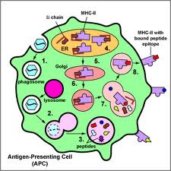
MHC class II presentation
MHC class II binds peptides long 15 - 35 amino acids
Certain MHC gp molecule binds peptides sharing identical structural features –binding motif
Invariant chain blocks the binding site for the peptide
The antigenic peptides are derived from extracellular proteins
Exogenous peptides binds to MHC class II in the endosome
https://www.youtube.com/watch?v=8krIaGVR6Gk

Slide 9
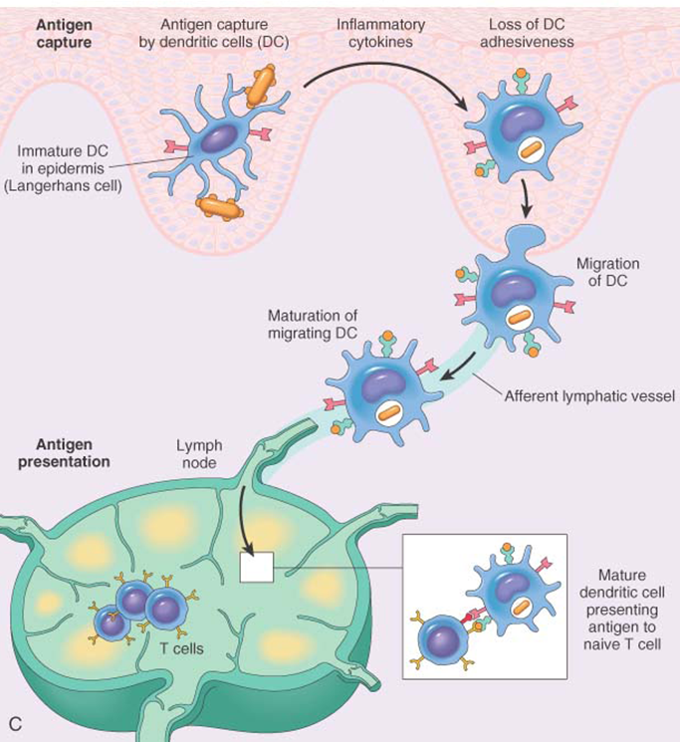
Dendritic cells

Slide 10
26. T-lymphocytes, ontogenesis, surface markers. Subpopulations of T-lymphocytes and their functions.
27. The role of the thymus.
Positive and negative selection of T-lymphocytes.

Slide 11
T cells
Cellular component of antigen-specific mechanisms
TCR recognize peptide-MHC complex
T cell are activated by APC
Several subsets of T lymphocytes (T_{H}1, T_{H}2, Treg, T_{C}…)
Regulation of immune processes and destruction
of virus-infected cells or tumor cells

Slide 12
T cell development
T cells originate in bone marrow and then migrate to the thymus where they mature (αβ T lymphocytes), the final differentiation
is after the activation by antigen processed and presented by APC
γδ T cells can develop outside the thymus (the minority population)
T cells are stimulated after activation to proliferate
and differentiate into effector cells and memory cells

Slide 13
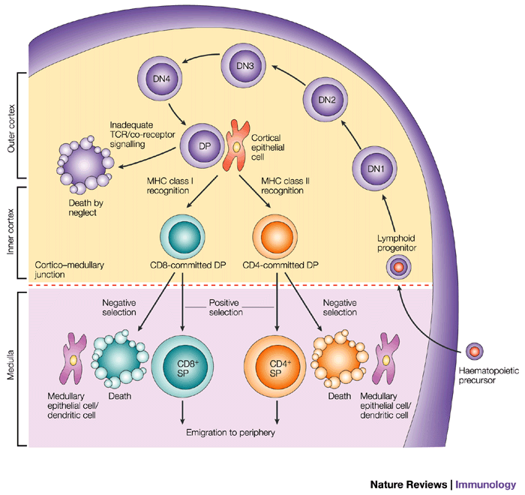
T cell development
Pluripotent hematopoietic stem cells
Lymphoid progenitors - are coming from the bone marrow
to the thymus
Pro-thymocytes – double negative T cells - begin to rearrange TCRβ genes, express on their surface
pre-TCR (Composed of β chain, pre-TCRα and CD3 complex),
then begin TCRα genes rearrangement
Cortical thymocytes – double positive T cells - express on their surface TCR and CD4 and CD8
co-receptor (double positive T lymphocyte),
T cell selection
Medullary thymocytes - single positive T cells - retain the expression of CD4 or CD8, then migrate
to the secondary lymphoid organs
Mature T cells (Medullary thymocytes) leave the thymus and migrate to secondary lymphoid organs

Slide 14
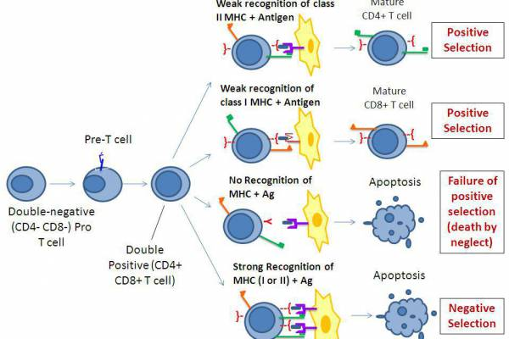
T cell selection
Positive selection - the elimination of cells with dysfunctional TCR,
thymocytes that recognize MHC gp with low affinity are positively selected, then maintain the expression of CD4 or CD8 (depending which class of MHC gp binds to the TCR).
Negative selection - the elimination of autoreactive cells, which strongly bind MHCgp with normal peptides (autoantigens) which are expressed on the surface of thymic cells
98% of pro-thymocytes in the thymus
during its development dies
https://www.youtube.com/watch?v=9E_UxnC_L2o

Slide 15
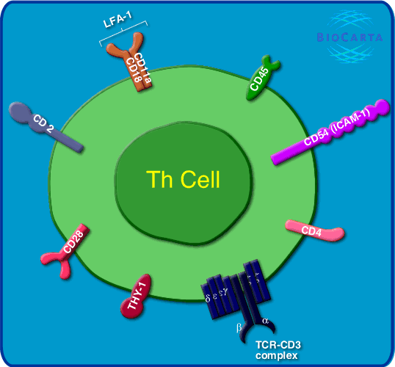
T cell surface markers
TCR - recognizes Ag peptide bound to MHC molecule
CD3 - TCR component, participates in signal transduction
CD4 co-receptor, binds to MHC class II
CD8 co-receptor, bind to MHC class I
CD28 - costimulatory receptor, binds to CD80, CD86 on APC
CTLA-4 (CD152) - inhibitory receptor, binds to CD80, CD86

Slide 16
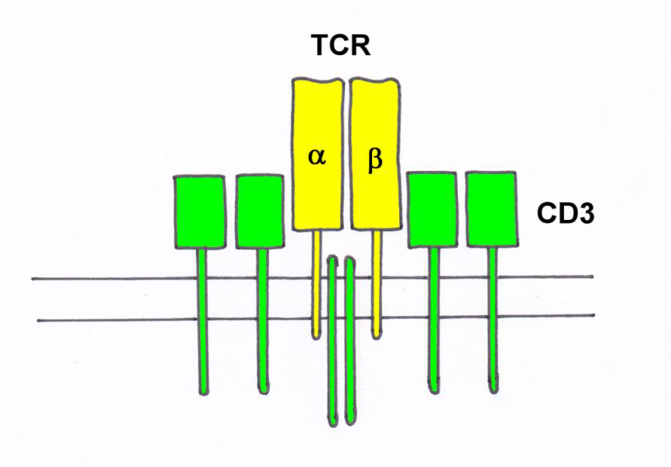
TCR
TCR (T cell receptor) is heterodimer
consisting of α and β (γ,δ) chains
associated with CD3 complex, which is necessary for signal
transduction
N-terminal parts of α and β (γ,δ) chains form the binding site for Ag

Slide 17
T cell subpopulations
αβ T lymphocytes - have TCRαβ, major type (95-98%), need the thymus for development, recognize peptide antigens in the complex with MHC gp
γδ T lymphocytes - (2-5%) may develop outside the thymus,
some are able to recognize native Ag, apply in defense of the skin and mucous membranes
NK-T cells – recognize CD1 complexes with lipids and glycolipids

Slide 18
αβ CD4⁺ T cells
Precursors of helper T cells (T_{H}), T_{H} differentiate to several subtypes, which secret different cytokines
T_{H}1 - IL-2, IFNγ; macrophages activation
T_{H}2 - IL-4, IL-5, IL-6, IL-10; protection against extracellular parasites
T_{H}17 - IL-17; proinflammatory, participation autoimmune diseases
Tfh - (follicular helper T cells); B cells assistance
Treg – (regulatory T cells) suppress the activity of others
T cells, especially autoreactive T cells; produce IL-10 and TGFβ

Slide 19
αβ CD8⁺ T cells
Precursors of cytotoxic T cells (T_{C})
T_{C} – recognize and destroy cells infected with viruses
or the cells infected with other intracellular parasites
and some cancer cells

Slide 20
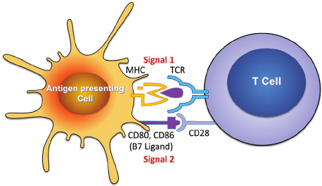
T cell activation
  https://www.youtube.com/watch?v=JPh9P1aEfMI

Slide 21
T cell activation
Signal: TCR – MHC gp I / II +Ag peptid (APC)
Co-stimulating signal: CD 28 (T lymphocyte) – CD 80, CD 86 (APC)
(Without costimulation the T cell becomes anergic )
Activation via TCR and CD28 results in proliferation and differentiation in effector or memory cells

Slide 22
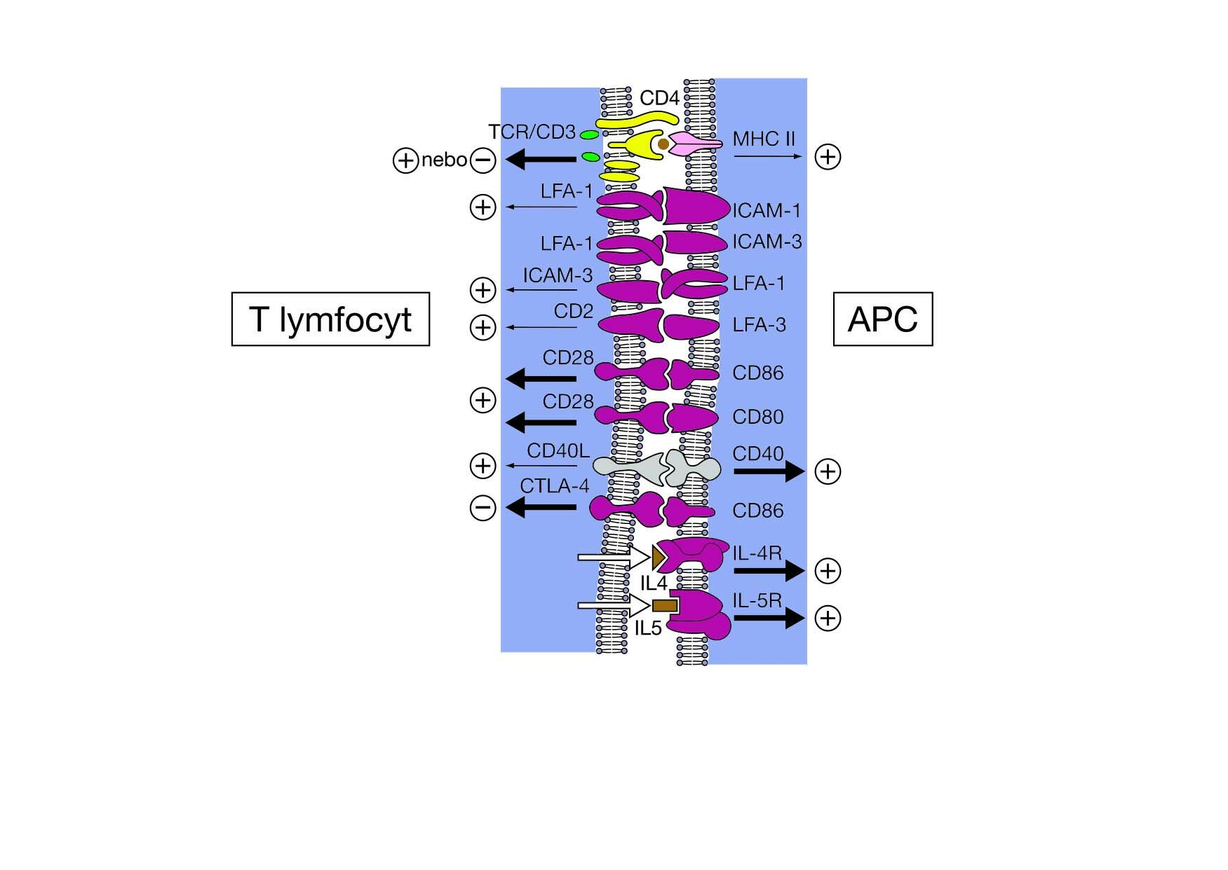
Immunological synapse between T cell and APC

Slide 23
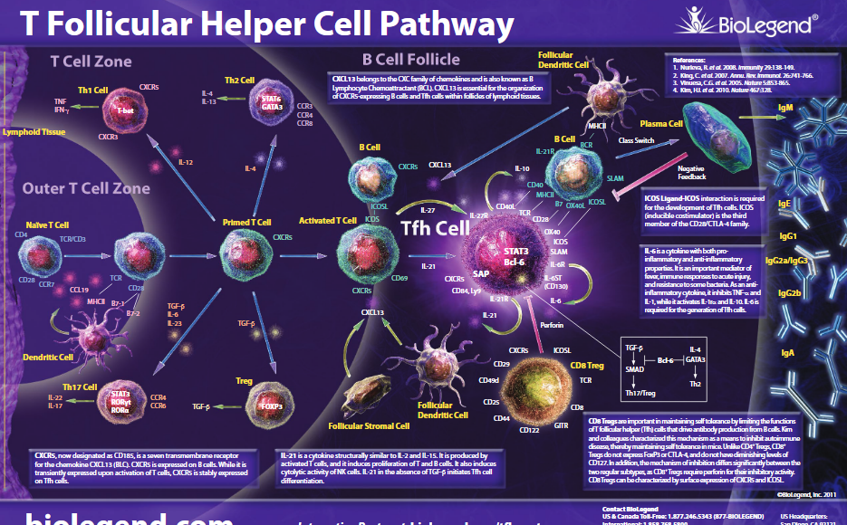
https://www.youtube.com/watch?v=iVMIZy-Y3f8

Slide 24
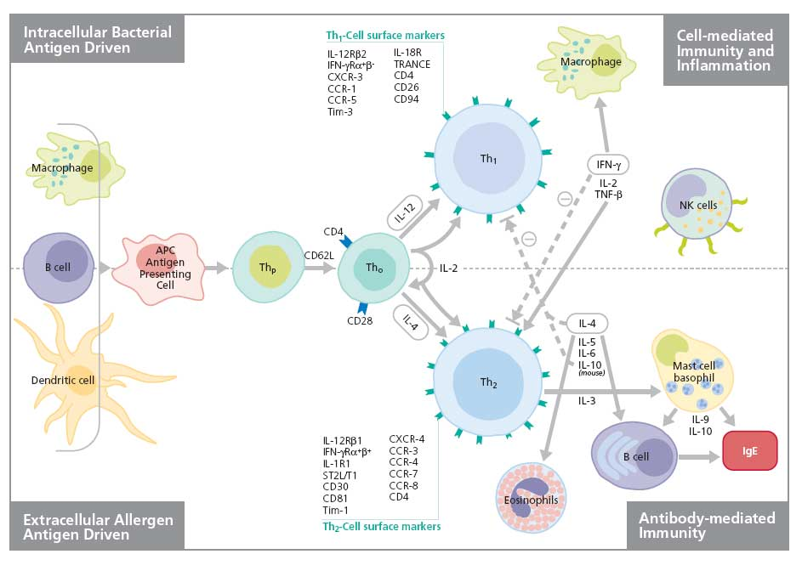
Th1 and Th2 based immune reaction

Slide 25
28. Th1 based immune reaction

Slide 26
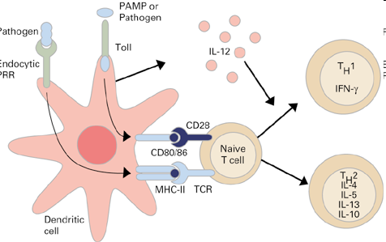
T_{H}1 based immune reaction
TH1 cell function is the defense against intracellular parasites
TH1 cells cooperate with macrophages and support
the differentiation of cytotoxic T lymphocytes
Macrophages and dendritic cells stimulated by some micro-organisms produce IL-12
A T_{H} precursor that recognizes an infected macrophage and receives signals via TCR, CD28 and the IL-12 receptor proliferates
and differentiates into effector T_{H}1 cells
T_{H}1 cells produce IFNγ and IL-2

Slide 27
T_{H}1 based immune reaction
IFNγ activates macrophages (↑ antigen presentation and lysosomal activity, activates inducible NO synthase)
IL-2 is essential for the proliferation and differentiation of T lymphocytes
Activated macrophages produce cytokines (IL-1, TNF ...) that stimulate
T cells and stimulate local inflammation to suppress infection
Interaction of TH1 cells and macrophages is a fundamental mechanism of delayed-type hypersensitivity (DTH; hypersensitivity rection type IV)

Slide 28
Interaction between APC and T_{H} precursor

Slide 29
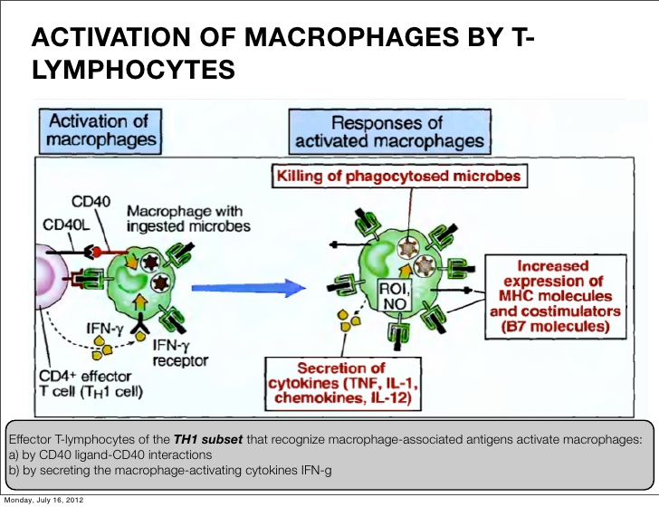

Slide 30
29. Th2 based immune reaction

Slide 31
Th2 based immune reaction
The basic function of T_{H}2 cells is protection against extracellular parasites
T_{H}2 cells cooperate with basophils, mast cells and eosinophils
T_{H}2 cells helps B lymphocytes in IgE production
T_{H} precursor, which recognize antigen on APC and receives signals via TCR, CD28, IL-4 receptor and IL-2 receptor proliferates and differentiates in effector TH2
Th2 produces IL-4, IL-5, IL-6, IL-10

Slide 32

Mutual regulation of activities T_{H}1versus T_{H}2
Whether the T_{H} precursor cell will develop into T_{H}1 or T_{H}2 decides cytokine ratio of IL-12 and IL-4
IL-12 is produced by macrophages and dendritic cells stimulated by certain microorganisms
IL-4 is produced by activated basophils, mast cells and T_{H}2 cells
T_{H}1 cytokines (mainly IFNγ) inhibit the development of T_{H}2 and stimulate the development of T_{H}1 (IL-2 stimulates also T_{H}2)
Cytokines produced by T_{H}2 (IL-4, IL-10) inhibit the development of T_{H}1 and stimulate the development of T_{H}2

Slide 33
Tfh – B cell assistance

Slide 34
Tfh – B cell assistance
The Tfh cells promotes B cell maturation, the help is mediated by cytokines (IL-21, IL-4…) and direct intracellular contact (CD40L)
The T_{H} precursor, which receives from APC signals through the TCR, CD 28 and receives a signal from the B cell via the ICOS molecule, then differentiates in the Tfh cell
For stimulation of B cells, there is usually a need for cooperation between APC → Tfh cell → B lymphocyte
In the case of the minimal model, it is sufficient cooperation between Tfh cell
and B lymphocyte

Slide 35
Tfh – B cell assistance
Specific direct help for B cells:
The Tfh cell helps to B cells stimulated with the same Ag
Tfh cell needs for the cytokine secretion signal via TCR
(B cells must present the appropriate Ag peptide - HLA II that recognizes the TCR; signal via costimulatory CD28 receptor is no longer required)
Interaction between CD40 (B lymphocyte) and CD40L (Tfh cell) is essential for initiation of somatic mutations, isotype switching, and memory cells formation

Slide 36
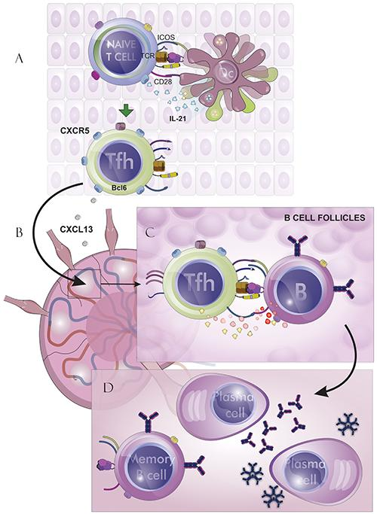
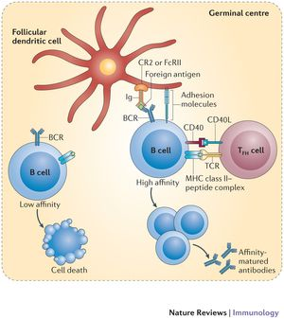
Tfh – B cell assistance

Slide 37
30. Tc based immune reaction

Slide 38
Cytotoxic T cells activation
T_{C} recognize cells infected with viruses or other intracellular parasites, and some tumor cells
Professional APC are dendritic cells or macrophages that are infected with virus, or phagocyted antigens from dead, infected, tumor or stressed cells
In order APC could activate the T_{C} precursor, APC must be stimulated by contact with T_{H}1 cell via CD 40, then the dendritic cell begins to express CD 80, CD86 and secrete cytokines (IL-1, IL-12); IFNγ increase expression of HLA molecul = change of resting APC in activated

Slide 39
Cytotoxic T cells activation
T_{C} precursor which recognizes a peptide-MHC gpI complex
on the surface of APC via TCR and receives signals via CD 28 proliferates and differentiates to clone mature effector cytotoxic cells (CTL)
For full T_{C} activation is necessary IL-12 and IL-2
CTL are spread by bloodstream into tissues; for activation of cytotoxic mechanisms is sufficient signal via TCR

Slide 40
CTL effector functions
Cytotoxic granules containing perforin, granzymes and granulysin
Fas ligand (FasL) - which binds to the apoptotic receptor Fas (CD95) presented on the surface of many different cells (also on the surface of T_{C})
TNFβ
Activation of effector mechanismus leads to apoptotic death of the target cell.
https://www.youtube.com/watch?v=WdCiaIS2LV4
https://www.youtube.com/watch?v=iQoY4RprTxo

Slide 41
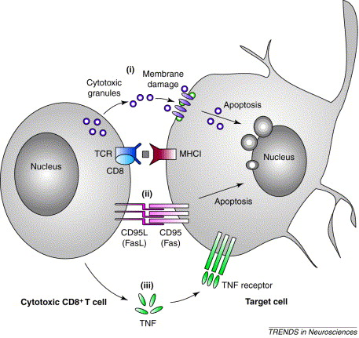
CTL effector functions

Slide 42
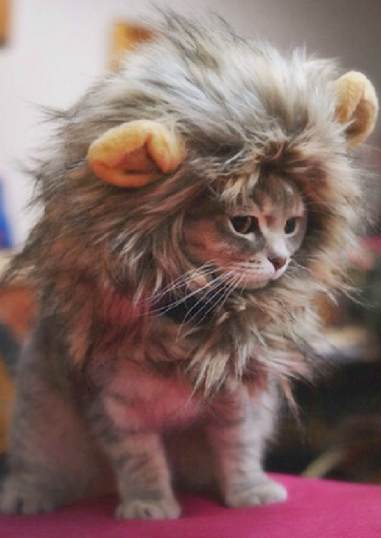
Thank you for your attention

