Slide 1
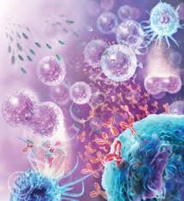
Imunologie
seminář 1
Immunology
J. Ochotná
j.ochotna@seznam.cz

Slide 2
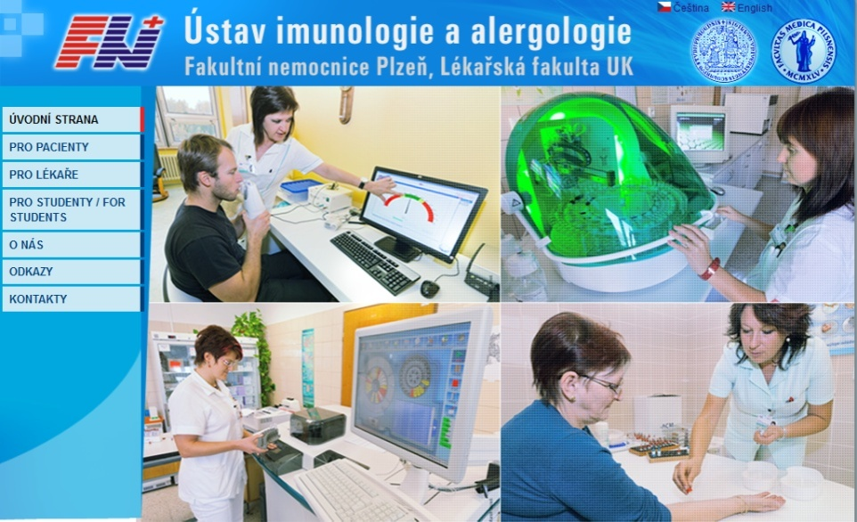
http://uia.fnplzen.cz/

Slide 3
Immune system
J. Ochotná

Slide 4
The main functions of the immune system Immune system belongs to the basic homeostatic mechanisms Defense Autotolerance Immune surveillance

Slide 5
Antigen (immunogen) * substance that can induce a humoral and/or cell-mediated immune response * predominantly proteins or polysaccharides * molecules >5 kDa (optimal size of antigen is about 40 kDa) * autoantigen * exoantigen * allergen

Slide 6
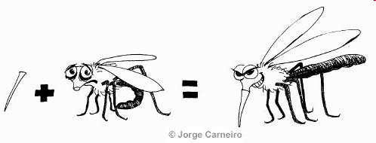
Haptens * small molecules, that are able to induce specific immune response only after the establishment to the macromolecular carrier (separate haptens are not immunogenic) * typically drugs (eg penicillin antibiotics, hydralazin)

Slide 7
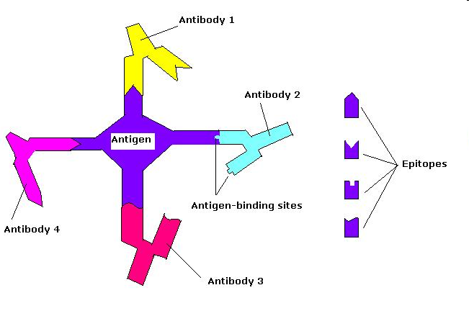
Interaction antigen – antibody * Binding site of antibody (paratop) form non-covalent complexes with the corresponding part on antigen molecule (epitope) * antigen-antibody complex is reversible

Slide 8
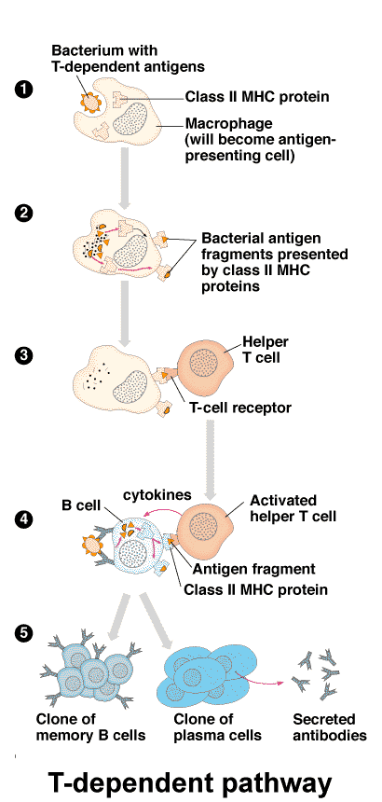
Types of antigens according to antigen presentation 1) thymus dependent antigens * more frequent, especially protein Ag * for induction of humoral immune response is necessary cooperation with T_{H} cells * assistance implemented in the form of cytokines produced by T_{H} cells

Slide 9
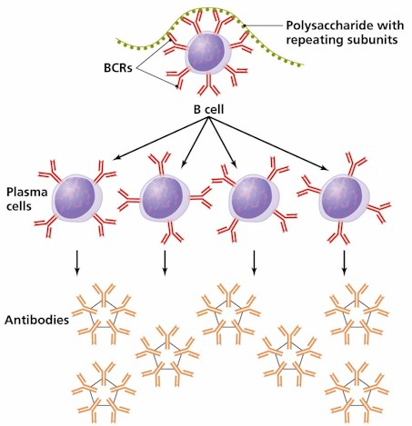
Types of antigens according to antigen presentation 2) thymus independent antigens * can induce antibodies production directly without the participation of T lymphocytes * mainly bacterial polysaccharides, lipopolysaccharides and polymer forms of proteins (e.g. Haemophilus, Str.pneumoniae)
T-independent pathway

Slide 10
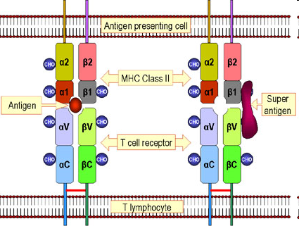
Superantigens * stimulate lymphocytes polyclonaly and massively (5-20%) * massive activation of T lymphocytes (massive cytokine release) can cause shock * e.g. bacterial toxins (Staph.aureus, Str.pyogenes, Pseud.aeruginosa)

Slide 11
Sequestered antigens * autoantigens that are normally hidden from the immune system and therefore unknow (e.g. the lens of the eye , testes, brain) * if they are "uncovered" by demage, can induce the immune response (one of the theories of autoimmune processes)

Slide 12
Components of the immune system

Slide 13
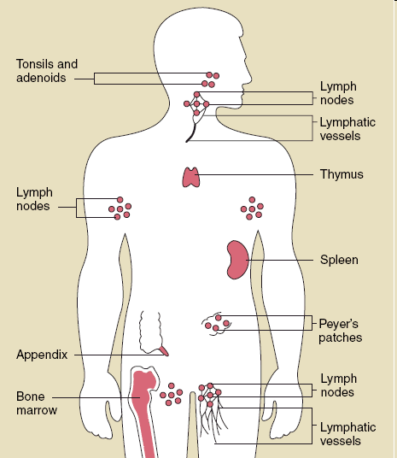
Components of the immune system
* Lymphoid tissues and organs * Cells of the immune system * Molecules of the immune system

Slide 14
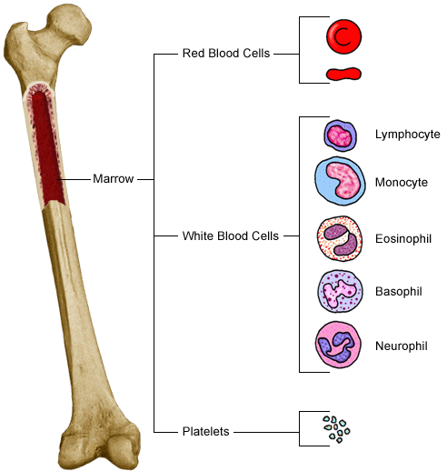
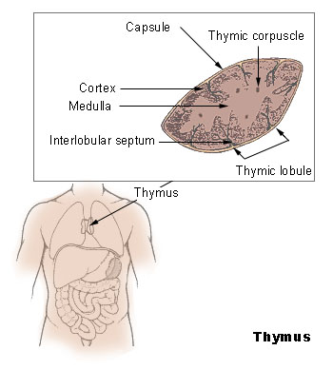
Lymphoid tissues and organs
* are linked with the other organs and tissues by network of lymphatic and blood vessels
Primary lymphoid tissues and organs * bone marrow, thymus * maturation and differentiation of immunocompetent cells * immature lymphocytes acquire here their antigenic specificity

Slide 15
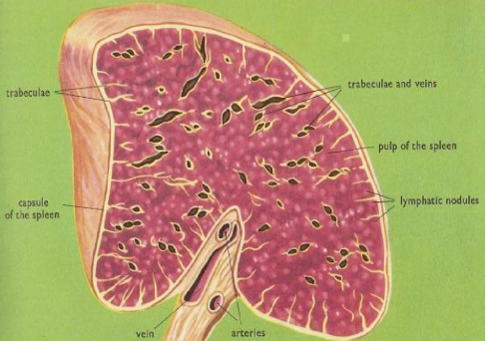
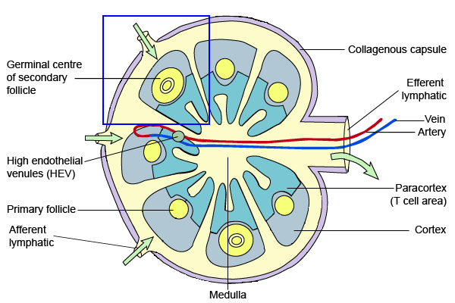
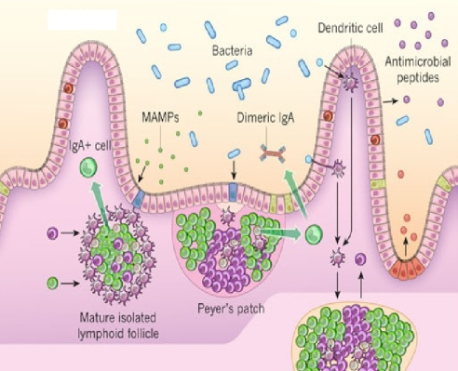
Secondary lymphoid tissues and organs
* meeting place of immunocompetent cells with Ag spleen
lymph nodes and their organized clusters (tonsils, appendix, Peyer patches in the intestine
MALT (mucous associated lymphoid tissue)

Slide 16
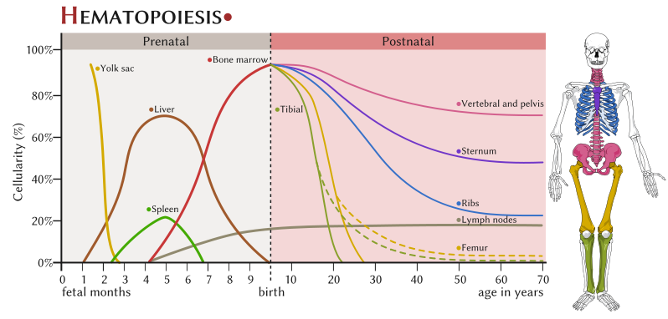
Cells of the immune system * development of red and white blood cells begin at yolk sack, then haematopoiesis travels to fetal liver and spleen (3 to 7 month gestation), then bone marrow has the main hematopoietic function * all blood cells arise from a pluripotent stem cell (CD 34) * haematopoiesis is regulated by cytokines

Slide 18
Immune mechanisms

Slide 19
Nonspecific (innate) immune mechanisms * non-adaptive, innate * evolutionarily older * no immunological memory * in the presence of pathogens react quickly, in minutes (based on molecules and cells which are in the body prepared in advance) * component cellular – granulocytes (neutrophils, eosinophils, basophils), monocytes (macrophages, DC), NK cells, mast cells humoral - complement, interferons, lectins and other serum proteins

Slide 20
Specific (adaptive) immune mechanisms * adaptive, antigen-specific * evolutionarily younger * have immunological memory * development of a full-specific immune response takes several days even weeks * component cellular - T lymphocytes (TCR) humoral - antibodies

Slide 21
Phagocytosis

Slide 22
Phagocytosis
= ability to absorb particles from the surroundings Professional phagocytes * protect the body by ingesting harmful foreign particles, bacteria, and dead cells * neutrophilic granulocytes, monocytes, macrophages and DC

Slide 23
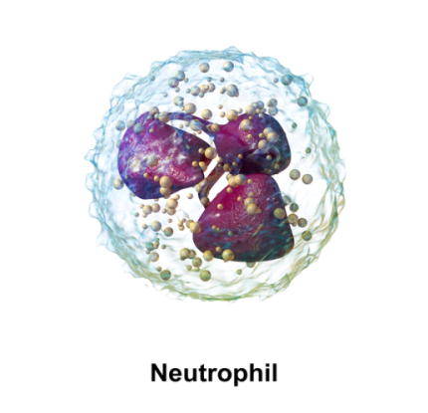
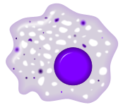
Professional phagocytes
granulocytes - defense against extracellular pathogens - able to perform effector functions immediately macrophages - removal of own apoptotic cells, defense against certain intracellular parasites, APC - fully functional after activation by cytokines (IFNγ, TNF)
Macrophage

Slide 24
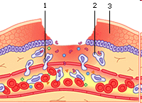
The migration of phagocytes in damaged and infected tissues 7% of peripheral neutrophils and phagocytes 93% neutrophils and phagocytes in the bone marrow * in place of damage phagocytes are captured on endothelium (due to inflammatory cytokine expression of adhesion molecules is higher)

Slide 25
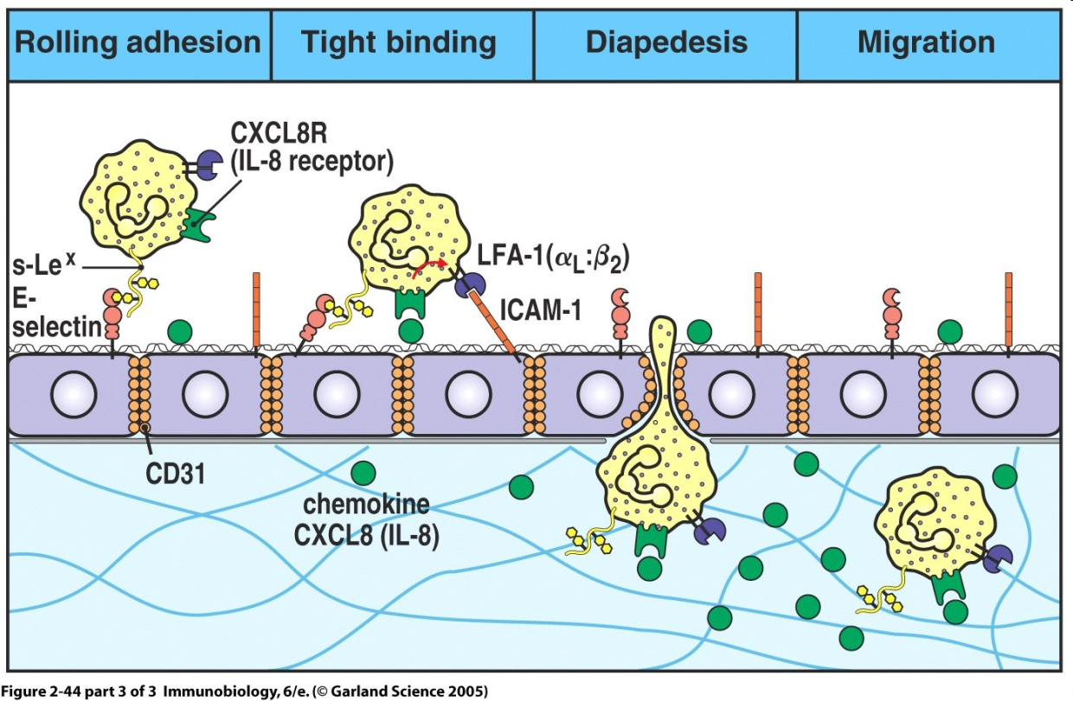
Phagocytosis * the first interactions with adhesion molecules slows the movement of neutrophils - roling * then there is a stronger link between endothelial cells and leukocytes and subsequent penetration between endothelial cells to the tissue - diapedesis (or extravasation) * phagocytes direct their movement to the site of inflammation by chemokines (IL-8, MIP-1α and β, MCP-1, RANTES, C3a, C5a, bacterial products ...)

Slide 26
Receptors on phagocytes PAMPs (pathogen associated molecular patterns) PRR (pathogen recognition receptors) * TLR receptors (binds bacterial lipoproteins, lipopolysaccharides, bacterial DNA…) * mannose receptor * galactose receptor * CD14 (binds bacterial LPS) * scavenger receptors (bind phospholipids on the surface of apoptotic cells)

Slide 27
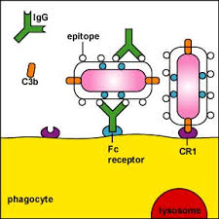
Opsonisation * enhances phagocytosis of an antigen * antigen is marked with opsonin * Opsonins - IgG, IgA, C3b, MBL, fibronectin, fibrinogen, CRP, SAP * Fc receptors on phagocytes (recognize antibodies linked to surface of micro-organism) * complement receptors (for binding C3b)

Slide 28
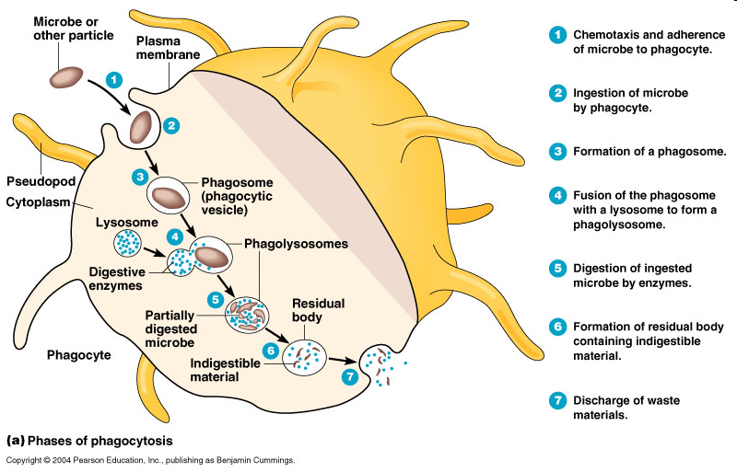
Phagocytosis

Slide 29
Degradation of ingested material * fagosome fusion with lysosomes - oxygen independent (lysozyme, defensines, serine proteases, myeloperoxidase, acidic pH…) * activation of membrane NADPH oxidase - oxygen dependent (superoxide, hydrogen peroxide, hypochlorous acid) * production of nitric oxide (NO) by macophages

Slide 30
Secretory products of phagocytes * IL-1, 6, TNF (systemic response to inflammation) * IL-8 (chemokine) * IL-3, GM-CSF (control haematopoiesis) * TGFα, TGFβ (tissue regeneration) * metabolic products of arachidonic acid (prostaglandins, prostacyclin, leukotrienes and thromboxanes)

Slide 31
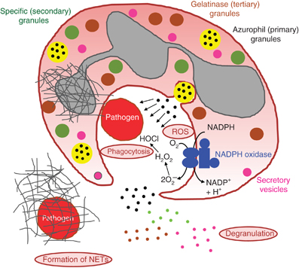
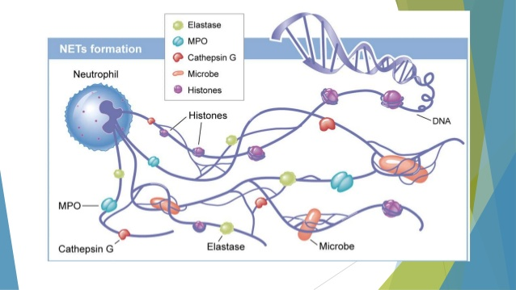
Neutrophils
Neutrophils have three ways of attacking pathogen: phagocytosis, degranulation and the formation of NETs

Slide 32
Complement

Slide 33
Complement
* system of about 30 serum and membrane proteins * complement components are present in the serum in inactive form * complement activation has cascade character * complement proteins are synthesized in the liver, less by tissue macrophages and fibroblasts * the main complement components: C1-C9 (C3 is the central component) * other complement components: factor B, factor D, factor P * regulatory proteins: C1 - inhibitor, factor I, factor H, DAF, MCP, CR1, CD59 (protektin) inactivator of anafylatoxin…

Slide 34
Complement functions
* Opsonization (C3b) * Chemotaxis (C3a, C5a) * Osmotic lysis (MAC C5b-C9) * Anafylatoxins (C3a, C4a, C5a)

Slide 35
Complement activation
* Alternative pathway * Clasial pathway * Lektin pathway

Slide 36
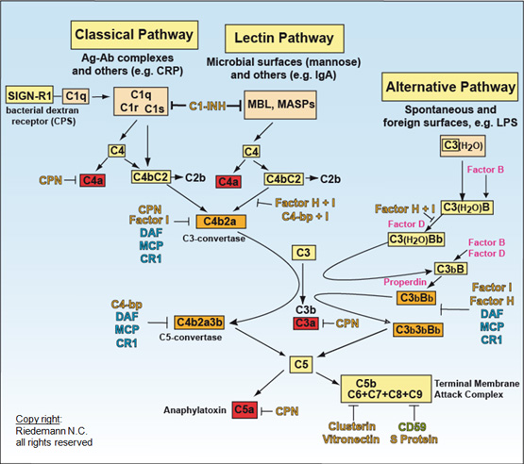

Slide 37
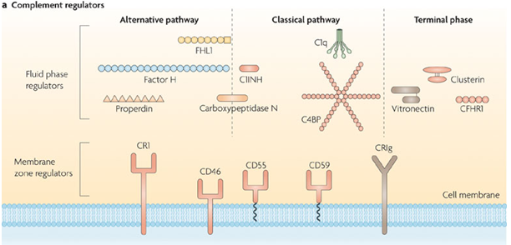
Regulation of complement and protection of own cells
Activation of complement cascade is controlled by the plasma and membrane inhibitors.
Anaphylatoxin inactivator
MCP
DAF
Protectin

Slide 38
Complement regulation
C1 inhibitor (C1-INH) – inhibits C1; if missing→ HAE
factor I with cofactors: MCP (membrane cofactor protein), CR1, factor H – C3b, C4b cleavage
DAF (decay-accelerating protein)-degradation of C3 and C5 convertase

Slide 39
Complement regulation
factor S (vitronectin) – inhibits complex C5bC6
CD 59 (protectin) - prevents the polymerization of C9
anaphylatoxin inactivator (CPN)- inactivates anafylatoxins (C3a, C4a, C5a)

Slide 40
Complement receptors * Bind fragments of complement components CR1 - on various cells - removing of immunecomplexes CR2 - on B lymphocytes and FDC - activation of B cells CR3, CR4 - on phagocytes - participation in opsonization, adhesion

Slide 41
Basophils and mast cells and their importance in immune responses

Slide 42
Mast cells
Mucosal mast cells - in the mucous membranes of respiratory and gastrointestinal tract, participate in parasitosis and allergy
Connective tissue mast cells - the connective tissue, in parasitosis and allergy are not participating

Slide 43
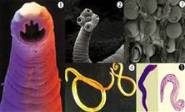
Mast cell functions
Defense against parasitic infections
Responsible for the early type of hypersensitivity (allergic reaction)
Apply during inflammation, in angiogenesis, in tissue remodeling
Regulation of immune response

Slide 44
Mast cell activation
Mast cells degranulation can be stimulated by:
Antigen or allergen through cross-linking of IgE Fc receptors
anafylatoxins (C3a, C4a, C5a)
TLR

Slide 45
Mast cell activation by cross-linking of IgE Fc receptors
Establishing of multivalent antigen (multicellular parasite) to IgE linked to highaffinnity Fc receptor for IgE (FcεRI)
Aggregation of several molecules FcεRI
Initiate mast cell degranulation (cytoplasmic granules mergers with the surface membrane and release their contents)
Activation of arachidonic acid metabolism (leukotriene C4, prostaglandin D2)
Production of cytokines (TNF, TGFβ, IL-4, 5,6 ...)

Slide 46
Activation schema of mast cell

Slide 47
Secretory products of mast cells
Cytoplasmatic granules: hydrolytic enzymes, heparin, chondroitin sulphate, histamine, serotonin
Arachidonic acid metabolites (leukotriene C4, prostaglandin D2)
Cytokines (TNF, TGF β, IL-4, 5,6 ...)

Slide 48
Histamine
vasodilation
increased vascular permeability
bronchoconstriction
increases intestinal peristalsis
increased mucus secretion

Slide 49
Basophils
Differentiate from myeloid precursor
Are very similar to mast cells by the receptor equipment, content of granules, the mechanisms of stimulation and functions
Play role in inflammation, regulation of immune responses, in allergic reactions, they are responsible for the emergence of anaphylactic shock
In high numbers at the sites of ectoparasite infection

Slide 51
Complement – clasical pathway https://www.youtube.com/watch?v=vbWYz9XDtLw
Complement – alternative pathwayhttps://www.youtube.com/watch?v=qga3Wn76d9w
Complement
https://www.youtube.com/watch?v=5Ao36HNvwvw
Immune reaction https://www.youtube.com/watch?v=G7rQuFZxVQQ

Slide 52
Alternative complement pathway * C3 component of complement spontaneously breaks into C3b and C3a * C3b can covalently bind on the surface of microorganism * to bound C3b join a factor B, which is cleaved by factor D to Ba and Bb, resulting complex C3bBb is stabilized by factor P and functions as an alternative C3 convertase * C3 convertase cleaves C3 to C3a (chemotaxis) and C3b, which binds to the surface of the microorganism (opsonization), or gives rise to other C3 convertases * from some C3 convertases form C3bBbC3b that act as an alternative C5 convertase, which cleaves C5 to C5a (chemotaxis) and C5b (starts terminal lytic phase)

Slide 53
Classical complement pathway * Can be initiated by antibodies (IgM, IgG, except IgG4) or by CRP, SAP , which are bound to antigen * C1 binds to antibodies that have already attached themselves to antigen , change its conformation and get proteolytic activity - starts cleave proteins C4 and C2 * fragments C4b and C2a bind to the surface of the cell and create the classic C3 convertase (C4bC2a), which cleaves C3 to C3a and C3b * then creates a classic C5 convertase (C4bC2aC3b) that cleaves C5 to C5a and C5b

Slide 54
Lectin complement pathway * is initiated by serum mannose binding lectin (MBL) * MBL binds to manose, glucose or other sugars on the surface of some microbes, after the bindins starts cleave C4 and C2 * this way is similar to the classical pathway

Slide 55
Terminal (lytic) phase of the complement cascade C5b fragments creates a complex with C6, C7 and C8, the complex dive into the lipid membrane of the cell and attached to it into a circle 13-18 molecules of C9, thus create pores in the membrane and cell can lysis (G-bacteria, protozoans, some viruses). Most microorganisms is resistant to this lytic effect of complement (protection by cell wall).

