Slide 1
Polyclonal and monoclonal antibodies

Slide 2
Polyclonal antibodies
PAbs are secreted by different B cell lineages
They are a collection of immunoglobulin molecules that react against a specific antigen, each identifying a different epitope.

Slide 3
The general procedure to produce polyclonal antibodies
Antigen preparation
Adjuvant selection and preparation
Animal selection
Injection process
Polyclonal IgG is purified from the mammal's serum
https://www.youtube.com/watch?v=_65_8BX8L-k

Slide 4
Advantages of polyclonal antibodies
Easy, cheap and quick preparation
PAbs are heterogeneous, bind to a wide range of antigen epitopes
PAbs can be made in large quantities

Slide 5
Use of polyclonal antibodies in treatment
Immunoglobulin substitution (in antibody imunodeficiencies)
Prophylaxis Passive immunization uses human antibodies (infectious jaundice type A or B, tetanus, Rh_{o}(D) immune globulin…) or antibodies of animal origin (rabies, botulism…)
Therapy Antithymocyte globuline – prevention and treatment of acute cellular rejection after organ transplantation Venom antiserum …

Slide 6
Use of polyclonal antibodies in diagnostic
Precipitation
Aglutination
Enzyme immunoassay
Radioimmunoassay
Immunofluorescence (direct, indirect)

Slide 7
Monoclonal antibodies
Monoclonal Ab are produced by a clone of cells derived from a unique parent cell
mAb bind very specifically to one epitope of an antigen

Slide 8
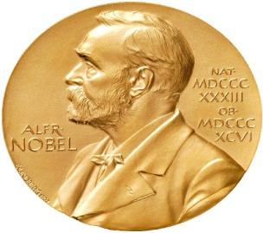
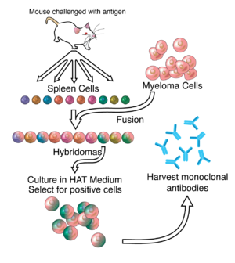
Production of monoclonal antibodies
Hybridoma technology
https://www.youtube.com/watch?v=8iyrbv1JauY
1984 – Nobel price César Milstein, Georges J.F. Kőhler

Slide 9
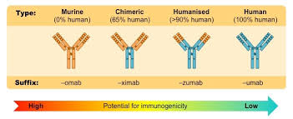
Use of monoclonal antibodies in treatment
Inhibition of transplant rejection
Treatment of some cancers (Herceptin…)
Treatment of autoimmune diseases (Rituximab…)
Treatment of some viral diseases
Treatment of severe allergic asthma (Omalizumab)
https://www.youtube.com/watch?v=5AXApBbj1ps

Slide 10
Use of monoclonal antibodies in diagnostic
Flow cytometry

Slide 11
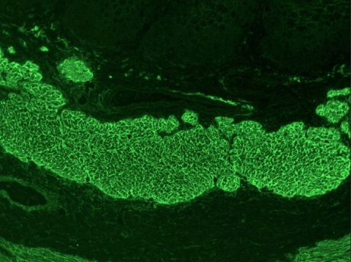
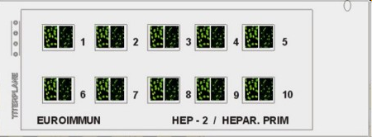
Indirect immunofluorescence
Autoantibodies detection
Cell lines and tissue sections are used as a substrate
Anti-endomysium antibodies
Anti-nuclear antibodies patterns

Slide 12
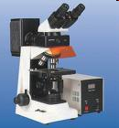
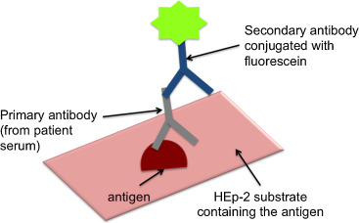
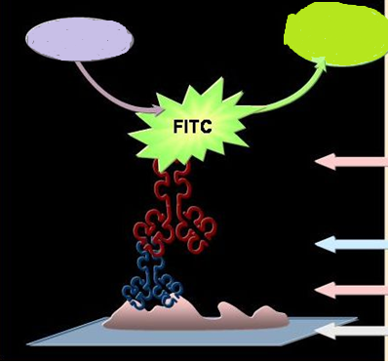
Indirect immunofluorescence
1. Incubating the patient's serum (Ab) with a substrate (Ag) fixed on a slide 2. Incubation with anti-human antibody labeled with FITC (anti-human IgG / FITC, anti-human IgA / FITC) 3. Fluorescence microscope evaluation
UV light
Green light

Slide 13
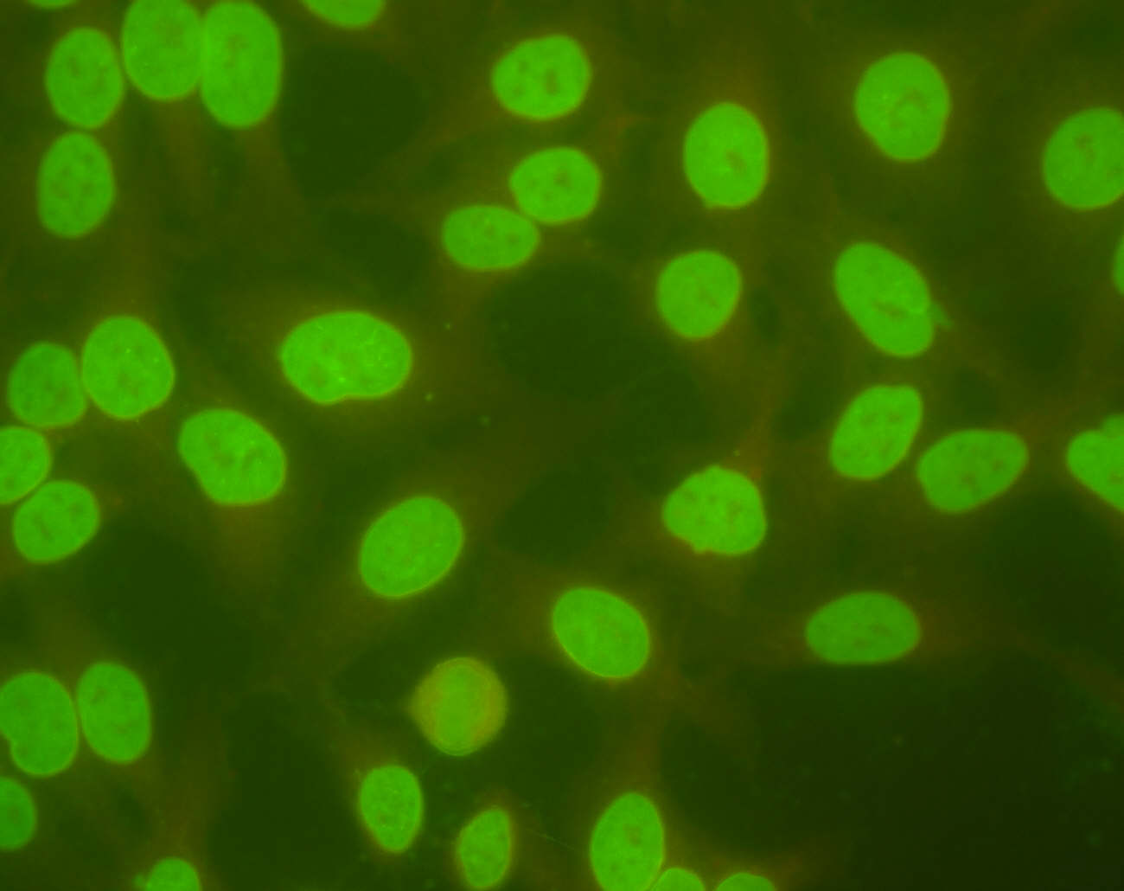
Homogenní fluorescence ANA

Slide 14
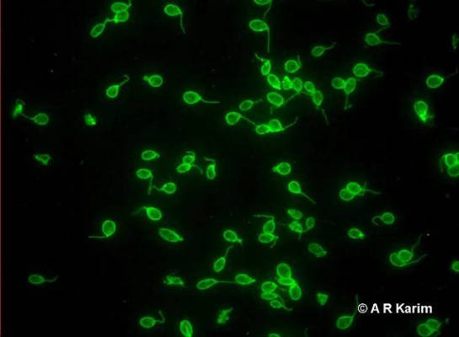
Crithidium luciliae – anti ds DNA protilátky

Slide 15
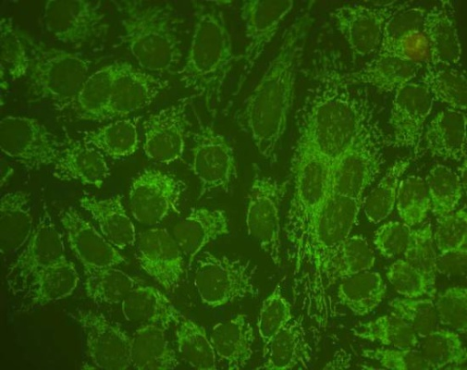
Antimitochondriální protilátky

Slide 16
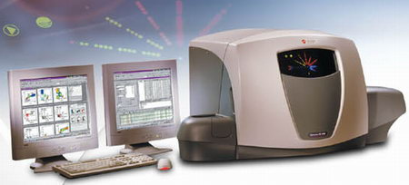
Flow cytometry

Slide 17
Flow cytometry
Method used to analyze cells in suspension
Quantitative tests: determination of: leucocyte subpopulations, the number of activated T lymphocytes, CD4/CD8 T cell ratio (dg. AIDS), oncoproteins (dg. malignit), etc.
Qualitative tests (functional): examination of phagocytosis (ingestion, burst test) activation tests (eg T-lymphocytes, basophils)

Slide 18
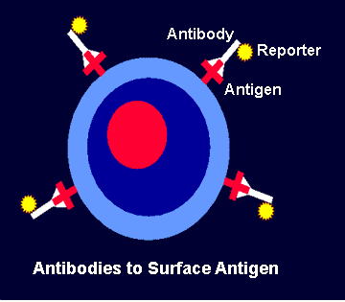
Determination of leukocyte subpopulations
Determination of individual cell populations by binding of monoclonal antibody to cell surface antigen (CD)
Different antibodies are labeled with different fluorochromes (FITC, PE, PC5…)

Slide 19
Flow cytometry
Flow cytometry detects:
FSC (forward scatter) - cell size
SSC (side scatter) – cell granularity
Fluorescence - monoclonal antibodies labeled with fluorochromes (FITC, PE, Texas red…) bind to cells

Slide 20
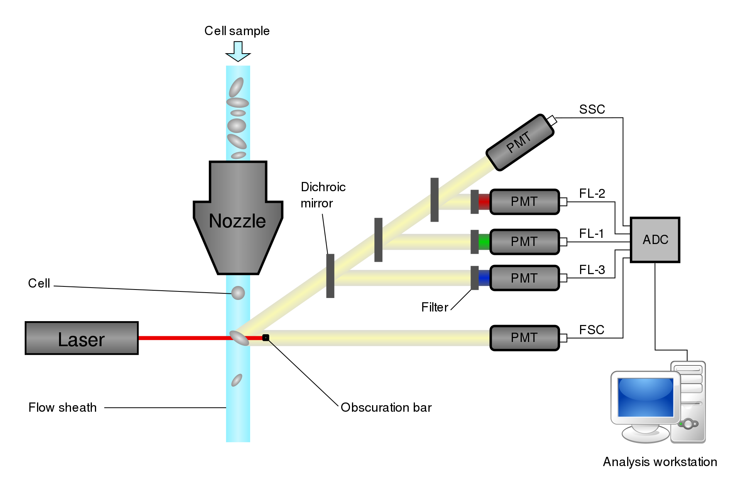
Flow cytometry

Slide 21
Leukocyte surface markers
CD3+ mature T cells CD4+ helper T cell subpopulations (30-60%) CD8+ subpopulation of cytotoxic T lymphocytes (15 - 30%) CD25+ activated T lymphocytes (1 - 5%) CD19+ mature B lymphocytes (5 - 15%) CD16+, CD56+ NK cells (5-15%) CD14+ monocytes CD15+ granulocytes CD38+ plasma cells

