Slide 1
Immunodeficiencies, part 2
Martin Liška

Slide 2
Primary immunodeficiencies

Slide 3
IV. Combined T and B cell deficiencies
a/ Severe Combined Immunodeficiency (SCID)
One of the most severe PIDs; without BMT, patients die during the first years of life
Defect of T cell function which can be accompanied with B cell and NK cell disorder
The most common is X-linked form (T-B+NK-)
The mutation affects so called common gamma chain (protein shared by receptors of various cytokines (IL-2, IL-4, IL-7, IL-9,IL-15, IL-21)) → severe defect of lymphocyte development and differentiation → severe decrease or absence of T cells and NK cells
Number of B cells normal X insufficient help from T cells → insufficient production of antibodies
JAK-3 deficiency
Similar features like X-linked form (defect of signal transmission through common gamma chain)

Slide 4
IV. Combined T and B cell deficiencies
a/ Severe Combined Immunodeficiency (SCID)
IL-7 R or CD45 deficiency (T-B+NK+ form)
Adenosine deaminase (ADA) or purine nucleoside phosphorylase (PNP) deficiency
AR heredity
These defects lead to purine metabolites cumulation → inhibition lymphocyte proliferation (ADA) or toxic effect to lymphocytes (PNP) → absence of T and B cells (T-B- form) – this form of SCID develops also on the basis of other mutations (e.g.RAG1 or RAG2 recombinase deficiency, MHC gp.II expression defect)

Slide 5
IV. Combined T and B cell deficiencies
a/ Severe Combined Immunodeficiency (SCID)
Omenn syndrome
Severe PID belonging to SCID group
Mutation of RAG recombinases →impaired VDJ recombinations → proliferation of one or more clones of autoreactive T cells → unlike in classical SCID, Omenn syndrome need not to display T lymphopenia (numbers of T cells can be increased) X number of B cells and Ig are very low
Symptoms: lymphadenopathy, hepatomegaly, generalized erythroderma with allopecia, symptoms
typical for SCID (pneumonia, chronic diarrhea, failure to thrive)
Dg: evidence of T cells clonality
genetic tests
Reticular dysgenesis syndrome
The most severe form of SCID
Mutation of adenylate kinase 2 gene (AK2) → increased apoptosis of myeloid and lymphoid precursors
T-B- form of SCID

Slide 6
IV. Combined T and B cell deficiencies
a/ Severe Combined Immunodeficiency (SCID)
Clinical symptoms of SCID
Onset in infancy
- Commonly severe infections of respiratory tract (pneumonia)
Failure to thrive, exanthemas similar to eczema, chronic diarrhea
Absence of tonsils and adenoids
Infections caused by bacterias, viruses or fungi – typically pneumocystic pneumonia, candidiasis, CMV infections, infections caused by BCG (BCGitis)
Treatment of SCID
The only successful and ultimate treatment is HSCT performed as soon as possible
Substitution of Ig

Slide 7
IV. Combined T and B cell deficiencies
b/ diGeorge syndrome
- deletion of long arm of chromosome 22 (22q11.2) → defective development of 3rd and 4th branchial pouch (complete, partial)
rare cases of diGeorge syndrome without 22q11.2 deletion
AD heredity
typically defect of development (absence) of thymus and/or parathyroid glands, severe congenital heart disease is characteristic, facial dysmorfia, mental retardation
Symptoms: usually symptoms of VCC predominates (typically Fallot’s tetralogy)
sometimes hypocalcemic spasms due to hypoparathyroidism
immunodeficiency (recurrent respiratory infections), sometimes as severe as
in SCID
Dg.: typical symptoms
genetic tests
Th: cardiac surgery, symptomatic treatment of hypoparathyroidism and
immunodeficiency, dispensarisation

Slide 8
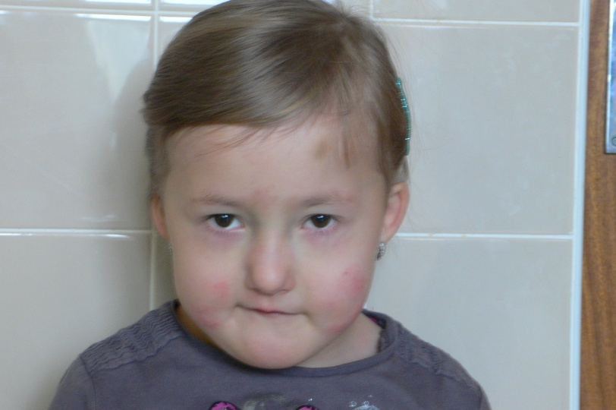
Facial dysmorphia in diGeorge syndrome

Slide 9
Combined T and B cell deficiencies

Slide 10
V. Immunodeficiency with immune dysregulation
a/ X-linked lymphoproliferative syndrome (XLP)
Abnormal immune response to EBV infection which leads to uncontroled lymphoproliferation
Disorder of gene localized on X chromosome - mutation of gene coding protein associated with signal activating molecule of lymphocytes SLAM (SAP) or inhibitor of apoptosis (XIAP)
Development of uncontroled lymphoproliferation and NK cell disorder
EBV infection with fulminant or fatal course leading to liver failure → surviving patients are at risk of B cell lymphoma development, hypogammaglobulinemia similar to CVID or aplastic anemia
Without BMT performed before EBV infection development, XLP is fatal sooner or later

Slide 11
V. Immunodeficiency with immune dysregulation
b/ Chronic mucocutaneous candidiasis
Primary immunodeficiency manifesting by recurrent infections of mucous membranes and skin caused by Candida in consequence of T cell disorder
Sometimes candidiasis combined with alopecia and polyendocrinopathy (APECED = Autoimmune PolyEndocrinpathy-Candidiasis-Ectodermal Dystrophy)
Mutation of genes STAT1, IL17RA etc.
Treated with antimycotics, ev.by substitution of lacking hormones

Slide 12
VI. Well-defined syndromes with immunodeficiency
a/ HyperIgE syndrome (HIES, Job’s syndrome)
Eczema + combined immunodeficiency manifesting by recurrent abscesses (cold abscesses) + recurrent sinopulmonary infections
More common AD form caused by mutation of STAT3 gene (Signal Transducer and Activator of Transcription 3), less common AR form caused by mutation of DOCK8 gene (Dedicator Of CytoKinesis 8)
Symptoms: onset frequently in infancy
recurrent staphylococcal abscesses of skin, lungs, joints or internal organs
recurrent sinopulmonary infections, pneumatocele
severe atopic eczema
in AD form: skeletal disorders (facial asymmetry, prominent forehead, broad nasal
bridge, spontaneous bone fractures, osteopenia), delayed dental erruption

Slide 13
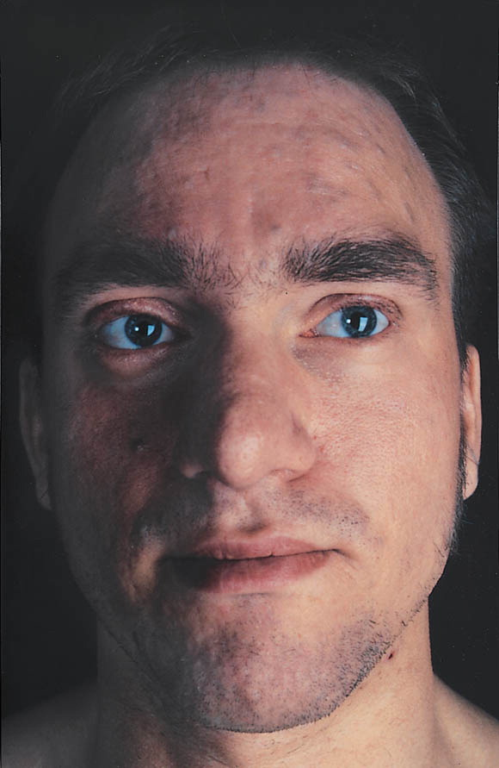
Typical facial features in HIES

Slide 14
VI. Well-defined syndromes with immunodeficiency
a/ HyperIgE syndrome (HIES, Job’s syndrome)
Symptoms: in AR form, recurrent viral infections (herpetic), increased
frequency of autoimmune or allergic diseases, skeletal
disorders often absent
Dg: clinical features
enormously increased level of serum IgE (˃ 2000 IU/ml)
genetic tests
Th: prophylaxis with anti-staphylococcal ATB
dermatological therapy of eczema
surgical treatment of abscesses

Slide 15
VI. Well-defined syndromes with immunodeficiency
b/ Wiskott-Aldrich syndrome (WAS)
X-linked recessive disease
Decreased number of small platelets (microthrombocytopenia), eczema and immunodeficiency
Mutation of WASp gene → decreased production of WASp protein (exprimed on hematopoietic cells, provides dynamic changes of cytoskeleton which are necessary for function of immune cells)
Symptoms: combined immunodeficiency: decreased Ig levels (↓IgM; ↑IgA
and IgE) + defects of T cell function → recurrent otitis and
sinusitis, autoimmune diseases
thrombocytopenia → increased bleeding

Slide 16
VI. Well-defined syndromes with immunodeficiency
b/ Wiskott-Aldrich syndrome (WAS)
Dg: clinical symptoms
proof of decreased expression of WASp on leukocytes
genetic tests
Th: symptomatic treatment
in case of matched donor BMT
studies of gene therapy

Slide 17
VI. Well-defined syndromes with immunodeficiency
c/ Ataxia-teleangiectasia
AR disease – mutation of gene ATR (11q22-q23) →
defect of ATM proteinkinase → defective mechanisms
of DNA reparation → increased sensitivity to ionizing
radiation → ↑susceptibility to develop malignancies
Symptoms: ataxia + teleangiectasia
↓IgA+E → recurrent sinopulmonary infections
hypoplasia of thymus a lymph nodes
Th: symptomatic

Slide 18
VI. Well-defined syndromes with immunodeficiency
d/ Netherton syndrome
congenital ichthyosis + bamboo hair + atopic disease
↑IgA+E
recurrent bacterial infections, failure to thrive
e/ IKAROS deficiency
anemia, neutropenia, thrombocytopenia, absence of B cells and NK cells, non-functional T cells

Slide 19
Therapy of immunodeficiency
Severe PIDs → HSCT
Other PIDs → gene therapy
Primary & secondary IDs → Ig replacement (SCIG, IVIG)
→ prophylaxis (ATB)
Mild IDs →immunomodulation

Slide 20
Secondary immunodeficiencies

Slide 21
Secondary immunodeficiencies
Acquired, symptoms manifest in any stages of life
More common than PID
Variable etiology (metabolic diseases, malignancies, immunosupressants, infections, stress etc.)

Slide 22
Secondary immunodeficiencies
Acute and chronic viral infections – infectious mononucleosis, influenza, varicella
Metabolic disorders – diabetes mellitus, uremia
Autoimmune diseases – SLE, autoimmune neutropenia
Allergic diseases
Chronic GIT diseases
Malignant diseases - leukemia
Hypersplenism/asplenia
Burns, surgery, injuries
Severe nutritional disorders
Chronic infections
Ionizing radiation
Drug induced immunodeficiencies – chemotherapy, immunosupressive treatment, drug-induced autoimmune phenomenons
Chronic stress
Chronic exposure to harmful chemical substances

Slide 23
I. Defects of phagocytes
Quantitative & qualitative defects of phagocytes
Symptoms similar to primary defects of phagocytes
Hematological malignancies (e.g.CML) can cause quantitative and/or qualitative defects of granulocytes
Chemotherapy
Autoimmune neutropenia – symptoms of ID usually mild

Slide 24
II. Defects of complement system
Decreased synthesis of complement system compounds due to liver disease
Increased consumption of compounds in immunocomplex autoimmune diseases
Symptoms of ID do not dominate

Slide 25
III. Antibody immunodeficiencies
Hematological malignancies
B cell lineage lymphoproliferative diseases (chronic lymphocytic leukaemia, CLL)
Frequently significant hypogammaglobulinemia, IgG subclass deficiency , poor specific antibody responses (esp.to pneumococcal polysaccharides)
Pathogenesis of hypogammaglobulinemia:
- replacement of normal B cells by (non-functional) CLL B cells → ↓B
cell function
- CLL B cells → subverting of T cell help → ↓B cell function
- CLL B cells → interaction with bone marrow plasma cells via Fas-
ligand/Fas interactions → ↓ production of Ig
- treatment related (chemotherapy, biological treatment)

Slide 26
III. Antibody immunodeficiencies
Hematological malignancies
Most frequently: chronic lymphocytic leukaemia (CLL) and multiple myeloma
Less frequently: Hodgkin’s and non-Hodgkin’s lymphomas, diffuse large B cell lymphoma, follicular lymphoma, mantle cell lymphoma, marginal zone lymphoma, Burkitt’s lymphoma
Beside humoral deficiency, cellular and innate immunosupression (CLL) → susceptibility to viral, fungal and opportunistic infections
Infections are an important cause of morbidity
Treatment: clinically significant humoral defect (↓Ig, recurrent and/or severe bacterial infections, poor specific antibody responses) → ATB prophylaxis → in case of failure replacement immunoglobulin

Slide 27
III. Antibody immunodeficiencies
2. Protein-losing states
a/ Protein-losing enteropathies
Primary:
- inflammatory (Crohn’s disease, ulcerative colitis, coeliac disease)
infective (enteric infections)
Protein loss via mucosal injury → hypoalbuminemia, ↓IgG
Treatment: therapy of underlying disorder
replacement immunoglobulin only exceptionally
Secondary:
- intestinal lymphangiectasia)

Slide 28
III. Antibody immunodeficiencies
Intestinal lymphangiectasia
primary lymphangiectasia is rare congenital disease
dilatations in mucosal and submucosal lymphatics → leakage of lymph into bowel lumen → ↓albumin, ↓Ig, ↓ lymphocytes
primary can be associated with the other syndromes (yellow-nail sy., neurofibromatosis type 1, Turner’s sy., Noonan’s sy. etc.
secondary in IBD, right-sided heart failure (↑central venous pressure)
patients can suffer from bacterial and opportunistic infections
Treatment: dietary exclusion of long chain fatty acids (limits losses into GIT)
surgical treatment
ATB prophylaxis and/or Ig replacement could be considered in
symptomatic patients

Slide 29
III. Antibody immunodeficiencies
2. Protein-losing states
b/ Protein-losing nephropathies
Nephrotic syndrome
Loss of albumin through glomeruli → edema, anasarca, loss of IgG →
hypogammaglobulinemia
Treatment: therapy of underlying disorder

Slide 30
III. Antibody immunodeficiencies
3. Disorders associated with impaired lymphatic circulation
a/ chylothorax
= presence of chyle in pleural cavity
Causes: damage to thoracic duct (trauma, surgery) malignant obstruction of thoracic duct
mediastinal lymphadenopathy thrombosis of superior vena cava
Chylothorax → loss of Ig and T cells → risk of bacterial and opportunistic infections
Treatment: therapy of underlying condition
b/ Proteus syndrome
= congenital disorder that causes skin overgrowth and atypical bone
development
Sequestration of Ig and lymphocytes in area of lymphoedema + intestinal lymphangiectasia + hypercatabolism of IgG →↓IgG+A

Slide 31
III. Antibody immunodeficiencies
4. Disorders associated with increased immunoglobulin catabolism
Myotonic dystrophy
Decreased levels of IgG attributed to hypercatabolism of IgG
Clinical significance of hypogammaglobulinemia is unclear
Treatment: in symptomatic patients, ATB prophylaxis, event. Ig replacement

Slide 32
III. Antibody immunodeficiencies
5. Iatrogenic antibody deficiency
a/ Rituximab
= monoclonal antibody against CD20 used for treatment of
lymphoproliferative diseases and systemic autoimmune diseases (RA,
Wegener’s granulomatosis, Churg-Strauss sy.)
B cell depletion → ↓Ig
Hypogammaglobulinemia observed esp.in B cell lymphoma (functional defect ? effect of chemotherapy ? effect of rituximab ? combination ?)
Treatment: minority of patients develop sustained hypoIg requiring
Ig replacement

Slide 33
III. Antibody immunodeficiencies
5. Iatrogenic antibody deficiency
b/ CD19-targeted chimeric antigen receptor T cells (CART)
Use of CART against B cell antigens (CD19) to treat acute lymphoblastic
leukaemia (ALL) was associated with B cell aplasia →↓Ig
Treatment: sometimes Ig replacement
c/ Atacicept
= humanized recombinant fusion protein against TACI → B cell
suppression
Tested in treatment of lupus nephritis → some subjects developed
hypogammaglobulinemia and serious infections

Slide 34
III. Antibody immunodeficiencies
5. Iatrogenic antibody deficiency
d/ Imatinib
= a selective tyrosine kinase inhibitor
Tested for treatment of chronic myeloid leukaemia (CML) – some patients developed hypogammaglobulinemia, maybe due to inhibition of Ig class switch recombination
e/ Mycophenolate mofetil
Inhibits de-novo synthesis of purines in lymphocytes → wide ranging effects across the immune system, but preferentially on B cell activation, proliferation and plasma cell generation
Used for treatment of transplanted patients or patients with SLE
Some patients developed hypogammaglobulinemia with bronchiectasis

Slide 35
III. Antibody immunodeficiencies
5. Iatrogenic antibody deficiency
f/ Cyclophosphamide
= alkylating agent killing activated T cells and B cells → immunosuppressive efects
Hypogammaglobulinemia and lymphopenia are well-recognized adverse effects
Used in combination with high-dose steroids and rituximab
g/ Corticosteroids
Some patients develop moderate reduction of IgG by systemic oral steroid treatment, but without clinical symptoms

Slide 36
III. Antibody immunodeficiencies
5. Iatrogenic antibody deficiency
h/ Antiepileptics
Some patients treated with phenytoin, carbamazepine, sodium valproate and lamotrigine developed hypogammaglobulinemia, some of them require Ig replacement
Pathogenesis is unclear
i/ Other drugs
Sulphasalazine (RA, IBD) and chlorpromazine (psychosis) can cause secondary hypogammaglobulinemia

Slide 37
IV. Cellular immunodeficiencies
Due to viral infections (HIV, EBV, CMV, VZV)
Malignancies (Hodgkin’s lymphoma)
Substances causing aplastic anemia (benzene, cytostatics, antibiotics)

Slide 38
Acquired ImmunoDeficiency Syndrome (A.I.D.S.)
Caused by Retrovirus HIV 1 or HIV 2
Current incidence 37 mil.people, predominantly in central Africa, 2mil. of new infections per year, 1.2 mil. deaths per year
CZ:10/14 - HIV+ 2330, AIDS 423, deaths 310
Virus has a tropism for cells bearing CD4 (T helper cells); also affects macrophages and CNS cells
Virus uses for entering into cells CD4 receptor and some chemokine molecules (CCR5 and CXCR4)
Viral genome transcribes into human DNA by using reverse transcriptase and infected cell provides viral replication
Transmission: sexual contact
body fluids (blood and blood products)
mother-to-child (prenatal, delivery, breast-
feeding)

Slide 39
Acquired ImmunoDeficiency Syndrome (A.I.D.S.)
Phases:
acute - 3 to 6 weeks after primoinfection
- flu-like symptoms or asymptomatic
asymptomatic - months or years
- viral replication, loss of Th cells
symptomatic - decrease of Th cells
- fevers, weight loss, anorexia
- infections (oropharyngeal candidiasis), autoimmune
disorders, malignancy, allergy
AIDS - systemic breakdown,
- opportunistic infections: pneumocystis pneumonia,
Cryptococcus, Mycobacteria, Toxoplasmosis etc.
- neoplasms (Kaposi’s sarcoma, Burkitt’s lymphoma)

Slide 40
Acquired ImmunoDeficiency Syndrome (A.I.D.S.)
Diagnosis:
Serology - specific antibodies, 4 to 12 weeks after primoinfection
Measurement of antigen p24 – before seroconversion
Viral RNA measurement – before seroconversion, PCR testing
Th cells counts
Therapy:
- HAART (Highly Active Antiretroviral Therapy) – combination of nucleoside (Zidovudine) and non-nucleoside (Nevirapin) reverse transcriptase inhibitors and protease inhibitors (Lopinavir)

Slide 41
Acquired ImmunoDeficiency Syndrome (A.I.D.S.)
Therapy:
Prophylaxis with antibiotics and antimycotics
TBC prevention (isoniazid)
Ig replacement

