Slide 1
Immunodeficiencies
Martin Liška

Slide 2
Immunodeficiency
= a disorder of immune system which manifests by impaired ability to carry out basic immunological functions, primarily defence against infection or immunological surveillance

Slide 3
Immunodeficies
Humoral – nonspecific immune system – complement system
specific immune system – immunoglobulins (B cells)
Cellular – nonspecific – phagocytes
specific – T cells
Primary – hereditary, symptoms manifest mostly in early stages
Secondary – acquired, symptoms manifest mostly in any stages of
life
variable etiology (metabolic diseases, malignancies,
immunosupressants, infections, stress etc.)

Slide 4
Typical age for immunodeficiency manifestation
Early infancy - severe combined primary immunodeficiencies
6 months – 2 years – severe hereditary antibody deficiencies
3 - 5 years – transitory or selective antibody deficiencies,
secondary immunodeficiencies
15 – 20 years – hormonal instability, thymus involution, lifestyle
changes, some typical infections (EBV), first symptoms
of CVID
Middleage – excessive workload, stress, CVID, autoimmune disease,
malignancies
Advanced/old age – rather symptoms of secondary
immunodeficiencies

Slide 5
Immunodeficiency – the main clinical features
Antibody d. - recurrent microbial infections (capsulated bacteria)
respiratory - pneumonia, sinusitis, otitis
GIT – diarrhea
Complement system d. – microbial infections (pyogenic), sepsis
immunocomplex diseases (SLE)
swellings in HAE – C1-inhibitor deficiency
T cells (+ B cells) d. - bacterial, fungal, viral infections
GIT – diarrhea
respiratory – pneumonia, sinusitis
Phagocytes d.- abscesses, recurrent pyogenic infections of skin,
granulomatous inflammation

Slide 6
Primary immunodeficiencies

Slide 7
Primary immunodeficiencies
Defects of phagocytes
Defects of complement system
Predominantly antibody deficiencies
Combined T cell and B cell immunodeficiencies
Diseases of immune dysregulation
Well-defined syndromes with immunodeficiency

Slide 8
European registry of primary immunodeficiencies from 2003 (prevalence 1,52/100000)
Disorder | Frequency (%)
Antibody deficiencies | 66,3
T cell deficiencies + combined | 17,6
Defects of phagocytes | 7,4
Complement system defects | 6,2
Other primary immunodeficiencies | 2,5

Slide 9
Various types of primary immunodeficiency in Czech Republic (2003)
Primary immunodeficiency | Frequency (%)
X-linked agamaglobulinaemia | 3,9
CVID | 19,6
HyperIgM syndrome | 0,8
Selective IgA-deficiency | 51,2
Selective deficiency of IgG subclasses | 2,4
SCID | 1,5
DiGeorge syndrome | 4,6
Wiskott-Aldrich syndrome | 0,5
Hereditary angioedema | 10,6
C2 deficiencey | 0,4
C4 deficiency | 0,5
LAD I | 0,2
CGD | 1,8
HyperIgE syndrome | 1,2
Chronic mucocutaneous candidiasis | 0,4
X-linked lymphoproliferative syndrome | 0,4

Slide 10
I. Defects of phagocytes
1/ Quantitative defects of phagocytes
a/ neutropenia, granulocytopenia
severe congenital neutropenia (Kostmann sy.)
cyclic neutropenia
reticular dysgenesis

Slide 11
I. Defects of phagocytes
2/ Quantitative defects of phagocytes
impaired ability of phagocytes to phagocyte or kill ingested microbes
a/ Chronic Granulomatous Disease (CGD)
X-linked (60%), event.AR
defect of NADPH oxidase system → impaired ability to produce toxic oxygen metabolites (e.g.H₂O₂) → decreased ability to kill microbes (especially producing catalase: Staph.aureus or Pseudomonas aeruginosa)
Symptoms: onset at early age
formation of granulomas and abscesses in skin and organs
Dg: respiratory burst test (FCM)
genetic tests
Th: ATB prophylaxis
in more severe cases BMT or gene therapy

Slide 12
I. Defects of phagocytes
b/ Myeloperoxidase deficiency
susceptibility to infections caused by Staph.aureus or Candida albicans
c/ Chédiak-Higashi syndrome
recurrent severe pyogenic infections (streptococci, staphylococcci)
neutrophils contain giant lysosomes (disorder of their content release → impaired killing of microbes)
Dg: neutrophils with abnormal chemotaxis and killing
Th: ATB, ev.BMT

Slide 13
I. Defects of phagocytes
d/ adhesion deficiency (LAD syndrome)
defects of neutrophil adhesion molecules expression
LAD I – defect of integrins expression
LAD II – defect of selectins expression
Clin.sympt.: recurrent skin and mucous infections, impaired healing of umbilical cord scar, formation of abscesses (especially in periproctal region) with poor production of pus
Dg: proof of decreased CR3 expression
Th: ATB, transfusion of donor granulocytes
only treatment is BMT

Slide 14
II. Defects of complement system
a/ C1, C2, C3, C4 deficiency
Increased development of systemic immunocomplex diseases (SLE-like), susceptibility to pyogenic infections
b/ C6, C7, C8, C9 deficiency
Susceptibility to pyogenic infections, in C9 deficiency meningococcal infections
c/ MBL deficiency
Mannan Binding Lectin deficiency (lectin pathway of complement system activation), increased frequency of common infections

Slide 15
II. Defects of complement system
d/ Hereditary angioedema (HAE)
absence or functional defect of C1 inhibitor
C1-inhibitor = regulation of complement system, kinin and hemocoagulation cascade → in case of C1-INH deficiency: dysregulation of bradykinin metabolism → swellings
Symptoms: recurrent swellings of skin, mucous membranes of
larynx, gut (mimicking intestinal obstruction)
onset mostly in adolescence
triggering factor most frequently injury, surgery
(e.g.dental), intercurrent infection
Laryngeal swelling could be life-threatening without rescue therapy

Slide 16
II. Defects of complement system
d/ Hereditary angioedema (HAE)
Dg: C1-inhibitor concentration assessment
C4 concentration assessment
functional test of C1-inhibitor
genetics
Th: preventive – androgens (Danazol), antifibrinolytics
(tranexamic acid), C1-inhibitor concentrate
rescue – administration of C1 inhibitor concentrate (Berinert),
selective bradykinin-receptor inhibitor (icatibant –
Firazyr), recombinant C1-inhibitor (Ruconest)
Angioedema can be secondary too

Slide 17
III. Predominantly antibody immunodeficiencies
X-linked (Bruton’s) agammaglobulinemia (XLA)
Mutation of Bruton’s tyrosinkinase gene (Btk)(Xq21.3-22) → block of maturation of pre-B cell into B cell → severely decreased Ig levels and B cell numbers
Most common X-linked form, but rarely forms affecting girls
Symptoms: onset between 6th month and 2nd year of age: recurrent pneumonias,
pyogenic otitis, sinusitis with complications
increased risk of pulmonary fibrosis
Dg: IgG, IgA, IgM levels ˂ 2* SD of age mean
absence of isohemaggulutinins and/or poor seroconversion to vaccination
B cell numbers markedly decreased or absent
genetic tests
Th: life-long IVIG substitution

Slide 18
III. Predominantly antibody immunodeficiencies
Common Variable Immunodeficiency (CVID)
Heterogenous group of diseases manifested by markedly decreased serum IgG a IgA levels (˃2* SD of age mean)
Similar to XLA, but symptoms onset usually at 2nd – 3rd decade of life
Symptoms: recurrent infections of respiratory tract, esp.pneumonias (Pneumococci,
Haemophilus, Branhamella, Mycoplasma)
complications: tumors or autoimmune diseases, e.g.hemolytic anemia,
fibrosis, endocrinopathies, lymphoproliferations, bronchiectasies
Dg: IgG+A markedly decreased
poor seroconversion to vaccination
numbers of B cells decreased or slightly increased
genetic test (mutations ICOS, BAFF, CD19, CD20 etc.)
Th: life-long IVIG or SCIG substitution
dispensarisation

Slide 19
III. Predominantly antibody immunodeficiencies
Transient hypogammaglobulinemia of infancy (THI)
Delayed onset of antibody production → decreased levels of Ig (esp.IgG), get normal until cca 3 years of age
More frequent infections, esp.of respiratory tract
B cell numbers normal
Th: symptomatic, event.transiently IVIG

Slide 20
III. Predominantly antibody immunodeficiencies
Selective IgA deficiency (SIAD)
Impaired function of B cells
The most common X the mildest PID
Symptoms: recurrent respiratory infections X very often without any
symptoms
Dg: IgA ˂ 0,07 g/l at age of ≥ 4 years, levels of IgG and IgM normal
Th: no treatment
patients with SIAD are not allowed to be vaccinated with live oral
vaccines; in case of blood transfusion, the should get autotransfusion or
properly washed erythrocytes

Slide 21
III. Predominantly antibody immunodeficiencies
IgG subclasses deficiency, specific Ig deficiency
Impaired production of some IgG subclass or specific IgG (e.g. against Pneumococci or tetan)
Symptoms manifest usually during childhood, most commonly respiratory infections caused by capsulated bacteria (H. influenzae, Pneumococci)
Th: symptomatic
in some cases, IVIG substitution necessary

Slide 22
III. Predominantly antibody immunodeficiencies
HyperIgM syndrome (HIGM)
Hereditary disorder of isotype switching
X-linked form is more frequent (defect of CD40L expression on surface of activated T cells or defect of its function), less frequent is AR form (non-functional CD40)
Symptoms: severe neutropenia
opportunistic infections
symptomatology similar to the other antibody deficiencies (XLA)
Dg: IgM level normal or increased, levels of other Igs are low
FCM assessment of CD40L expression on T cells
genetic tests
Th: IVIG substitution
prophylaxis with TRI/COT
BMT

Slide 23
IV. Combined T cell and B cell deficiencies
a/ Severe Combined Immunodeficiency (SCID)
One of the most severe PIDs; without BMT, patients die during the first years of life
Defect of T cell function which can be accompanied with B cell and NK cell disorder
The most common is X-linked form (T-B+NK-)
The mutation affects so called common gamma chain (protein shared by receptors of various cytokines (IL-2, IL-4, IL-7, IL-9,IL-15, IL-21)) → severe defect of lymphocyte development and differentiation → severe decrease or absence of T cells and NK cells
Number of B cells normal X insufficient help from T cells → insufficient production of antibodies
JAK-3 deficiency
Similar features like X-linked form (defect of signal transmission through common gamma chain)

Slide 24
IV. Combined T cell and B cell deficiencies
a/ Severe Combined Immunodeficiency (SCID)
IL-7 R or CD45 deficiency (T-B+NK+ form)
Adenosine deaminase (ADA) or purine nucleoside phosphorylase (PNP) deficiency
AR heredity
These defects lead to purine metabolites cumulation → inhibition lymphocyte proliferation (ADA) or toxic effect to lymphocytes (PNP) → absence of T and B cells (T-B- form) – this form of SCID develops also on the basis of other mutations (e.g.RAG1 or RAG2 recombinase deficiency, MHC gp.II expression defect)

Slide 25
IV. Combined T cell and B cell deficiencies
a/ Severe Combined Immunodeficiency (SCID)
Omenn syndrome
Severe PID belonging to SCID group
Mutation of RAG recombinases →impaired VDJ recombinations → proliferation of one or more clones of autoreactive T cells → unlike in classical SCID, Omenn syndrome need not to display T lymphopenia (numbers of T cells can be increased) X number of B cells and Ig are very low
Symptoms: lymphadenopathy, hepatomegaly, generalized erythroderma with allopecia, symptoms
typical for SCID (pneumonia, chronic diarrhea, failure to thrive)
Dg: evidence of T cells clonality
genetic tests
Reticular dysgenesis syndrome
The most severe form of SCID
Mutation of adenylate kinase 2 gene (AK2) → increased apoptosis of myeloid and lymphoid precursors
T-B- form of SCID

Slide 26
IV. Combined T and B cell deficiencies
a/ Severe Combined Immunodeficiency (SCID)
Clinical symptoms of SCID
Onset in infancy
- Commonly severe infections of respiratory tract (pneumonia)
Failure to thrive, exanthemas similar to eczema, chronic diarrhea
Absence of tonsils and adenoids
Infections caused by bacterias, viruses or fungi – typically pneumocystic pneumonia, candidiasis, CMV infections, infections caused by BCG (BCGitis)
Treatment of SCID
The only successful and ultimate treatment is BMT performed as soon as possible
Substitution of Ig

Slide 27
IV. Combined T cell and B cell deficiencies
b/ diGeorge syndrome
- deletion of long arm of chromosome 22 (22q11.2) → defective development of 3rd and 4th branchial pouch (complete, partial)
rare cases of diGeorge syndrome without 22q11.2 deletion
AD heredity
typically defect of development (absence) of thymus and/or parathyroid glands, severe congenital heart disease is characteristic, facial dysmorfia, mental retardation
Symptoms: usually symptoms of VCC predominates (typically Fallot’s tetralogy)
sometimes hypocalcemic spasms due to hypoparathyroidism
immunodeficiency (recurrent respiratory infections), usually not so severe like
in SCID
Dg.: typical symptoms
genetic tests
Th: cardiac surgery, symptomatic treatment of hypoparathyroidism and
immunodeficiency, dispensarisation

Slide 28
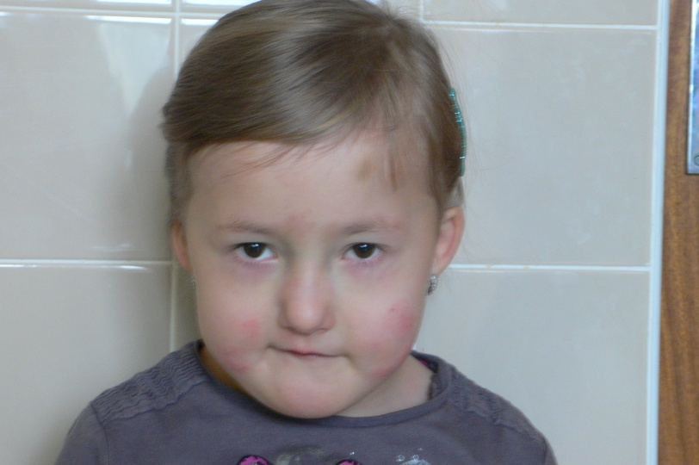
Facial dysmorfia in diGeorge syndrome

Slide 29
Combined T cell and B cell deficiencies

Slide 30
V. Immunodeficiency with immune dysregulation
a/ X-linked lymphoproliferative syndrome (XLP)
Abnormal immune response to EBV infection which leads to uncontroled lymphoproliferation
Disorder of gene localized on X chromosome - mutation of gene coding protein associated with signal activating molecule of lymphocytes SLAM (SAP) or inhibitor of apoptosis (XIAP)
Development of uncontroled lymphoproliferation and NK cell disorder
EBV infection with fulminant or fatal course leading to liver failure → surviving patients are at risk of B cell lymphoma development, hypogammaglobulinemia similar to CVID or aplastic anemia
Without BMT performed before EBV infection development, XLP is fatal sooner or later

Slide 31
V. Immunodeficiency with immune dysregulation
b/ Chronic mucocutaneous candidiasis
Primary immunodeficiency manifesting by recurrent infections of mucous membranes and skin caused by Candida in consequence of T cell disorder
Sometimes candidiasis combined with alopecia and polyendocrinopathy (APECED = Autoimmune PolyEndocrinpathy-Candidiasis-Ectodermal Dystrophy)
Mutation of genes STAT1, IL17RA etc.
Treated with antimycotics, ev.by substitution of lacking hormones

Slide 32
VI. Well-defined syndromes with immunodeficiency
a/ HyperIgE syndrome (HIES, Job’s syndrome)
Eczema + combined immunodeficiency manifesting by recurrent abscesses (cold abscesses) + recurrent sinopulmonary infections
More common AD form caused by mutation of STAT3 gene (Signal Transducer and Activator of Transcription 3), less common AR form caused by mutation of DOCK8 gene (Dedicator Of CytoKinesis 8)
Symptoms: onset frequently in infancy
recurrent staphylococcal abscesses of skin, lungs, joints or internal organs
recurrent sinopulmonary infections, pneumatocele
severe atopic eczema
in AD form: skeletal disorders (facial asymmetry, prominent forehead, broad nasal
bridge, spontaneous bone fractures, osteopenia), delayed dental erruption

Slide 33
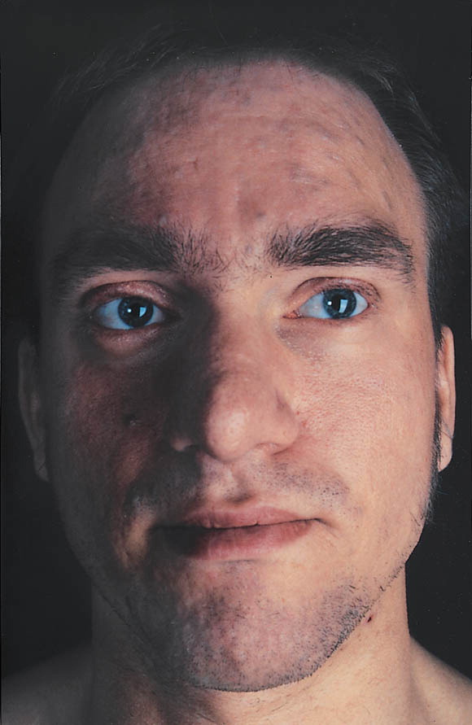
Typical facial features in HIES

Slide 34
VI. Well-defined syndromes with immunodeficiency
a/ HyperIgE syndrome (HIES, Job’s syndrome)
Symptoms: in AR form, recurrent viral infections (herpetic), increased
frequency of autoimmune or allergic diseases, skeletal
disorders often absent
Dg: clinical features
enormously increased level of serum IgE (˃ 2000 IU/ml)
genetic tests
Th: prophylaxis with anti-staphylococcal ATB
dermatological therapy of eczema
surgical treatment of abscesses

Slide 35
VI. Well-defined syndromes with immunodeficiency
b/ Wiskott-Aldrich syndrome (WAS)
X-linked recessive disease
Decreased number of small platelets (microthrombocytopenia), eczema and immunodeficiency
Mutation of WASp gene → decreased production of WASp protein (exprimed on hematopoietic cells, provides dynamic changes of cytoskeleton which are necessary for function of immune cells)
Symptoms: combined immunodeficiency: decreased Ig levels (↓IgM; ↑IgA
and IgE) + defects of T cell function → recurrent otitis and
sinusitis, autoimmune diseases
thrombocytopenia → increased bleeding

Slide 36
VI. Well-defined syndromes with immunodeficiency
b/ Wiskott-Aldrich syndrome (WAS)
Dg: clinical symptoms
proof of decreased expression of WASp on leukocytes
genetic tests
Th: symptomatic treatment
in case of matched donor BMT
studies of gene therapy

Slide 37
VI. Well-defined syndromes with immunodeficiency
c/ Ataxia-teleangiectasia
AR disease – mutation of gene ATR (11q22-q23) →
defect of ATM proteinkinase → defective mechanisms
of DNA reparation → increased sensitivity to ionizing
radiation → ↑susceptibility to develop malignancies
Symptoms: ataxia + teleangiectasia
↓IgA+E → recurrent sinopulmonary infections
hypoplasia of thymus a lymph nodes
Th: symptomatic

Slide 38
Immunoglobulin replacement therapy
Immunoglobulin concentrates are made from human plasma pooled from thousands of donors
Donors are tested for infectious diseases (HIV, hepatitis), inactivating procedures to minimize the risk of transmitting infection
Ig concentrates contain only IgG, content of IgA is minimal
Preparates for i.v. (Gammagard, Octagam) or s.c. administration (Subcuvia, Gammanorm)

Slide 39
Indications for Ig replacement therapy
Primary antibody deficiencies (IVIG) – life-long in XLA or CVID, transitory in combined immunodeficiencies (SCID)
IgG subclasses or specific Ig deficiency is sometimes also indication
Secondary antibody deficiencies – typically B cell leukemia, lymphoms

Slide 40
Dosage of Ig concentrates
Agammaglobulinemia – i.v. imunoglobulins 400-600 mg/kg/month
Regular administration in day-care centres every 3 or 4 weeks
Last years, „home therapy“ is frequently used - administration of subcutaneous Ig by infusion pump (cca every 5 to 7 days, more comfortable for patient, less adverse effects)

Slide 41
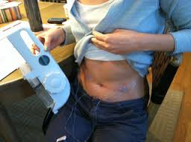
Administration of subcutaneous Ig by infusion pump

Slide 42
Adverse effects of the treatment
Allergic reactions, anaphylaxis
In less severe reactions (shivers, headache), slowing down the infusion is usually sufficient
Sometimes, premedication with intravenous corticosteroids is necessary
Change of preparate (lower content of IgA)

Slide 43
Secondary immunodeficiencies

Slide 44
Secondary immunodeficiencies
Acute and chronic viral infections – infectious mononucleosis, influenza
Metabolic disorders – diabetes mellitus, uremia
Autoimmune diseases – autoantibodies against immunocompetent cells (neutrophils, lymphocytes); autoimmune phenomena also after administration of certain drugs (e.g. oxacilin, quinidine)
Allergic diseases
Chronic GIT diseases
Malignant diseases (leukemia)
Hypersplenism/asplenia
Burn, postoperative status, injuries
Severe nutritional disorders
Chronic infections
Ionizing radiation
Drug induced immunodeficiencies (chemotherapy)
Immunosupression
Chronic stress
Chronic exposure to harmful chemical substances

Slide 45
Secondary immunodeficiencies
Splenectomy – deficiency in generation of antibodies against encapsulated microorganisms (Pneumococci, Neisseria)
A loss of immunoglobulins – nephrotic syndrome
- lymphangiectasies
Lymphomas, myelomas, CLL

Slide 46
Acquired ImmunoDeficiency Syndrome (A.I.D.S.)
Caused by Retrovirus HIV 1 or HIV 2
Current incidence 37 mil.people, predominantly in central Africa, 2mil. of new infections per year, 1.2 mil. deaths per year
CZ:10/14 - HIV+ 2330, AIDS 423, deaths 310
Virus has a tropism for cells bearing CD4 (CD4+ T helper cells); also affects macrophages and CNS cells
Virus uses for entering into cells CD4 receptor and some chemokine molecules (CCR5 and CXCR4)
Viral genome transcribes into human DNA by using reverse transcriptase and infected cell provides viral replication
Transmission: sexual contact
body fluids (blood and blood products)
mother-to-child (prenatal, delivery, breast-
feeding)

Slide 47
Acquired ImmunoDeficiency Syndrome (A.I.D.S.)
Phases:
acute - 3 to 6 weeks after primoinfection
- flu-like symptoms or asymptomatic
asymptomatic - months or years
- viral replication, loss of Th cells
symptomatic - decrease of Th cells
- fevers, weight loss, anorexia
- infections (oropharyngeal candidiasis), autoimmune
disorders, malignancy, allergy
AIDS - systemic breakdown,
- opportunistic infections: pneumocystis pneumonia,
Cryptococcus, Mycobacteria, Toxoplasmosis etc.
- neoplasms (Kaposi’s sarcoma, Burkitt’s lymphoma)

Slide 48
Acquired ImmunoDeficiency Syndrome (A.I.D.S.)
Diagnosis:
Serology - specific antibodies, 4 to 12 weeks after primoinfection
Measurement of antigen p24 – before seroconversion
Viral RNA measurement – before seroconversion, PCR testing
Th cells counts
Therapy:
- HAART (Highly Active Antiretroviral Therapy) – combination of nucleoside (Zidovudine) and non-nucleoside (Nevirapin) reverse transcriptase inhibitors and protease inhibitors (Lopinavir)

Slide 49
Acquired ImmunoDeficiency Syndrome (A.I.D.S.)
Therapy:
Prophylaxis with antibiotics and antimycotics
TBC prevention (isoniazid)
Ig replacement

