Slide 1
HLA system, antigen-presenting cells,
B cells, primary and secondary immune organs, mucous immune system
Martin Liška

Slide 2
HLA system
(MHC glycoproteins)

Slide 3
MHC glycoproteins class I
(Major histocompatibility complex)
The function of MHC I gp is presentation of intracellular peptide fragments (which are produced by cell, including viral peptides) on the cell surface to T cells (cytotoxic CD8+)
MHC I is exprimed on all nucleated cells of the organism
3 isotypes of classical human MHC I gp. (HLA - A,-B,-C)
3 isotypes of nonclassical MHC I gp. (HLA - E,-F,-G;
molecule CD1)

Slide 4
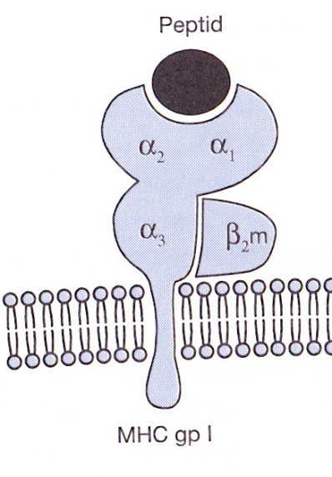
Structure of MHC gp I
MHC gp class I consists of transmembrane
chain α and non-covalently associated
β₂mikroglobulin
α chain has 3 domains, 2 N-terminal (α1, α2 - binding site for peptides) and 1 C-terminal domain (α3 - anchored in the cytoplasmic membrane, a structure similar to immunoglobulin domain)
Binding of peptide is necessary for a stable conformation of MHC gp and thus ensure its long presentation on the cell surface

Slide 5
Peptides binding to MHC gp I
MHC gp I bind peptides with a length of 8 to 10 aminoacids
Certain MHC gp molecule binds peptides sharing common structural features - coupling motif (critical are aminoacids near to the end of peptide)
The binding of endogenous peptides takes place in the endoplasmic reticulum during biosynthesis of MHC gp

Slide 6
Peptides binding to MHC I gp
After α chain and β₂microglobulin are created in the ER, they fold into the correct conformation, followed by their mutual association and the association with an appropriate peptide; then complex is further processed in the Golgi apparatus and presented on the cell surface
Linked peptides derived from proteins degraded in proteasome, which cleaves cytoplasmic proteins for destruction (labeled with ubiquitin), peptide fragments are transported into the ER by specific membrane pump

Slide 7
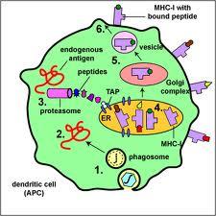
Peptides binding to MHC I gp

Slide 8
Non-classical MHC I gp
HLA - E,-F,-G; CD1 molecules
Structurally similar to classical MHC gp
Are less polymorphic
There are expressed only on some cells
They specialize in binding of specific ligands

Slide 9
HLA-E and HLA-G – expressed on trophoblast
Complexes of HLA-E and HLA-G with peptides are recognized by inhibiting receptors of NK cells and contribute to the tolerance of the fetus in utero
CD1 molecules - bind glycolipids (recognized by NK-T lymphocytes)

Slide 10
MHC glycoproteins class II
Expressed by APC (dendritic cells, monocytes, macrophages, B lymphocytes)
3 isotypes of MHC II gp (DP, DQ, DR)
The function of MHC II gp is the presentation of peptide fragments from protein which were engulfed by antigen presenting cell to T cells (CD4+)

Slide 11
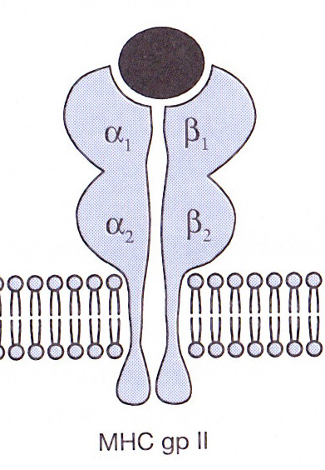
Structure of MHC II gp
MHC gp II consist of 2 non-covalently
associated transmembrane subunits
α and β
The peptide binding site consists of N-terminal
domains α1 and β1
Binding of peptide is necessary for a stable MHC gp conformation and thus ensure its long presentation on the cell surface

Slide 12
Binding of peptides to MHC II gp
MHC II gp bind peptides with a length of 15 to 35 aminoacids
Certain MHC gp molecule binds peptides sharing common structural features - coupling motif

Slide 13
Binding of peptides to MHC II gp
After a string α and β are created in ER, they fold into the correct conformation and the mutual associated are connected with another transmembrane chain (invariant chain), which blocks the binding site for the peptide
This complex is processed in the Golgi apparatus, secretory vesicles isolated from GA merge with endosomes, then split the invariant chain and peptide fragments from cell absorbed proteins bind into binding site of MHC gp
The complex is then displayed on the cell surface

Slide 14
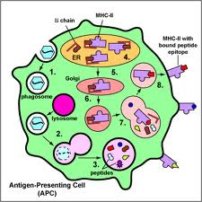
Peptides binding to MHC II gp

Slide 15
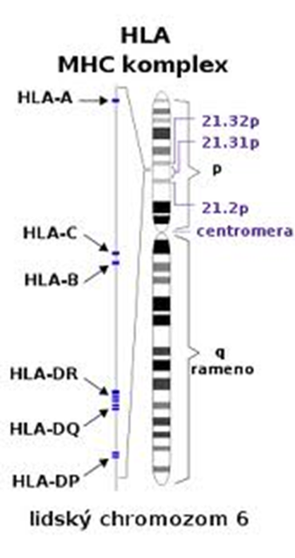
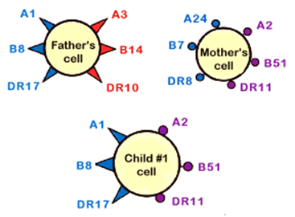
HLA system – genetic background
HLA complex is encoded
on chromosome 6
Codominant inheritance of HLA
( Individual has 3 cell surface isotypes
of HLA molecules (HLA-A,-B,-C) mostly
in 2 different allelic forms )

Slide 16

Polymorphism of MHC glycoproteins
MHC gp are highly polymorphic (except the non-classical MHC gp)
Polymorphism is important both for individual and for population
Polymorphism MHC gp causes complications in transplantations

Slide 17
Macrophages
Terminal stage of monocyte-macrophage line differentiation
Monocyte-macrophage cells differentiate from myeloid precursor (developed from pluripotent stem cell bearing CD34) in bone marrow
Mature monocytes are released to peripheral blood stream, then move in organs and develop into tissue macrophages

Slide 18
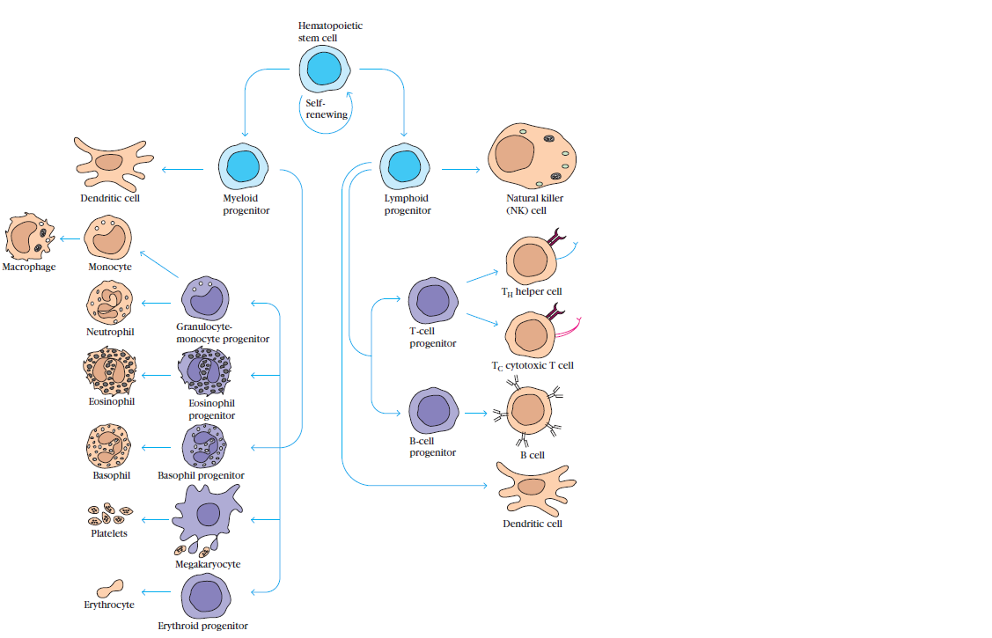

Slide 19
Development
of monocytes and macrophages is affected by various cytokines:
SCF(stem cell factor): produced by stromal cells → activation of stem cell
GM-CSF (granulocyte-monocyte colony stimulating factor): produced by bone marrow (BM) stromal cells, lymphocytes → stimulation of monocyte production
M-CSF (monocyte colony stimulating factor): produced by stromal cells, lymphocytes, endothelial and epithelial cells → production and maturation of monocytes
IL-3: produced by lymphocytes → production of monocytes (and other blood cells)

Slide 20
Macrophages- development
Monocytes- in the blood (7%) and the rest in bone marrow
Macrophages - in tissues

Slide 21
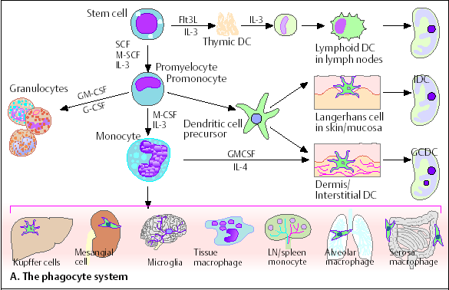

Slide 22
Macrophage surface molecules
MHC gp I, II assist in the presentation of antigen to T lymphocytes
CD 35 - complement receptor 1 (CR 1), binds component C3b
Receptor for the Fc portion of IgG
CD 14 - receptor for bacterial lipopolysaccharides

Slide 23
Cytokines produced by macrophages
IL- 1 α, ß - stimulate both T and B cells, Ig synthesis, activation of other macrophages, sensitizing cells to IL-2 and IFN
TNF- α - similar in function to IL-1
IL- 8 - secreted by activated macrophages
- chemokine attracting neutrophils and T cells
IL-12 - promotes induction of Th1 cells, inhibits Th2 cells
IFN- α- activates host cells to induce enzymes inhibiting viral replication; increases expression of MHC gp I on host cells; activates NK cells, T cells, other macrophages

Slide 24
Functions of macrophages
Phagocytosis
Production of cytokines
Presentation of epitops with MHC gp II
Presentation of epitops with MHC gp I

Slide 25
Phagocytosis
a foreign substances are ingested
microbes are killed and digested
follows processing of antigenic epitopes and their presentation on the cell membrane

Slide 26
Macrophage - functions
Macrophages provide defense against tumor cells and human cells infected with fungi or parasites.
T cell becomes an activated effector cell after recognition of an antigen on the surface of the APC → release chemical mediators → stimulation of macrophages

Slide 27
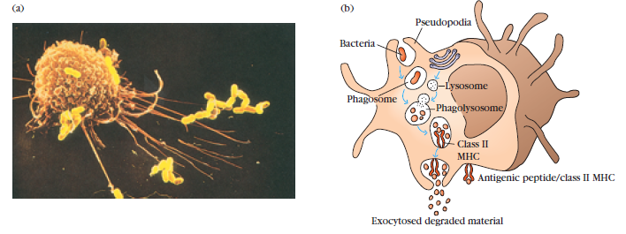

Slide 28
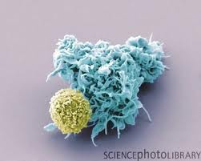
Dendritic Cells (DC)
DC mature after a contact with pathogen, then migrate to lymph nodes where antigen-specific immune response develops
DC are equipped with numerous cytoplasmic processes, allowing contact with up to 3000 T cells
In lymph nodes, the expression of MHC gp I and co-stimulatory molecules (CD80, CD86) on DC increases

Slide 29
Types of Dendritic Cells
Myeloid DC
– similar to monocytes
– give rise to Langerhans cells (epidermis), interticial DC (lymph nodes)
Lymphoid DC
– give rise to plasmocytoid DC - looks like plasma cells, but have certain characteristics similar to myeloid cells, they produce huge amounts of interferons

Slide 30
Function of DCs
DCs are the most important APC
DCs can be easily infected by viruses → processing of viral proteins → their presentation in complex with MHC gp I → activation of Tc
DCs can ingest extracellular viral particles → their presentation in complex with MHC gp II → activation of Th2 cells → help for B cells → production of antiviral antibodies
DCs can also be activated by apoptotic cells

Slide 31
B-lymphocytes - ontogenesis, surface markers, function.

Slide 32
B-lymphocytes
are an essential component of the adaptive immune system
Maturation of B cells takes place in BM
B cell originates from stem cell and need to be in touch with the stromal cells in the bone marrow
Stromal cells produce SCF (stem cell factor) necessary for development at early period, IL-7 necessary at later period of maturation
Ig gene rearrangements and the appearance of surface markers identify the stage of B-cell development

Slide 33
Development of B lymphocytes
Lymphoid progenitor → pro-B cells
During maturation from pro-B cells into pre-B cells: Ig genes of the heavy chain recombine; pre-B cells express pre-BCR
During maturation from pre-B cells into B cells: Ig genes of the light chain recombine
Immature B cells express membrane IgM
Mature B cells express membrane IgM and IgD = BCR and are able to respond to antigen in peripheral lymphoid tissues

Slide 34
Negative selection
If an immature B cell binds an antigen in the bone marrow with high affinity → further maturation is stopped and B cell dies by apoptosis
Negative selection eliminates potentially dangerous cells that can recognize and react against self antigens
B cells that survive this selection process leave the bone marrow through efferent blood vessels

Slide 35
B-lymphocytes – surface markers
CD 10 - immature B cells, malignant cells
CD 35 - receptor for the C3b of the complement
CD 19 - characteristic marker of B cells
CD 20 - typical surface antigen of Ig-positive B lymphocytes
IgM, IgD - antigen receptors = BCR
MHC gp II - antigen-presenting molecules

Slide 36
B-lymphocytes – functions
After stimulation B lymfocytes convert into the plasma cells and produce antibodies against soluble antigens
Other functions are :
antigen presentation
cooperation with complement
system

Slide 37
Primary immune organs and their role in the immune system.

Slide 38
Primary immune organs
Bone marrow
Thymus
are organs of development, differentiation and maturation of immune cells and elimination of autoreactive cells
T and B lymphocytes mature and become competent to respond to antigens in PIOs

Slide 39
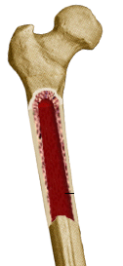
Bone marrow
Localized in bone cavity, the site of generation of all circulating blood cells in adults, including immature lymphocytes, and the site of B cell maturation.
The pluripotent stem cell gives rise to the progenitors of all immune cells
Production of the cells takes place in the spaces divided by vascular sinuses
Endothelial cells of the sinuses and stromal produce cytokines
Sinuses are lined by reticular cells

Slide 40
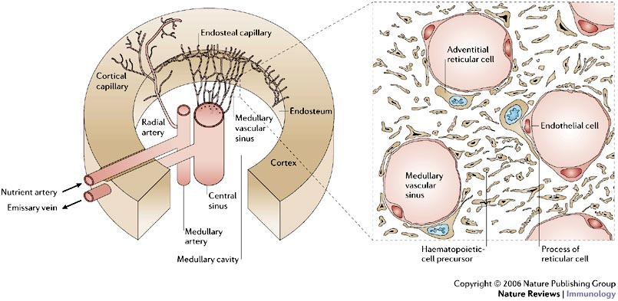

Slide 41
Differentiation in the BM
Differentiation from the stem cell is influenced by:
membrane interaction between the stem
cells and the stromal cells
cytokines (SCF, IL-3, thrombopoetin,
erythropoetin)

Slide 42
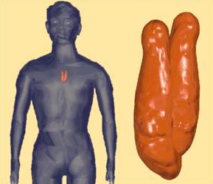
Thymus
is localized between the sternum and the major vessel trunks
It consists of two lobes
Each lobe is surrounded by a capsule and is divided into lobules, which are separated from each other by strands of connective tissue = trabeculae

Slide 43
Structure of the thymus
Each lobule is organized into two compartments:
the cortex (outer compartment) – contains proliferating lymphocytes
the medulla (inner compartment) - mature lymphocytes, Hassall´s corpuscles

Slide 44
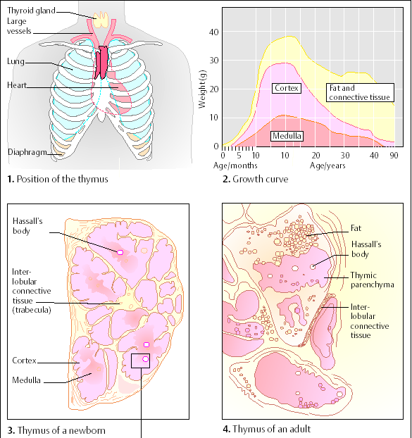

Slide 45
Thymus - morphology
Various kinds of stromal cells:
thymic epithelial cells – production of thymulin, thymopoetin, thymosin that influence the maturation of T cells
dendritic cells
macrophages
The thymus contain a large number of blood vessels and efferent lymphoid vessels that drain into the mediastinal lymph nodes

Slide 46
Positive and negative selection of T cells
Thymus is a site o T cell differentiation (TCR – gene rearrangement)
Immature thymocytes undergo a process of selection, based on the specificity of their T cell receptors.
This involves selection of T cells that are functional (positive selection), and elimination of T cells that are autoreactive (negative selection)

Slide 47
Secondary immune organs - structure and function of lymphatic node and spleen.

Slide 48
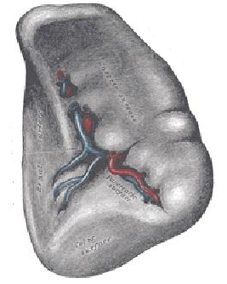
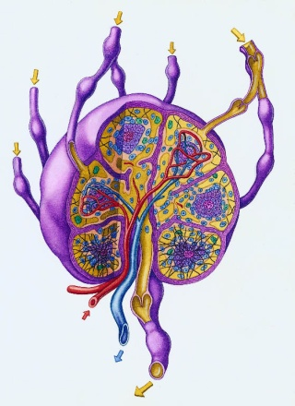
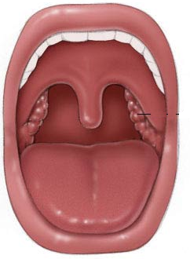
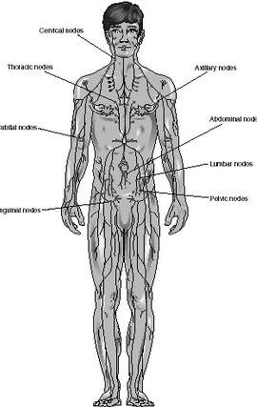
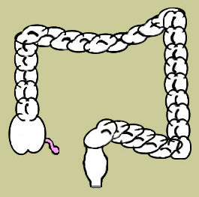
Secondary immune organs
consist of the spleen, the lymph nodes, the mucosal and cutaneous immune system
are organized to optimize interactions of antigens, APCs and lymphocytes
are places of the development of adaptive immune responses
lymph
nodes
Peyer´s
patches
spleen
tonsils
MALT
appendix

Slide 49
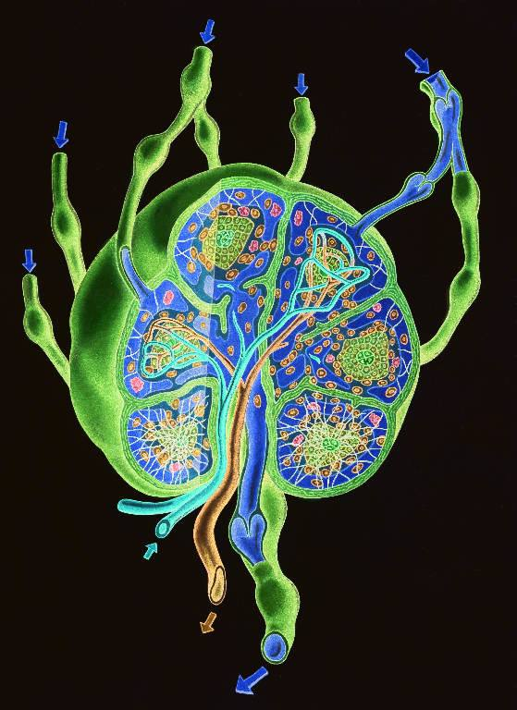
Lymph node
Lymph nodes are nodular aggregates of lymphoid tissues located along lymphatic channels throughout the body
Lymph flows infrom tissues and most parenchymal organs to the lymph nodes
Lymph contains a mixture of substances absorbed from epithelia and tissues
As the lymph passes through lymph nodes, APCs in the LN are able to sample the antigens of microbes that may enter through epithelia into tissues

Slide 50
Lymph node
lymph circulates to the lymph node via afferent lymphatic vessels and drains into the node just beneath the capsule in a space called the subcapsular sinus
the subcapsular sinus drains into trabecular sinuses and finally into medullary sinuses
the sinus space is criss-crossed by the pseudopods of macrophages which pick up foreign particles and filter the lymph
the medullary sinuses converge at the hilum and lymph then leaves the lymph node via the efferent lymphatic vessel

Slide 51
Lymph node - medulla
The medullary cords are cords of lymphatic
tissue, and include plasma cells and T cells
The medullary sinuses are vessel-like spaces
separating the medullary cords; contain
histiocytes (= immobile macrophages) and
reticular cells.
Lymph flows to the medullary sinuses from
cortical sinuses, and into efferent lymphatic
vessels

Slide 52
Lymph node - cortex
Contains lymphoid follicles = accumulation of B-lymphocytes and follicular dendritic cells
When a lymphocyte recognizes an antigen, B cells become activated and migrate to germinal centers = to the secondary nodule

Slide 53
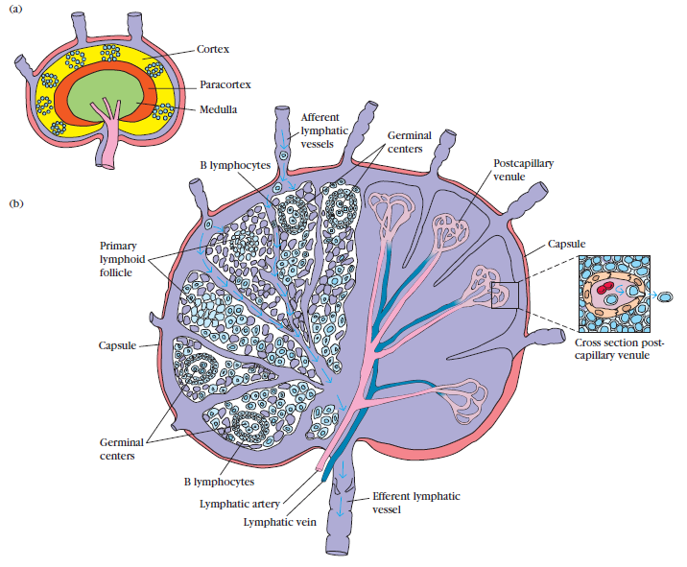

Slide 54
Spleen
is a secondary lymphoid organ located high in the left abdominal cavity
is surrounded by a capsule, which sends trabeculae into the interior to form a compartmentalized structure
there are two types of compartments -red pulp and white pulp with a marginal zone in between
is NOT supplied by afferent lymphatics

Slide 55
Spleen
Red pulp : place of mechanical filtration and elimination of senescent red and white blood cells and microbes
White pulp : T lymphocytes CD4+,CD8+ are around arterioles (periarteriolar lymphoid sheaths), B lymphocytes are in the follicles; final maturation of B lymphocytes course in germinal center of secondary follicles

Slide 56
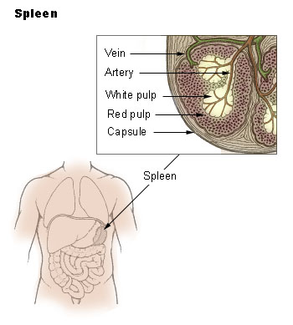

Slide 57
Mucosal immune system
MALT = mucosa-associated lymphoid tissue
GALT = gut-associated lymphoid tissue
BALT = bronchus-associated lymphoid tissue
GIT, respiratory, and urogenital systems are lined by mucous membranes
Includes clusters of lymphoid cells in lamina propria of intestinal villi
contains a very large population of plasma cells that synthesize IgA antibodies

Slide 58
M cells
are epithelial cells that are specialized for the transport antigen from the lumen of the respiratory, GIT, and urogenital tracts to the underlying MALT
contain a characteristic pocket filled with B cells, T cells, and macrophages
are found at inductive sites that overlie organized lymphoid follicles in the lamina propria
antigens are endocytosed and transported within vesicles from the luminal membrane to the pocket membrane, where the vesicles fuse and deliver their contents to antigen-presenting cells

Slide 59
Secretory IgA
daily production of secretory IgA into mucus secretions exceeds that of any other class of immunoglobulin (5-15 g each day)
is an important line of defense for mucosal surfaces against bacteria
binding of secretory IgA to bacteria and viruses also prevents attachment to mucosal epithelial cells, thereby inhibiting infection and colonization

Slide 60
