Slide 1
Antigen presenting cells,
T cells, B cells, primary and secondary immune organs, mucosal immune system
Martin Liška

Slide 2
Antigen presenting cells

Slide 3
Antigen presenting cells
A. Professional
- Expression of MHC class I and II gp.
Monocytes, macrophages, dendritic cells and B cells
B. Non-professional
Expression of MHC class I gp.; expression of MHC class II gp. when induced by pro-inflammatory cytokines
fibroblasts, endothelial and epithelial cells

Slide 4
Monocytes
Differentiate from myeloid precursor (differentiated form hematopoietic stem cell (CD34+)) in bone marrow
Continuously released from bone marrow to periphery
7% in blood circulation; the rest is located in bone marrow or spleen – the proportion is influenced by cytokines and bacterial products
Monocytes adhere to vessel wall by using β1-integrins binding to VCAM-1 on endothelial cells

Slide 5
Monocytes
Then, monocytes move among vessel endothelial cells to tissues
In tissues, they differentiate into different subtypes of tissue macrophages (Kupffer cells, microglia, alveolar macrophages etc.)

Slide 6
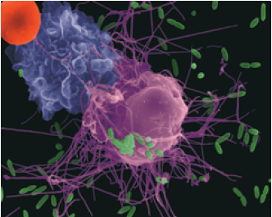
Macrophages
Terminal stage of differentiation of monocyte-macrophage cell line
Mature monocytes are released to peripheral blood stream, then catched in organs and differentiate to tissue macrophages
There are different subpopulations of macrophages in different tissues

Slide 8
Subtypes of macrophages
Kupffer cells – liver
Alveolar macrophages - lungs
Microglia – CNS
Osteoclasts – bone
Histiocytes – connective tissue
Mesangial cells - kidney

Slide 9
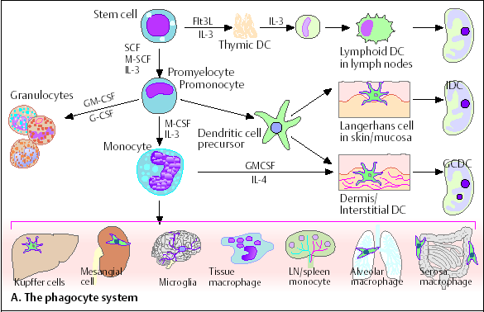

Slide 10
Cytokines influencing the development of macrophages
SCF (Stem Cell Factor) – produced by stromal cells → development and maintenance of hematopoietic stem cell function
GM-CSF (Granulocyte-Monocyte Colony Stimulating Factor) – produced by bone marrow stromal cells, lymphocytes → stimulation of monocyte differentiation
M-CSF (Monocyte Colony Stimulating Factor) – produced by stromal cells, lymohocytes, endothelial and epithelial cells → stimulation of monocytes differentiation
IL-3 – produced by lymphocytes → monocyte (and other cells) differentiation

Slide 11
Macrophage surface markers
MHC class I and II gp.
CD35 - CR1 receptor for C3b fragment of complement system
Fc receptor for IgG
CD14 – receptor binding bacterial lipopolysaccharides
Receptors recognizing apoptotic cells

Slide 12
Macrophages - function
Proffesional antigen presenting cells (APC) – presentation of Ag at an early stage of the specific immune response
Phagocytes – uptake of microbes and old or damaged own cells
Completely functional when activated by cytokines produced by T cells (IFN-γ)
Production of cytokines, enzymes, complement system components, microbicidal, cytotoxic and tumoricidal substances, bioactive lipids (PG,PC,TX,LT)

Slide 13
Cytokines produced by macrophages
IL-1α and β – stimulation of T and B cells, activation of the other macrophages
IL- 6 – endogenous pyrogen, activator acute phase proteins synthesis in liver
TNFα – similar function to IL-1

Slide 14
Cytokines produced by macrophages
IL-8 – secreted by activated macrophages, induce chemotaxis of neutrophils, T cells
IL-12 – induction of Th1 response, supression Th2 response
IFN-α – induction of production of enzymes inhibiting virus replication, increases expression of MHC class I gp. by host cell, activation of NK cells,T cells and the other macrophages

Slide 15
Dendritic cells (DCs)
Differentiate from myeloid or lymphoid precursor
DCs are the most important APCs
Migration of DCs precursors to tissues is influenced by chemokines (RANTES, MCP-1, MIP-1a, MIP-1b)
DCs are dispersed in all tissues and organs

Slide 17
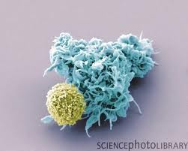
Dendritic cells (DCs)
Upon contact with antigens, they mature and migrate
to secondary immune organs where induce antigen-specific immune response
Expression of MHC class I and II gp., co-stimulatory ligands and adhesive molecules necessary for activation of naïve T cells
DCs have numerous processes enabling contact with up to 3000 T cells
In lymph nodes, DCs increasing expression of:
    MHC class I and II gp. + co-stimulatory molecules (CD80, CD86)

Slide 18
Types of DCs
Langerhans cells – from myeloid line, in epidermis
Interstitial DCs – from myeloid line, in dermis and most of organs
Lymphoid (plasmocytoid) DCs – form lymphoid line, in blood and secondary immune organs
Follicular dendritic cells (FDCs) – presentation of antigen to B cells during secondary immune response

Slide 19
Surface markers of DCs
Receptors for IgG, IgE and C3b – enable internalization of immune complexes
Pattern Recognition Receptors - TLR and CD14 (= receptor for LPSs)
Receptors recognizing apoptotic cells
Molecules important for presentation of antigen - mature DCs exprime MHC class I and II gp. and co-stimulatory molecules CD80 and CD86

Slide 20
Function of DCs
DCs are the most important APCs
DCs can be easily infected by viruses → viral proteins processed in a complex with MHC class I gp. → activation of Tc cells
DCs are able to internalize extracellular viral particles → viral peptides presented in a complex with MHC class II gp. → activation of Th2 cells → help to B cells → production of anti-viral antibodies
DCs can also be activated by apoptotic cells

Slide 21
B cells

Slide 22
B cells
B cells are responsible for specific antibody-mediated immune response
B cells recognize native antigen by using BCR
(B cell receptor) = surface bound IgM (or IgD)
Such B cell is stimulated to proliferation and differentiation to effector (plasma) cells producing huge amount of antibodies of the same specifity like BCR
Part of stimulated B cells differentiate to memory cells

Slide 23
Surface markers of B cells
CD19 - typical B cell surface marker
CD20 – expressed on the surface of Ig-positive B cells
IgM, IgD - BCR
MHC class I and II gp. - antigen presenting molecules
CD40 – co-stimulatory receptor

Slide 24
Differentiation of B cell
B cell differentiation begins in bone marrow and completes in secondary
immune organs after contant with an antigen
Hematopoietic stem cell
B cell progenitor → start of recombination processes → many clones
of B cells with distinct BCR
Pre B cell → expression of pre-B receptor (H(μ) chain and surrogate L chain)
Immature B cell → expression of surface IgM (BCR)
elimination of autoreactive clones
Mature B cell → expression of surface IgM or IgD (BCR)

Slide 25
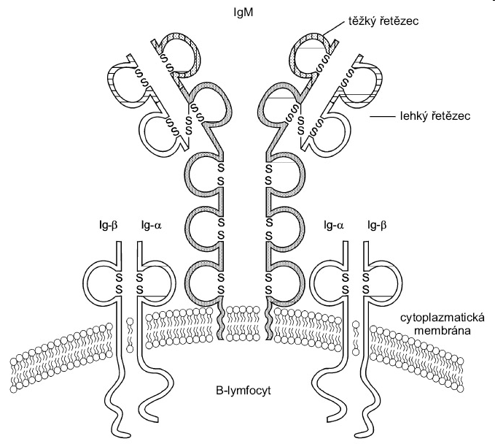
BCR
BCR consists of surface immunoglobulin (IgM, IgD –
H chains are membrane-bound; recognition of Ag) and associated signalling molecules (Igα and Igβ) which are associated with cytoplasmic protein tyrosin-kinases (PTK) Src
If Ag binds simultaneously to 2 or more BCRs → PTKs draw closer → mutual phosphorylation of PTKs → phosphorylation of other cytoplasmic proteins → changes in gene transcription → proliferation, differentiation of B cell → secretion of antibodies
heavy chain
light chain
cytoplasmic membrane
B cell

Slide 26
Elimination of autoreactive clones of B cells
Recombination processes could give arise the clones of B cells who bear autoreactive BCRs and produce autoreactive antibodies
Majority of autoreactive B cells is eliminated at stage of immature B cell – if they bind autoantigen by their BCR with a sufficient afinity, then they receive signal leading to apoptosis
If some autoreactive clones pass through elimination proces, then it does not manifest – lack of suitable T_{H} cells, many autoantigens are cryptic, or they are in low concentrations → ignored

Slide 27
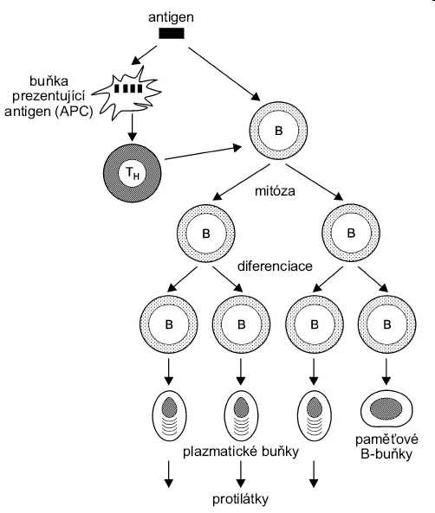
Meeting of B cell with an antigen in secondary immune organ
antigen presenting cell
mitosis
differentiation
plasma cells
memory
B cells
antibodies

Slide 28
Function of B cells
Antibody response
Immunological memory
Presentation of antigen – B cells are able to pick-up exogenous antigens by using BCR (typically allergens or toxins), to internalize them by endocytosis and to present them with MHC class II gp. to T_{H} cells

Slide 29
Primary immune organs

Slide 30
Primary immune organs
Bone marrow, thymus
Sites of inception, maturation and differentiation of immunocompetent cells
Immature lymphocytes get there their antigenic specifity

Slide 31
Bone marrow
Site of haematopoiesis in postnatal period
Localized in flat bones (pelvis, scapula, sternum, ribs) or in cancellous material of epiphysis of long bones
Consists of cells, extracellular matrix and blood vessels
Blood cells differentiate from hematopoietic stem cell in regions bordered by vascular sinuses
Sinuses lined with endothelial cells producing cytokines
Outer wall of sinuse bordered by reticular cells

Slide 32
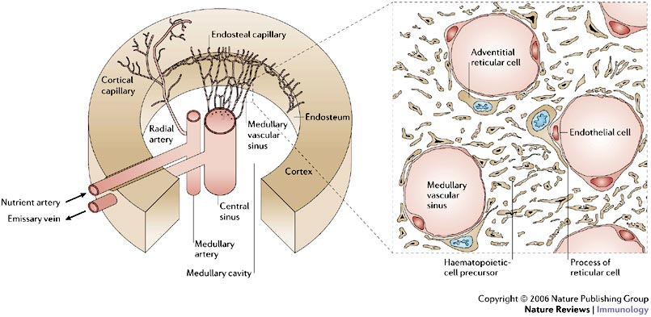

Slide 33
Immune cells (immunocytes)
Haematopoiesis starts in yolk sac, then it moves to fetal liver and spleen (3th to 7th month of gestation)
The main site of postnatal haematopoiesis is bone marrow
All blood cells differentiate from hematopoietic stem cell (HSC)(CD34+).
HSC proliferates and maintains throughout whole life
Haematopoiesis is controlled by cytokines secreted by stromal cells, activovated T_{H} cells and macrophages

Slide 34
Haematopoiesis in bone marrow
Differentiation from HSCs (CD34+ CD45+) – is regulated by membrane interactions between HSCs and stromal cells + cytokines (SCF, IL-3, thrombopoietin, erythropoietin)
Differentiation from less differentiated precursors to more differentiated stages
Haematopoiesis react to momentary needs of macroorganism

Slide 35
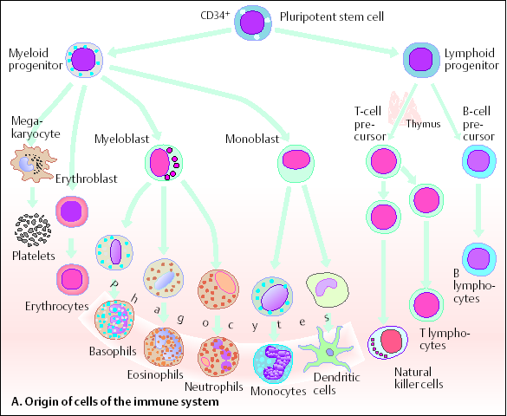

Slide 36
Thymus
Site of T cell differentiation
2 lobes consisting of cortex (cluster of lymphocytes = rapidly proliferating cells) and medulla (mature cells, Hassall’s corpuscles) separated by corticomedulary junction
In cortexu and corticomedullary junction, there are macrophages and dendritic cells influencing the differentiation of thymocytes

Slide 37
Thymus
Differentiation is regulated by thymic hormones (thymulin, thymopoietin, thymosin) secreted by thymic epithelial cells and the other growth factors (SCF, IL-7)
Proliferation and differentiation of T cells in thymus → development of TCR → negative and positive selection of T cells
Thymus – induction of tolerance of own antigens

Slide 38
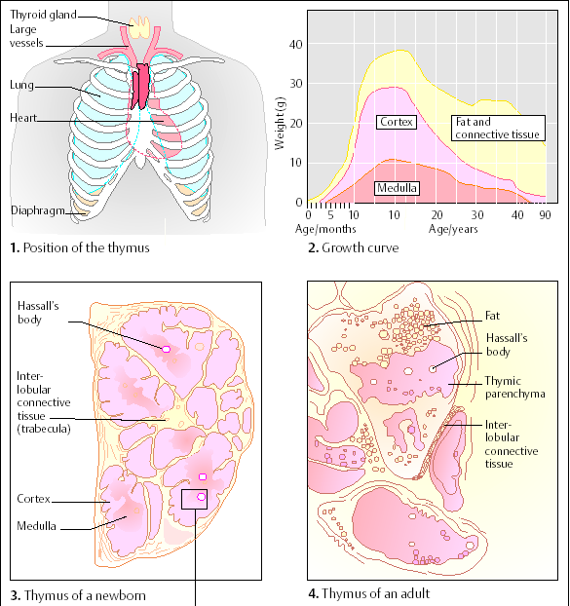

Slide 39
Secondary immune organs

Slide 40
Secondary immune organs
„Meeting-point“ of immunocompetent cells and antigens
Proliferation of immunocompetent T and B cells
Terminal differentiation of lymphocytes to effector cells

Slide 41
Secondary immune organs
Spleen – in comparison to lymph nodes, spleen filtrates the blood and picks-up antigens
Lymph nodes – filtration of lymph, uptake of antigens
MALT (Mucosa Associated Lymphoid Tissue) – diffuse and organized lymphoid tissue, uptake of antigens passing through mucous membranes, their presentation and induction of immune response

Slide 42
Spleen and lymph nodes
Passage of the majority of circulating lymphoid cells
Uptake of microbial antigens from blood and lymph
Lobular structure with trabeculae
Stabilization by reticular connective tissue

Slide 43
Lymph nodes
Located along lymphatic vessels
Drainage of the skin and the other surface tissues - cervical, axillary, inguinal l.n.
Drainage of mucous membranes and internal organs - mesenterial, mediastinal, paraaortic l.n.
Convex side of lymph node – entrance of afferent lymphatic vessels (subcapsular sinus)
Hilum – entrance of afferent and efferent blood vessels, exit of efferent lymphatic vessels
Node is surrounded by fibrous capsule which forms trabeculae containing vessels and nerves

Slide 44
Lymph node - cortex
Contains primary and secondary follicles – outer portion more B cells, deeper layers more T cells
Paracortical region - T cells and accesory cells (macrophages, dendritic cells)
Dendritic cells enter to lymph nodes with processed antigen → antigen presentation to T cells OR antigen alone enters the lymph node → uptake by APCs → antigen processing → antigen presentation

Slide 45
Lymph nodes - medulla
Medullary cords surround medullary sinuses that run to hilum
B and T cells migrate from follicles and paracortical region to medulla together with plasma cells → efferent vessels → migration to tissues and organs
T and B cells - effector cells, a portion differentiates into memory cells
Efferent lymphatic vessels → ductus thoracicus → vena subclavia (blood circulation)

Slide 46
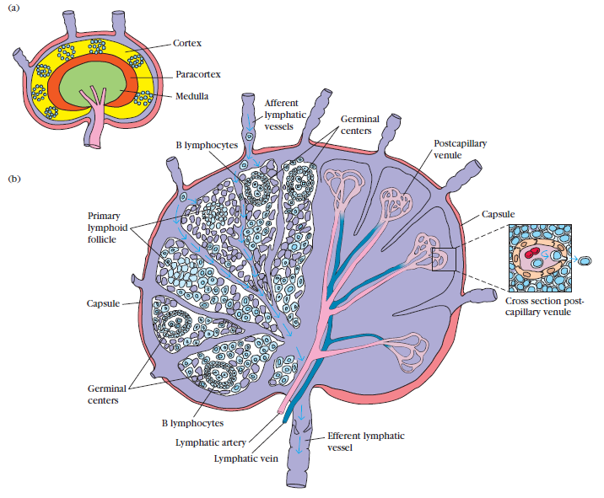

Slide 47
Spleen
Oval organ with lobular structure
Located in the left upper quadrant of abdomen
Consists of red and white pulp

Slide 48
Spleen - red pulp
Splenic sinuses between arteries and veins → filtration of blood
Marcophages remove from the blood old erythrocytes and leukocytes and microbial antigens
Elimination of immune complexes bound to erythrocytes

Slide 49
Spleen – white pulp
Lymphoid tissue located in periarteriolar lymphoid sheats and lymphoid follicles
In lymphoid follicles more B cells, in periarteriolar lymphoid sheats more T cells
Primary and secondary lymphoid follicles
Secondary follicles – germinal centre (isotype switching, somatic hypermutations → affinity maturation of B cells´ response)

Slide 51
Spleen - function
Filtration of blood – removal of old or damaged blood cells
Removal of immune complexes
Immune functions – specific cell-mediated and humoral immune response (affinity maturation, somatic hypermutations, isotype switching, response to T-independent antigens) – in case of absence or loss of spleen, vaccination against Pneumococci, Haemophilus, Neisseria is necessary
Reservoir of erythrocytes, lymphocytes and the other blood elements

Slide 52
Mucosa Associated Lymphoid Tissue (MALT)

Slide 53
Function and structure of mucosal and skin immune system
Mucosa and skin are in permanent contact with the environment, concentration of cca 80% immunocompetent cells
Skin – barrier against mechanical, physical and chemical damage and penetration of microorganism, in human cca 1.5 m²
Mucosal immune system – barrier against penetration of pathogenic micoorganisms, prevention of induction of self-damaging immune reactions against pathogens or harmless antigens from environment, cca 400 m²

Slide 54
Mucosal immune system
Mucous membrane of oral and nasal cavity, respiratory, gastrointestinal and urogenital tract, eye, ear etc.
Non-immunological defense mechanisms: mucociliary clearance, flow of the air and fluids, secretions of exocrinal glands with bactericidal effects (fatty acids, lysozyme, pepsin, defensins), low pH in stomach and urine

Slide 55
Structure of mucosal immune system
MALT (Mucosa Associated Lymphoid Tissue)
BALT (Bronchus Associated Lymphoid Tissue)
GALT (Gut Associated Lymphoid Tissue)
o-MALT (organized) – lymphoid follicles in submucosa; Waldeyer’s tonsilar ring, appendix, Peyer’s patches
d-MALT (diffuse) – leukocytes spread in lamina propria mucosae (T and B cells, macrophages, neutrophils, eosinophils, mast cells)

Slide 56
Intraepithelial T cells
Located mainly in villi of small intestine
Mostly bear TCRγδ and co-receptor CD8
Produce TGFβ (healing of mucous membrane)
Suppress undesirable immune reactions against food allergens (→ oral tolerance)

Slide 57
Humoral mechanisms of mucosal immune system
s IgA
Secretory immunoglobulin A
The most important mucosal immunoglobulin, also in breast milk
transcytosis – IgA is transported through epithelium by using transport Fc receptor (poly-Ig-receptor) → in luminal surface, IgA is cleaved-off together with portion of transport Fc-receptor (secretory component) which protects sIgA from gut proteases
Neutralization of antigens attacking mucous membrane; IgA does not activate complement system; IgA binds Fc receptors of phagocytes; IgA- containing immune complexes can be catched in Peyer’s patches and then induce immune response

Slide 58
Induction of mucosal immune reaction
Oral tolerance
* the majority of orally administered antigens induces suppression of specific immune response (a size of antigen is crucial)
* Treg cells (regulatory) – production of IL-10
Induction of mucosal immune reaction
M cells - specialized enterocytes ensuring transportation of Ag (endocytosis)
- in close contact with lymphocytes and APCs
Immunization in mucosa stimulates Th₂ and Th₃ cells and production of IgA

Slide 59
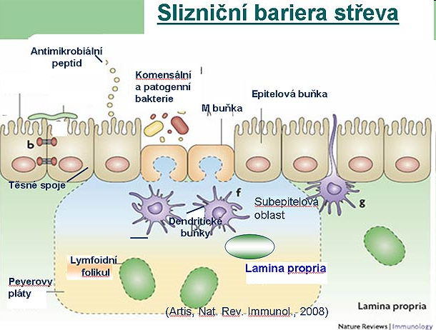
Mucosal barrier of the gut

