Slide 1
Laboratory diagnostics
Martin Liška
Department of Immunology and Allergology
Faculty of Medicine and Faculty Hospital in Pilsen

Slide 2
Topics:
Laboratory methods of assessment of humoral immunity.
Radioimmunoassay, enzyme immunoassay
Laboratory measurement of specific IgE antibodies.
Laboratory measurement of autoantibodies.
Laboratory methods of assessment of cellular immunity.
Flow cytometry - principles, practical use.

Slide 3
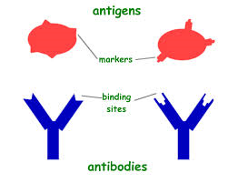
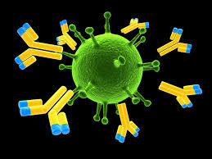
Laboratory methods of assessment of humoral immunity
all methods use an antigen (Ag) – antibody(Ab) reaction as
their primary means of detection
we assess either Ag or Ab

Slide 4
Laboratory methods of assessment of humoral immunity
Precipitation – immunodiffussion
immunoelectrophoresis
turbidimetry
nephelometry
Agglutination
Radioimmunoassay, enzyme immunoassay
Immunofluorescence

Slide 5
Immunodiffusion
Diagnostic test which involves diffusion of Ag or Ab through
a substance such as agar
Two commonly known forms are:
- single radial immunodiffusion
- Ouchterlony double immunodiffusion

Slide 6
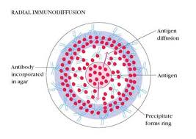
Single radial immunodiffusion assay
Used in immunology to determine the quantity of an antigen by measuring the diameter of circles of precipitin complexes surrounding samples of the antigen
Radial immunodiffusion
Antigen diffusion
Antigens diffuse into the medium, react with antibodies suspended in the medium and form insoluble precipitin complexes.
Antibody incorporated in agar
Antigen
Precipitate forms ring

Slide 7
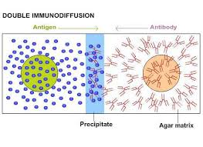
Double immunodiffusion (Ouchterlony)
passive double immunodiffusion
used for detection and identification of antibodies and
antigens such as immunoglogulins and extractable nuclear
antigen
Antigens and antibodies each diffuse out of their wells, if antibodies recognize antigens, they will form immune complexes. The immune complexes precipitate in the gel to give a thin white line, which is a visible signature of antigen recognition.

Slide 8
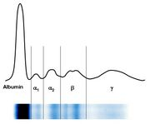
Immunoelectrophoresis
- is a laboratory technique, in which the blood serum is placed into a gel and exposed to an electric field to separate the serum protein components into five major fractions:
Serum albumin
Alfa-1-globulins
Alfa-2-globulins
Beta-globulins
Gamma-globulins (immunoglobulins)

Slide 9
Immunofixation
Permits the detection and typing of monoclonal immunoglobulins in serum or urine
It is of great importance for diagnosis and monitoring of myeloma
Immunofixation takes place in two steps:
1. separating the serum immunoglobulins on a gel under the effect of
an electric field, immunofixation requires to migrate serum tested
several times.
2. then, anti-immunoglobulin antibodies are individually added to
each migration lane.
The presence of a monoclonal immunoglobulin results in the apperance of a narrow band after staining complex precipitates.

Slide 10
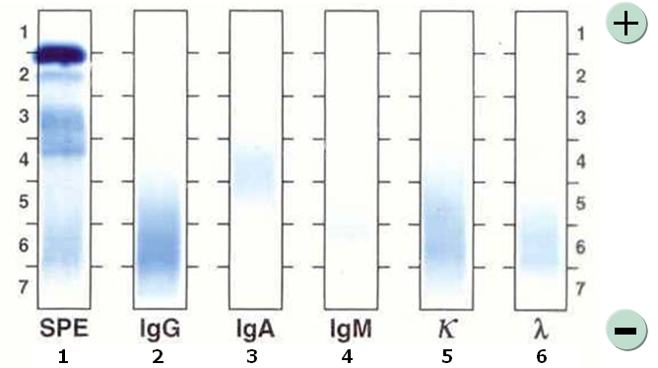
Immunofixation of healthy sample
Legend: bar 1: electrophoresis of serum
other bars: imnunochemic typing of distinct heavy and light
chains of immunoglobulins, polyclonal production
is apparent

Slide 11
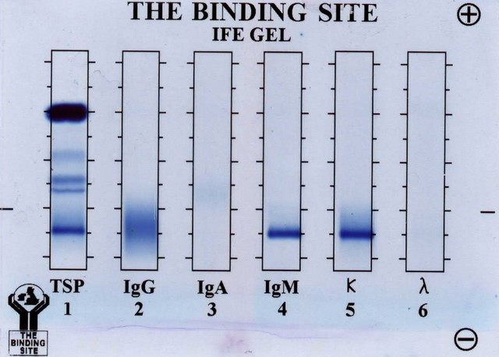
Immunofixation of pathological sample
Typing of M band by immunofixation. In this example, the M band found on electrophoresis (1) is identified as an IgM (type K).

Slide 12
Nephelometry and turbidimetry
methods based on measuring of concentration of suspended immune complexes in a solution
technique used in immunology to determine the levels of blood plasma proteins, for example levels of IgG, IgA and IgM, CRP, RF, C3 and C4 complement, C1 inhibitor

Slide 13
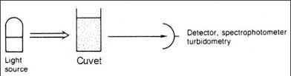
Turbidimetry:
Definition: a measurement of the loss of transmitted light intensity due to the effect of turbidity caused by immune complexes forming in medium.
Arrangement of photometr: right opposite the light source

Slide 14
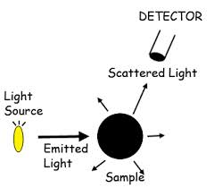
Nephelometry:
Definition: a measurement of intensity of scattered light at right angles to the direction of the light.
Arrangement of photometer: measure the light scattered at right angle to the direction of the light from the source

Slide 15
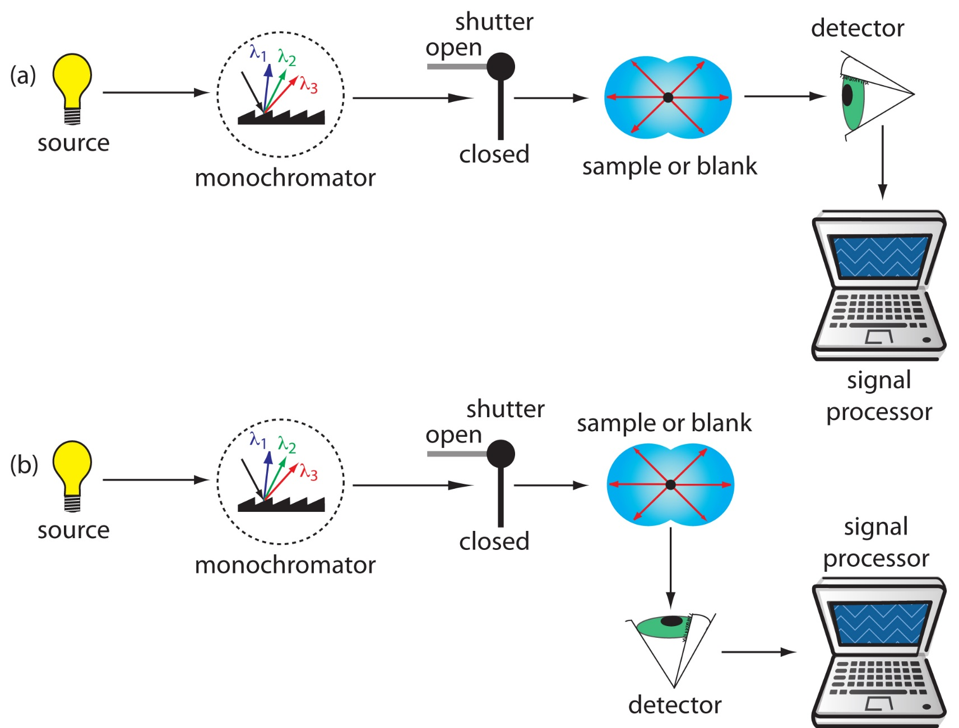
Turbidimetry (a) and nephelometry (b)

Slide 16
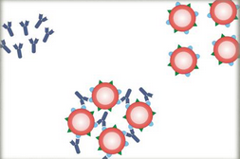
Agglutination
The interaction between specific antibody and antigenic determinant on the surface of antigen results in visible clumping called agglutination.
Antigens include: bacteria, red blood cells, latex particles

Slide 17
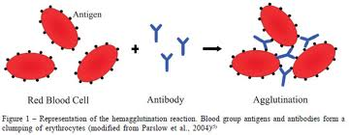
An agglutinin is an antibody that interacts with antigen on the surface of particles such as erythrocytes, bacteria or latex particles.
An agglutinogen is an antigen on the surface of particles such as red blood cells that react with the antibody known as agglutinin to produce agglutination (the most widely known agglutinoges are those of ABO and related blood group system).
The hemagglunation reaction- blood group antigens and antibodies form a clumping of erythrocytes.

Slide 18
Radioimmunoassay, enzyme immunoassay
sensitive methods used to measure small concentrations of
antigens (not detected by precipitation or agglutination)
labeled immunoassays
measure indirectly using a labeled antigen/antibody
antigen or antibody are labeled by
- radioactive element (radioimmunoassay)
- enzyme (enzyme immunoassay)

Slide 19
Radioimmunoassay (RIA)
competitive binding assay
uses radiaoctive isotopes (iodine ¹²⁵) as a label
Principle: known radiolabeled antigen compete with unknown patient’s antigen for sites on bound antibody
High radioactivity = small amount
of patient’s antigen
Low radioactivity = high amount
of patient’s antigen
Concentration is inversely proportional to detected radioactivity.

Slide 20
ImmunoRadioMetricAssay (IRMA)
Noncompetitive binding assay
Principle: patient’s antigens bind to adsorbed antibodies, added radiolabeled antibodies bind to bound antigens
The concentration is directly releated to detected radioactivity.
High radioactivity = high amount of patient’s antigen
Low radioactivity = low amount of patient’s antigen

Slide 21
RIA/IRMA- andvantages and disadvantages
Advantages:
- extremely sensitive and precise
- detects trace amounts of analytes small in size
Disadvantages:
- expensive equipment necessary
- work with radioactive isotopes, radioactive waste
Enzyme immunoassays have largely replaced radioimmunoassay.

Slide 22
Enzyme immunoassay (EIA)
labeled immunoassay
antigen or antibody are labeled by enzyme
horseradish peroxidase and alkaline phosphatase are the most popular enzymes
Basic principle: Ag or Ab labeled by enzyme (Ag*, Ab*) reacts with Ab or Ag in the sample immune complexes are produced (Ag-Ab*, Ab-Ag*) linked enzym reacts with added substrate
we can detect colour change of substrate (ELISA), fluorescence (FEIA) or chemiluminiscence (LEIA)
Assessment of specific IgE antibodies, cytokines, hormones, specific autoantibodies, anti-infectious antibodies (anti-HIV Abb)
- Použití: kvantitativní stanovení proteinů (protilátek), které se vyskytují v séru v nízkých koncentracích (autoprotilátky o známé specifitě, protil. proti očkovacím antigenům a proti infekčním činitelům, stanovení cytokinů)

Slide 23
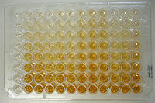
EIA – enzyme immunoassay
ELISA - enzyme-linked immunosorbent assay
special sandwich type of EIA
can be used to quantify antigen/antibody in the sample
large no of samples can be proceed at a time
highly sensitive method
involves coating the Ag/Ab to a solid phase, the common format is to absorb the Ag/Ab to the wells of a 96- well microplate and to use substrates that produce a colored soluble product

Slide 24
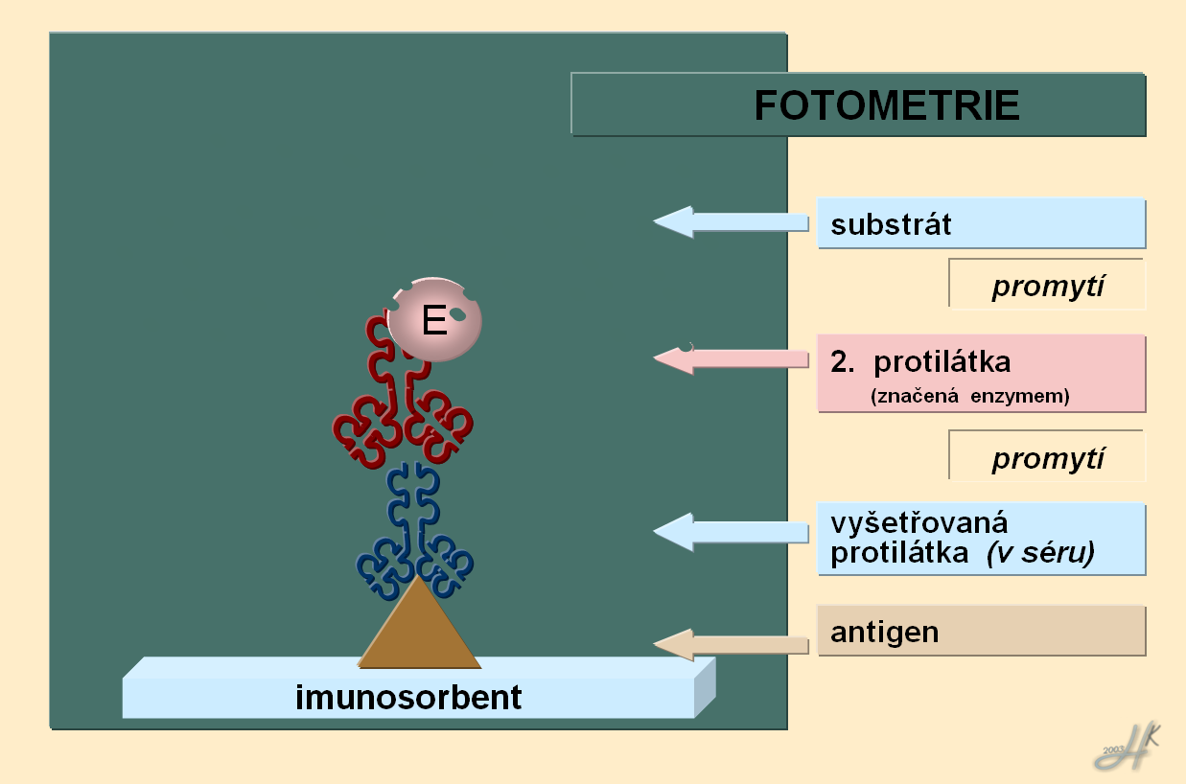
ELISA – assessment of specific antibodies
Add sample to well coated with antigen. If antibody of interest is present in the sample, it will bind to the antigen. After washing add second antibody, that will specifically bind first antibody. After washing the substrate is added to the mixture. This substrate will trigger a reaction with enzyme attached to a second antibody to produce coloured substance.
Spectrophotometry
substrate
wash
2.Antibody
(labeled by enzyme)
wash
Specific antibody detected in the serum
Antigen – coated well

Slide 25
Assessment of specific IgE antibodies

Slide 26
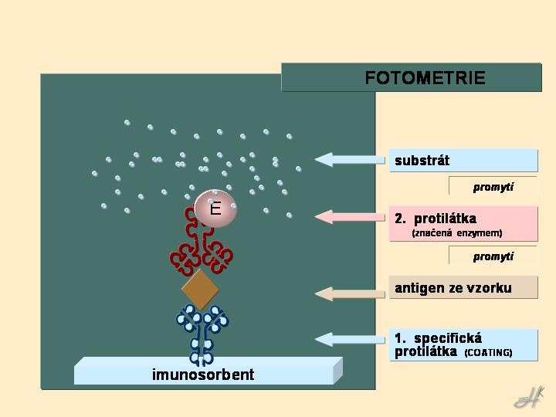
ELISA – assessment of antigen
Spectrophotometry
substrate
wash
2.Antibody
(labeled by enzyme)
wash
Antigen detected in serum
1. specific antibody (coated to well)

Slide 27
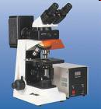
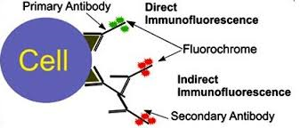
Immunofluorescence assay
Immunofluorescence is a technique allowing the vizualization of a specific protein or antigen in tissue sections by binding a specific antibody chemically conjugated with a fluorescent dye such as fluorescein isothiocyanate ( FITC).
The specific antibodies are labeled with a compound (FITC)
that makes them glow an apple-green color when observed
microsopically under UV light
There are two major types of immunofluorescence staining methods
1. direct IF: staining in which the primary
antibody is labeled with fluorescence dye
2. indirect IF: staining in which a secondary
antibody labeled with fluorochrome is used
to detect a primary antibody

Slide 28
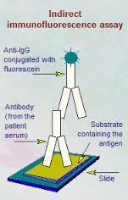
Indirect immunofluorescence
is considered the standard technique for detection of autoantibodies
uses two types of antibodies, the first (the primary antibody) recognises the target molecule and binds to it, and second (the secondary antibory), which carries the fluorophore, recognises the primary antibody and binds to it
For the determination of autoantibodies, tissue
sections are used as antigen substrates.
If sample is positive, specific autoantibodies in
the diluted serum sample attach to the antigens
coupled to the solid phase.
In a second step, the attached antibodies are
stained with fluorescein-labeled anti-human
antibodies and visualized with the fluorescence
microscope.
Anti IgG conjugated with fluorescein
Antibody(from the patient serum)
Substrate containing antigen

Slide 29
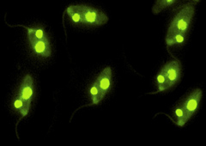

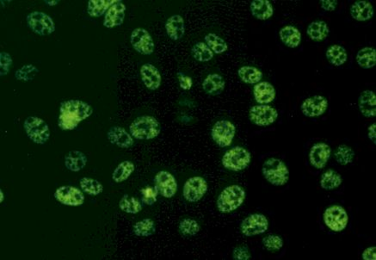
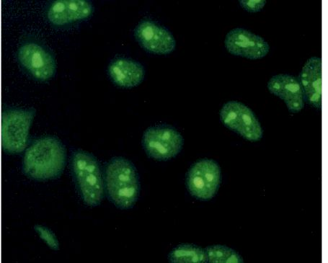


Indirect immunofluorescence
a laboratory test used to detect antibodies in serum or other body fluids
Autoantibodies are detected on specific substrates:
Anti ds-DNA on protozoan Crithidia lucilliae substrate
ANA- on Hep-2 substrate
ANCA on neutrophil substrate
AMA- on mouse stomach, kidney substrate
Anti LKM- on mouse liver, stomach, kidney
Homogeneous
pattern
Speckled pattern
Nucleolar pattern
P-ANCA
C-ANCA

Slide 30
Asessment of cellular imunity
Number of cells - subpopulations
Phagocytosis
Activation of lymphocytes

Slide 31
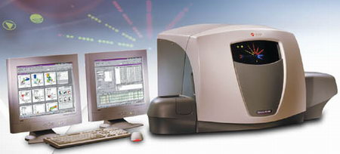
Flow cytometry
- the main diagnostic tool for the assessment of cellular immunity

Slide 32
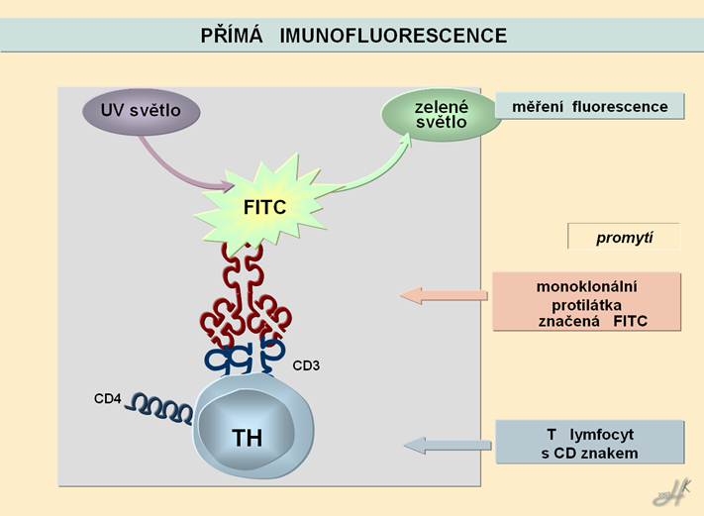
Flow cytometry
- method used for analysis of cells
- uses direct immunofluorescence assay to identify a particular cell
type
Direct immunofluorescence
Primary, or direct, immunofluorescence uses a single, primary antibody, chemically linked to a fluorophore (FITC, PE).
The primary antibody recognizes the target molecule (antigen) and binds to a specific region called the epitope (CD 3, CD 4)
UV
Green light
Fluorescence detection
Wash out
FITC labeled monoclonal antibody
T lymphocyte with specific CD marker

Slide 33
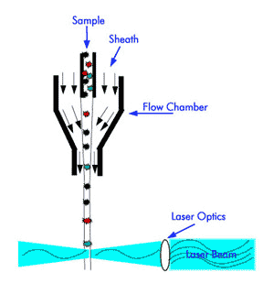
Flow cytometry
Is a technology that simoultaneously measures and then analyzes multiple physical characteristics of single cells, as they flow in a fluid stream through a beam of laser light.
When cells pass through the laser, they scatter laser light and emit fluorescence.
Scattered and emitted light signals are converted to electronic pulses, that can be processed by the computer.
The properties measured include a particle’s relative size, relative granularity and relative fluorescence intensity.

Slide 34
IMPORTANT LEUKOCYTE POPULATIONS
CD3⁺ T lymphocytes:
mature T lymphocytes 50 - 75%
CD4⁺ T lymphocytes:
helper T lymphocytes 30 - 60%
CD8⁺ T lymphocytes:
cytoxic T lymphocytes 15 - 30%
CD25⁺ T lymphocytes:
activated T lymphocytes 1 - 5%
CD19⁺ B lymphocytes:
mature B lymphocytes 5 - 15%
CD56⁺ NK cells:
natural killer cells 5 - 15%
CD14⁺ cells: monocytes
CD15⁺ cells: granulocytes
CD38⁺ cells: plasma cells

Slide 35
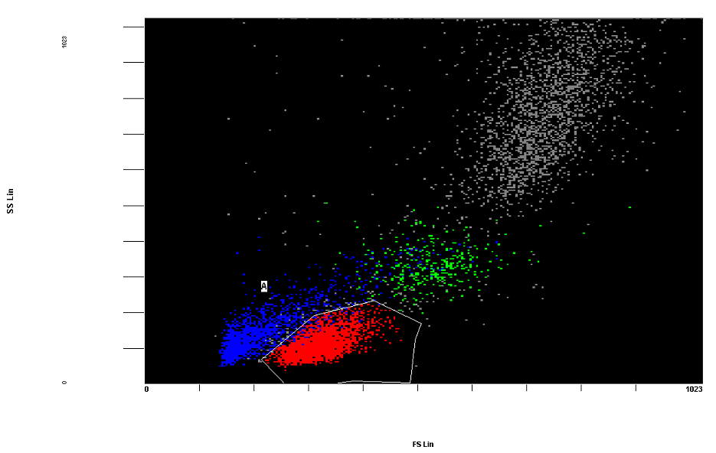
Gating of lymphocytes
Major leucocyte subpopulations can be differentiated using FSC (forward-scattered light - proportional to cell size) and SSC (side-scattered-light - proportional to cell granularity).
granulocytes
Erytrocytes, debris
monocytes
lymphocytes
Cell subpopulation based on FSC vs SSC

Slide 36
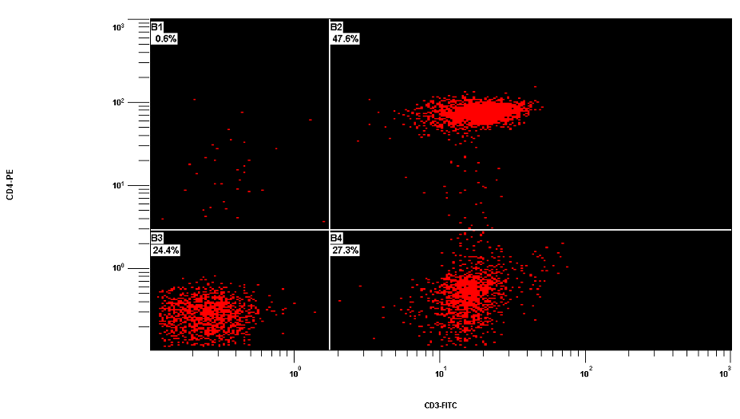
T and Th lymphocytes

Slide 37
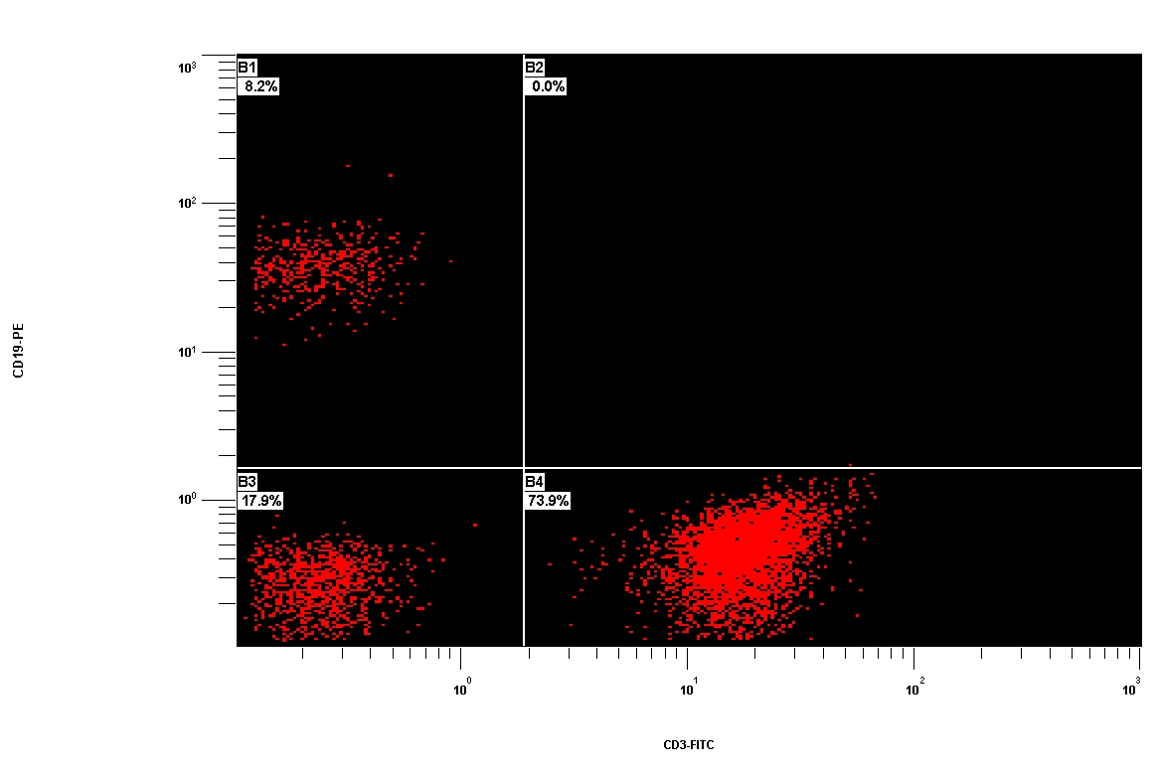
T and B lymphocytes

Slide 38
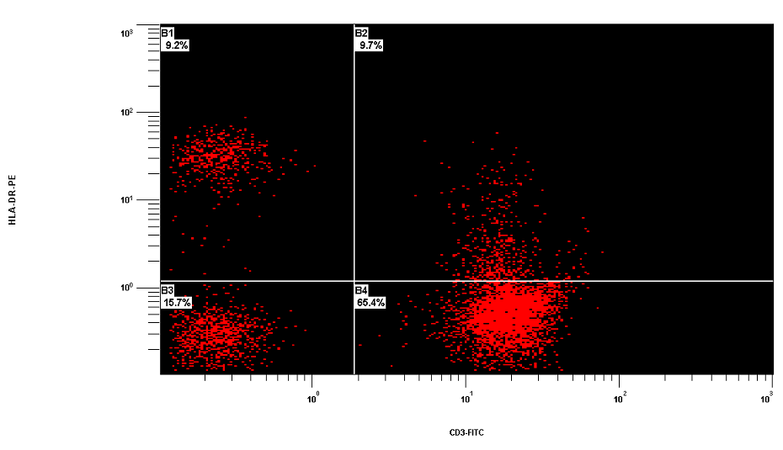
Activated T lymphocytes

Slide 39
TESTS OF LYMPHOCYTE FUNCTION
Ability to proliferate
Ability to produce cytokines
Dg. Severe Combined Imunodeficiency
(SCID)
TESTS OF PHAGOCYTIC FUNCTION
No of granulocytes
Phagocytar activity of granulocytes
Respiratory burst
Dg. Chronic Granulomatous Disease (CGD)

Slide 40
http://www.lifetechnologies.com/cz/en/home/support/tutorials.html#vid4

Slide 41
http://www.lifetechnologies.com/cz/en/home/support/tutorials.html#vid4
http://www.lifetechnologies.com/cz/en/home/support/tutorials.html#vid4
Thank you for your attention!

