Slide 1
11.11. 2016 MUDr. Martina Vachová Topics: 31. Immunoglobulins - structure. 32. Immunoglobulins - functions. 33. Genetic background of immunoglobulin production. 34. Biological and chemical characteristics of immunoglobulin classes IgG and IgA. 35. Biological and chemical characteristics of immunoglobulin classes IgM, IgD and IgE. 36. Isotype switching. Idiotypes and anti-idiotypes - their role. Immunological memory. 37. Ontogenesis of the immune response. 38. Primary immune response. 39. Secondary immune response. Effector functions of antibodies.

Slide 2
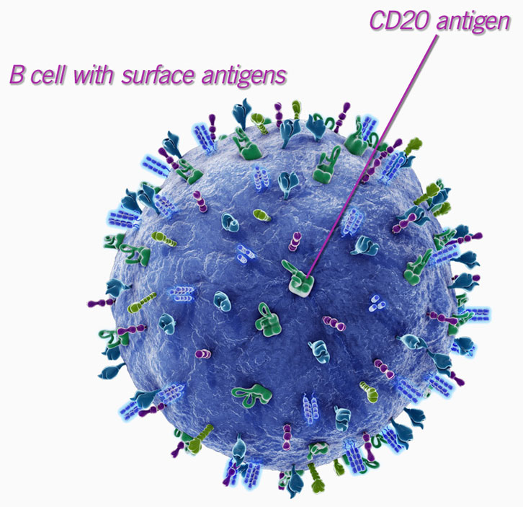
B lymphocytes

Slide 3
B-lymphocytes
B lymphocytes are a type of lymphocytes, which play a role in the humoral part of the specific (adaptive) immune system
B-cells recognize native antigen through BCR (B cell receptor)
B-lymphocytes which bind Ag with BCR are stimulated to proliferate and differentiate into effector plasma cells which produce large quantities of antibodies of the same specificity as the BCR (it is actually the same protein in soluble form). Part of stimulated B-cells differentiate to memory cells.
APC (antigen presenting cell)

Slide 4
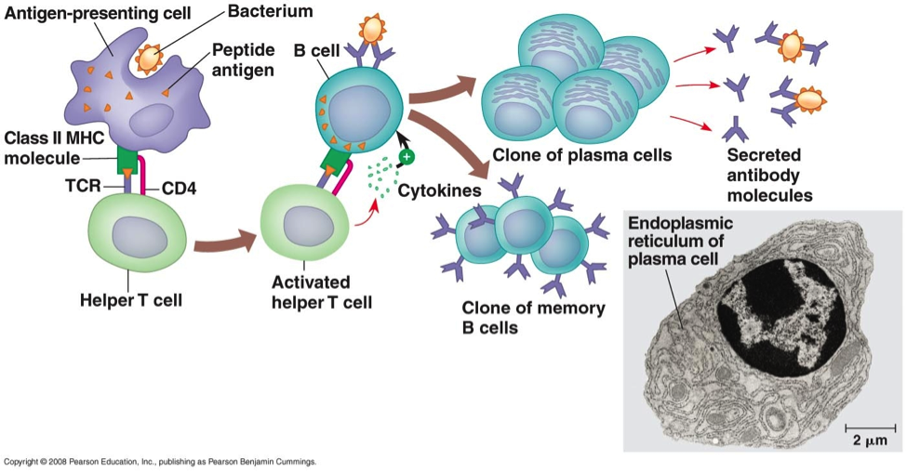
Antigen recognition by B cell in secondary lymphoid organs

Slide 5
Surface markers of B lymphocytes
CD 10 - immature B cells
CD 19 - characteristic surface marker of B cells
CD 20 - on the surface of Ig-positive B cells
IgM, IgD - BCR
MHC gp II - Ag presenting molecules
CD 40 – costimulating receptor

Slide 6
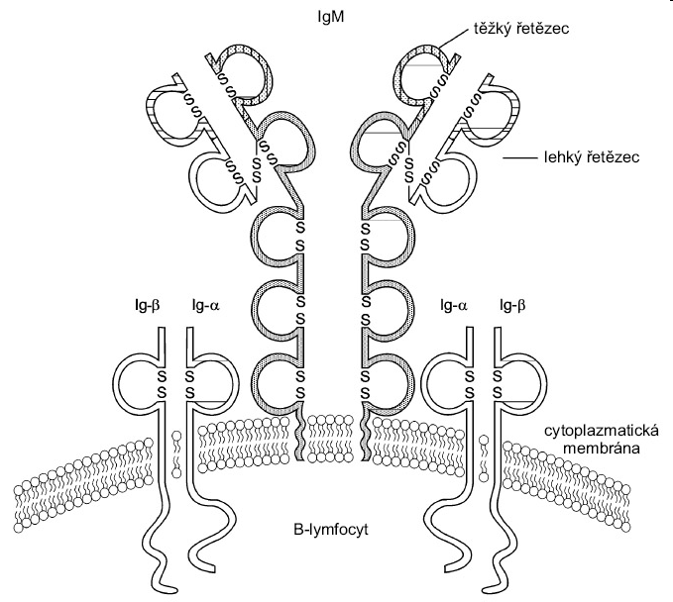
BCR
BCR is composed of surface immunoglobulin (IgM, IgD) which recognizes Ag and associated signaling molecules Igα and IGβ, which are associated with the cytoplasmic protein-tyrosine kinases (PTK) Src Group
After binding of Ag to 2 or more BCR, PTK will approximate , mutual phosphorylation and phosphorylation of other cytoplasmic proteins begin, leading to changes in gene transcription, proliferation, differentiation and secretion of antibodies

Slide 7
B cell development
Development of B cells takes place in the bone marrow and completes after activation with Ag in secondary lymphoid organs. Pluripotent hematopoietic stem cell (CD 34) Progenitor B cell - begin recombination processes which lead to a large number of B lymphocytes clones with individual specific BCR Pre - B cell - expression of pre-B receptor (composed of H (μ) chain and alternate L chain) Immature - B lymphocyte - expression of surface IgM (BCR) at this stage elimination of autoreactive clones Mature B lymphocyte - expression of surface IgM and IgD (BCR)

Slide 8
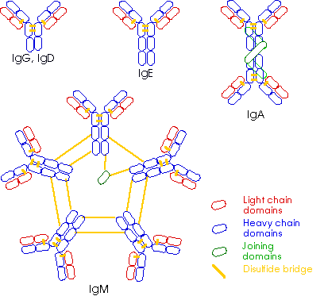
Immunoglobulins
(Antibodies)

Slide 9
Immunoglobulin structure
2 heavy (H) chains covalently linked by disulfide bonds, each H chain is connected to a light (L) chain by disulfide bonds
H chain consists of 4 to 5 domains (1 variable, 3-4 constant)
L chain consists of 2 immunoglobulin domains (1 variable, 1 constant)
Types of L chains - κ, λ
Types of H chains - μ, δ, γ (γ1-4), α (α1, α2), ε

Slide 10
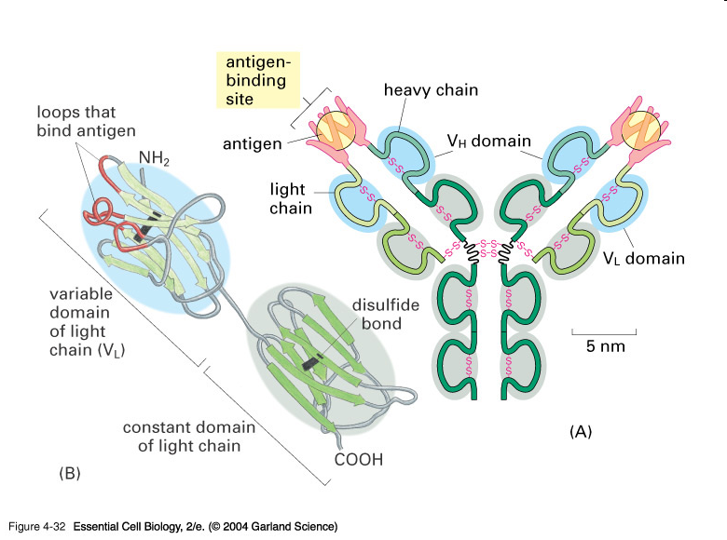
Immunoglobulin structure

Slide 11
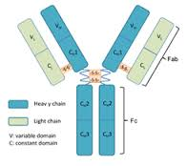
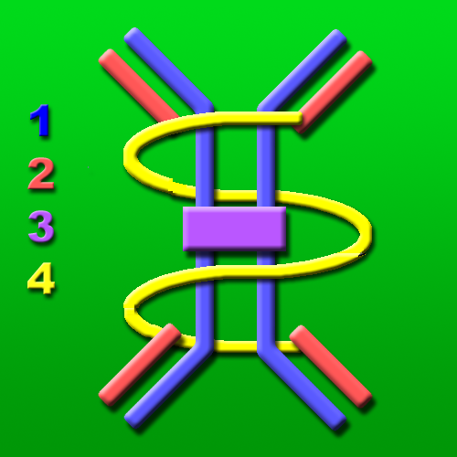
Variable domains of L and H chain form the binding site for Ag
Hinge region where are the heavy chains linked
by disulfide bonds
Immunoglobulins are glykoproteins
(glycosylated Fc part)
J chain - molecules of immunoglobulin classes (IgM, IgA) consist of several monomer units – joined together by J chain
Secretory component (IgA)

Slide 12
Immunoglobulins functions
Antigen neutralization Antibodies prevent bacterial adherence or inhibit activity of toxins, viruses and other microorganisms by binding to their important epitopes
Complement activation (IgM, IgG) Antibody activates complement, which enhances opsonization and lyses some bacteria
Opsonization (IgA, IgG) Antibodies promote phagocytosis by APC
Mast cell activation using IgE
ADCC (antibody-dependent cellular cytotoxicity)

Slide 13
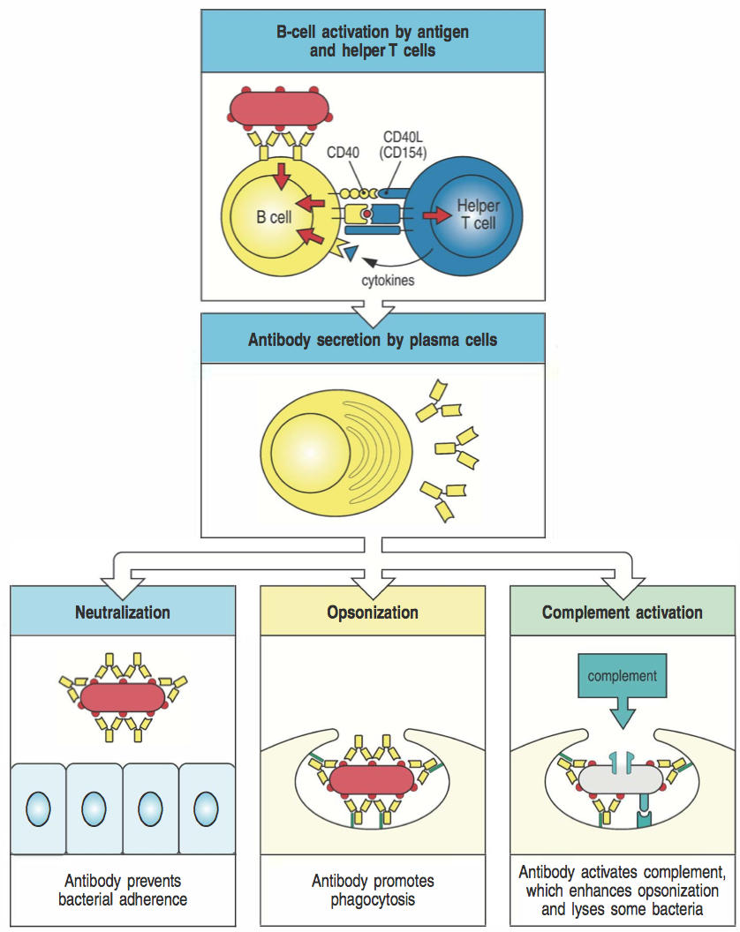

Slide 14
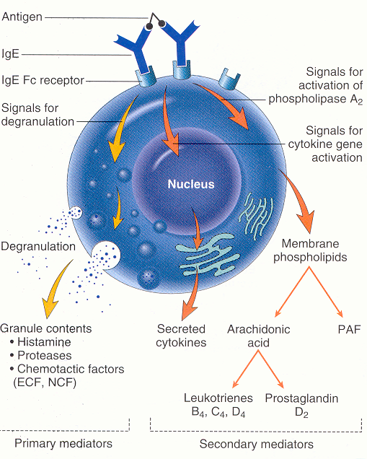
Immunoglobulins functions
Mast cell activation using IgE
Mast cells can be stimulated by cross-linking of IgE receptors (Fce RI)
Basis of allergic reation and of the defence against multicellular parasites

Slide 15
Mast cell activation by cross-linking of IgE Fc receptors
Allergen or multicellular parasite
binds to IgE on mast cell→ cross-
linking of several molecules FcεRI
initiate mast cell degranulation (release of histamin, tryptase, serotonin…)
activation of arachidonic acid metabolism (leukotriene C4, prostaglandin PGD2) - amplification of inflammatory responses
cytokine production by mast cell (TNF, TGFβ, IL-4, 5, 6)

Slide 16
Histamine
vasodilatation, increase of vascular permeability (erythema, edema, itching)
bronchoconstriction (cough, wheezing, dyspoe)
increases intestinal peristalsis (diarrhea)
increased mucus secretion (cough)
Responsible for the clinical signs of allergy.
Helps eliminate the parasite.

Slide 17
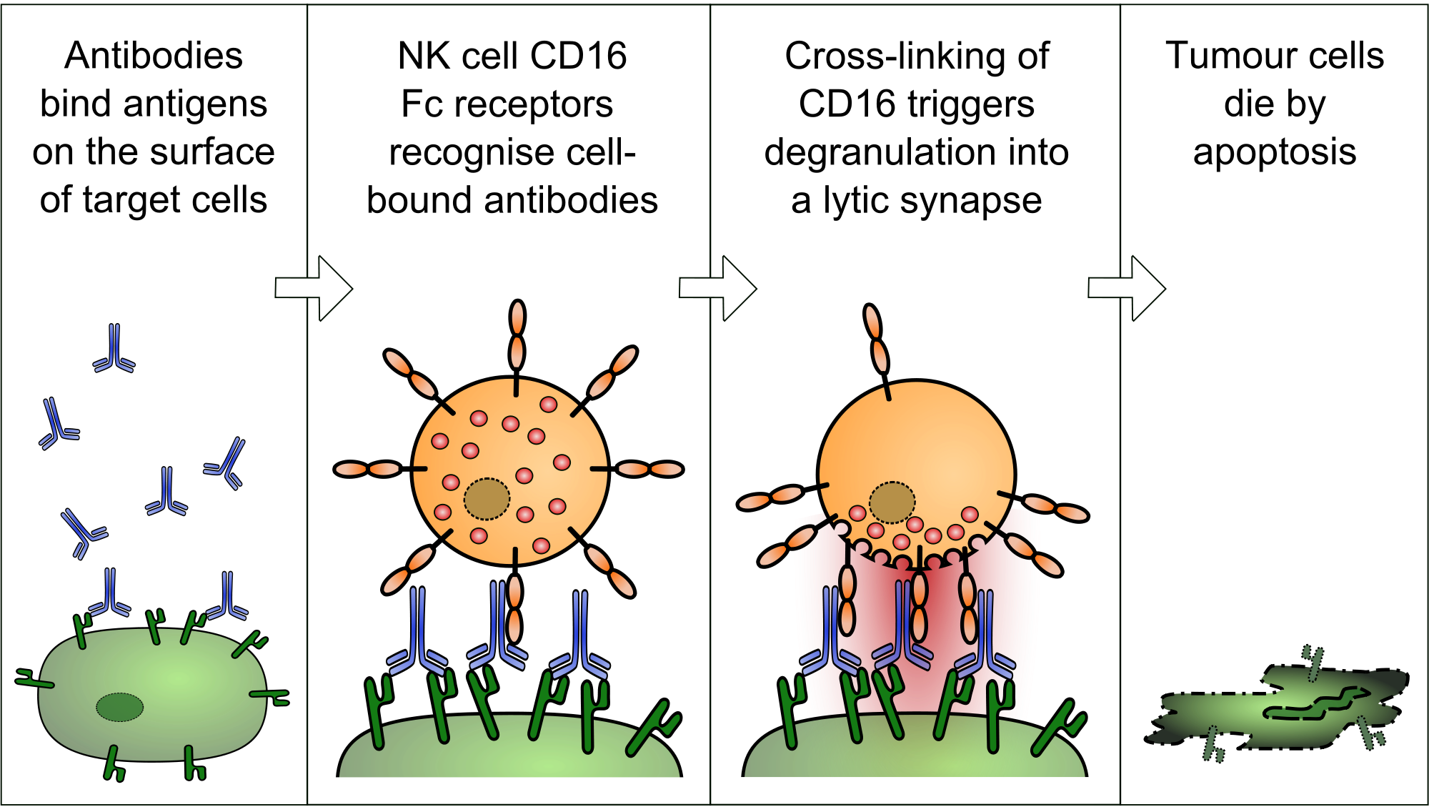
Immunoglobulins functions
ADCC (antibody-dependent cellular cytotoxicity) NK cells recognize cell opsonized with IgG antibodies by the Fc receptor CD16, this leads to the activation of cytotoxic mechanisms (NK degranulation)

Slide 18
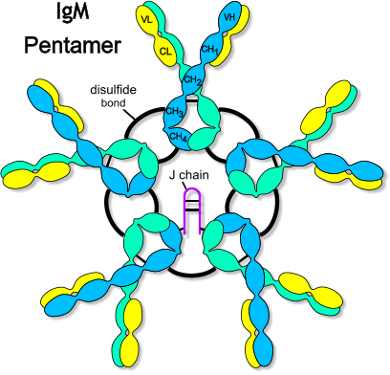
Classes of immunoglobulins and their functions
Distinguished by the constant part of H chain IgM, IgD, IgG (IgG1 - IgG4), IgA (IgA1, IgA2), IgE
IgM
as a monomer form BCR
secreted as pentamer (10 binding sites)
first isotype that forms after the meeting with Ag
functions: Ag neutralization, complement activation, do not bind to Fc receptors on phagocytes
(concentration of 0.9 to 2.5 g / l; biol. half-life 6 days)

Slide 19
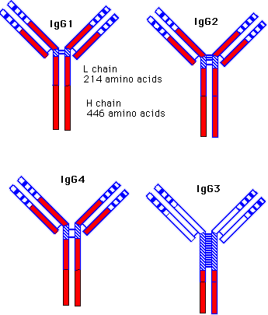
IgG
predominantly formed in secondary immune
response
functions: Ag neutralization, opsonization,
complement activation, ADCC
isotypes IgG1-IgG4 with different ability of complement activation and binding to Fc receptors on phagocytes (opsonization)
passes the placenta (protection of fetus in utero)
(concentration of 8 to 18 g / l; biol. half-life of 21 days)

Slide 20
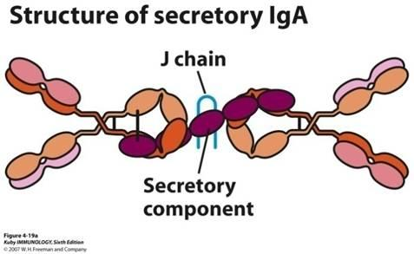
IgA
Secretory IgA
most significant mucosal immunoglobulin
dimer with secretory component
transcytosis - IgA is transported across the epithelium using transport Fc receptor (polymeric-Ig receptor), on luminal side is IgA split off with the part of the receptor called secretory component, which protects Ig against intestinal proteases
provides protection of mucous membranes
functions: Ag neutralization, do not activate complement , opsonization (in Peyerś patches may be immune complexes with IgA captured and can induce immune response)
saliva, tears, breast milk
Serum IgA
monomer, dimer or trimer
(0.9 to 3.5 g / l; biol. half-life of 6 days)

Slide 21
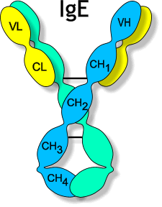
IgD
monomer form a BCR
in serum is in a very low concentration
(0.1 g / l; biol. half-life 3 days)
IgE
applies in defense against multicellular parasites
is the main cause of allergic reactions
( 3x10⁻⁴ g / l; biol. half-life 2 days)

Slide 22
https://www.youtube.com/watch?v=6A9JFaeU7Io
https://www.youtube.com/watch?v=EMThHM-YD5k

Slide 23
The genetic basis of the immunoglobulins development
Gene segments for H chains – on chromosome 14 V (variable) segments D (Diversity) segments variable domains of H chain J (joining) segments C segments constant domains of H chain
Gene segments for L chains - κ on chromosome 2 - λ on chromosome 22 V (variable) variable domains of H chain J (joining) C constant domain of L chain
At the ends of V, D, J segments there are signal sequences which are recognized by enzyme VDJ recombinase that carry out the rearrangement of these genes
On the sides of C segments are so-called switch sequences, which are recognized by enzyme recombinase that carry out isotype switching

Slide 24
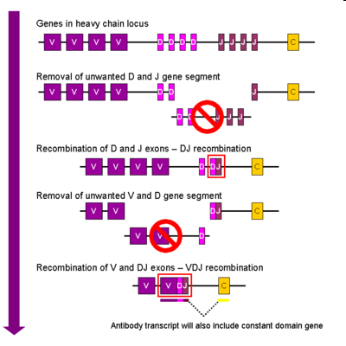
The rearrangement of genes coding H chain
1) DJ rearrangement - excision a section of gene complex between some D and J segment (runs on both chromosomes)
2) VD rearrangement
- excision a section between some
V segment and DJ, if rearrangement on
some chromosome is successfull, stops the
regrouping on the second chromosome –
it is called allelic exclusion (this is also true
for L chain).
The rearranged IgH gene is transcribed into
mRNA

Slide 25
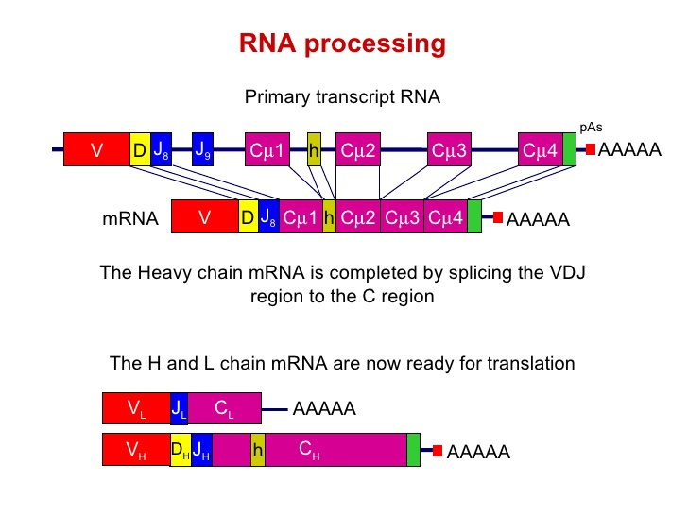
The rearrangement of genes coding H chain
The first formed H chain is μ.
If rearrangement is unsuccessful, B lymphocyte die.

Slide 26
The rearrangement of genes coding L chain
1) First, rearrange the genes encoding the L chain κ, there is excision of sections between a V and J segment (simultaneously on both chromosomes), if the rearrangement is successful on one chromosomes, regrouping on the second chromosome stops – it is called allelic exclusion. 2) If regrouping of the κ genes is unsuccessful, start the regrouping genes λ. If regrouping is unsuccessful, B lymphocyte die.

Slide 27
https://www.youtube.com/watch?v=A7hPuHozz0g

Slide 28
Isotype (class) switching
Occurs during the terminal differentiation of B lymphocyte after activation with Ag on the surface of FDC and T_{H}2 (require costimulating signal through CD40)
Enzymes recombinases recognize the switch sequences located on the sides of C segments and excise gene segments
Switch sequence is not between Cμ and Cδ segments - B cell can produce before isotype class switching IgM and IgD simultaneously
After elimination of some C segment, the closest segment to VDJ segment is transcribed into mRNA, and after splicing and translation arise corresponding isotype of the H chain

Slide 29
Isotype switching

Slide 30
Isotype switching
Cytokines regulate which isotype will be produced: IL-4 stimulates switching to IgE and IgG4 TGFβ stimulates switching to IgG2 and IgA

Slide 31
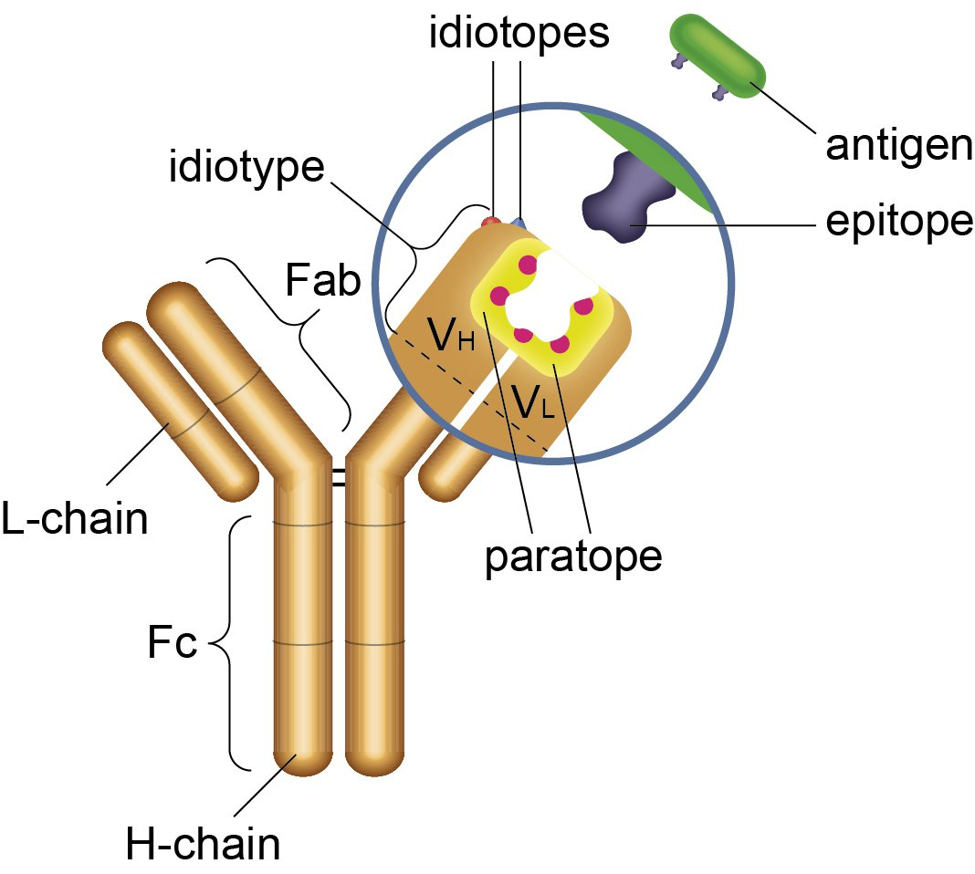
Anti-idiotypic antibodies
IDIOTYP = group of idiotops which are on the variable part of antibody

Slide 32
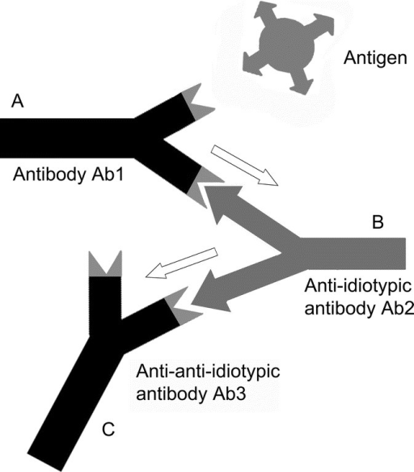
Anti-idiotypic antibodies
Idiotypic structures of 1st generation antibodies can be recognized by some B cells as antigens and can induce production of anti-idiotypic antibodies (2nd generation antibodies; some binding sites may remind Ag, which caused formation of 1st generation antibodies)
Against the 2nd generation antibodies
formate antibodies of 3rd generation
(anti-antiidiotypic antibodies).
The idiotypic network may play a role
in regulation of antibody response

Slide 33
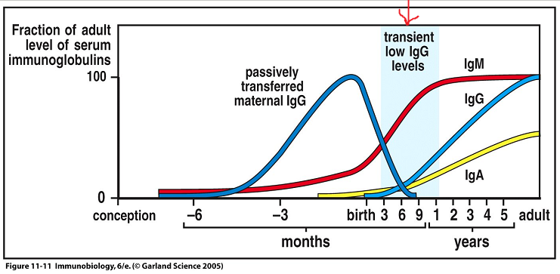
Ontogenesis of antibodies
Synthesis of specific antibodies begins around the 20.-24. week of gestation, the total concentration of IgA and IgM remains undetectable until birth, IgG begins to form after birth After birth begins slow growth of own IgG, which is accompanied by decline in maternal IgG (about 3. to 6.month)
The IgM concentration reaches values comparable with adults in the 1- 3 year of life, IgG and IgA between 10.-15. year

Slide 34
After birth B lymphocytes respond to immunization predominantly by IgM formation, switching to other isotype is slower
Antibody response to polysaccharide antigens appears around 2. year of life
In old age is a lower antibody response to new stimuli and increased autoantibodies production

Slide 35
Humoral immune response

Slide 36
Humoral response induced by
T-independent antigens
Cause predominantly IgM production
Bacterial polysaccharides, lipopolysaccharides, and polymeric forms of protein
T-dependent antigens
Reaction to these Ag occurs in two phases - primary and secondary
Initiate the development of memory cells and formation of high-affinity antibodies and different isotypes

Slide 37
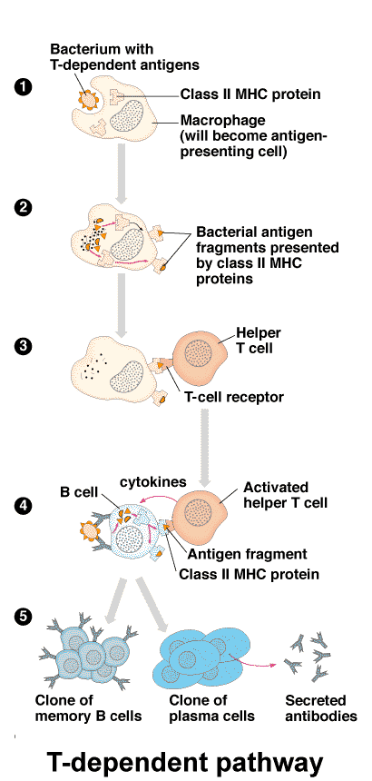
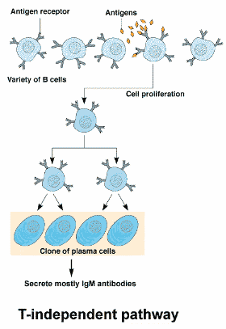
T-independent and T-dependent immune response

Slide 38
Antibody responses induced by T-dependent antigen
Primary phase of antibody response
Takes place in secondary lymphoid organs
After the first contact with Ag 2 processes run simultaneously:
- stimulation of B cells by Ag binding to BCR
- Ag absorption by APC and its presentation via MHC gp class II to precursors of T_{H} cell → formation of clone of antigen-specific T_{H}2 cells, which provide assistance to competent B cells, leading to their proliferation, differentiation into plasma (produce Ab) and memory cells

Slide 39
T-dependent immune response

Slide 40
Antigen presentation by B lymphocyte to Th2 lymphocyte

Slide 41
Plasma cells are spread by bloodstream into the organism (particularly bone marrow)
Antibodies produced in the primary phase (3-4 days) are IgM and have a low affinity for Ag, create with Ag immune complexes
Immune complexes are captured in the secondary lymphoid organs on the surface of FDC (follicular dendritic cells) - Ag presenting cells to B lymphocytes

Slide 42
Secondary phase of antibody response
Begins when sufficient amount of immune complexes on FDCs is catched and when Ag in immune complexes are recognized by B cells
Germinal center reaction: under the influence of signals from the FDC (Ag) and T_{H}2 cells (CD40L, cytokines) is again started the proliferation and differentiation of B cells accompanied with somatic mutations → formation of clones of B cells with new BCR → survive only B cells with a BCR with the highest affinity to Ag = affinity maturation of antibodies (4-6 x higher afinity to Ag)

Slide 43
Secondary phase of antibody response
Besides somatic mutations also isotype switching starts- instead of IgM other isotypes of immunoglobulins are produced, which isotypes (IgG, A, E) arise determines cytokine environment
Contact between CD40 (B lymphocytes) and CD40L (T_{H}2 lymphocytes) is essential for the initiation of somatic mutations, isotype switching and formation of memory cells

Slide 44
In the secondary phase of the immune response there are generated antibodies with higher affinity to Ag and with other effector characteristics , which are dependent on isotype. During this phase also memory cells are formed, prepared for next meeting with the Ag
Antibodies in the body persist for a long time after primary infection

Slide 45
https://www.youtube.com/watch?v=jPqb1_pE41g&list=PLNMRM8YNM-urW9d6KrbkeW2nakXFm0zI9&index=1

Slide 46
Primary and secondary immune response
Primary immune response – occurs after the first exposure to antigen
Secondary immune response –occurs after subsequent encounter with the same antigen and is more rapid leading to the activation of previously generated memory cells

Slide 47
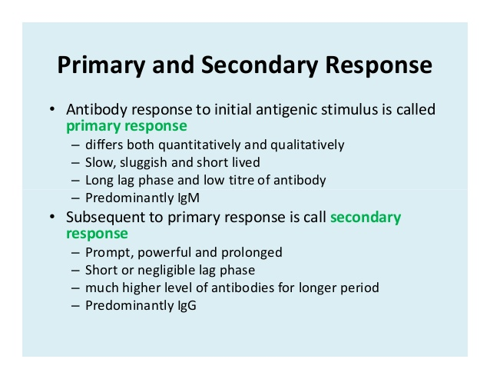
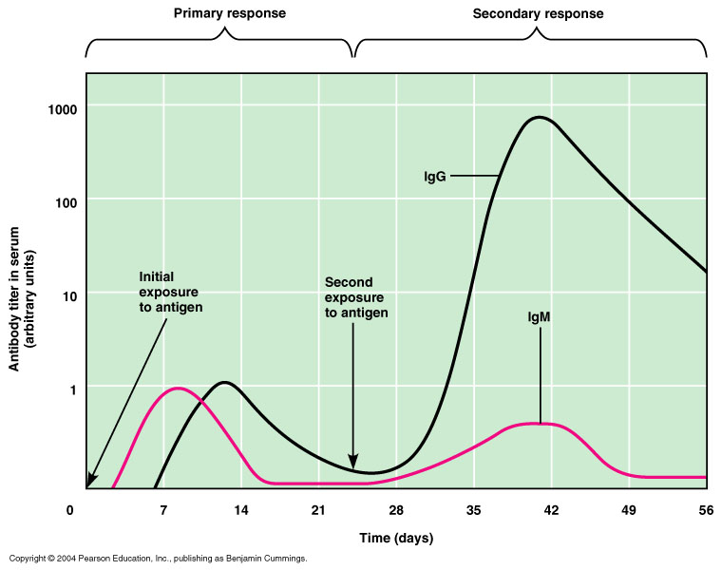
Primary and secondary immune response

Slide 48
https://www.youtube.com/watch?v=548wQ5C6ufQ

Slide 49
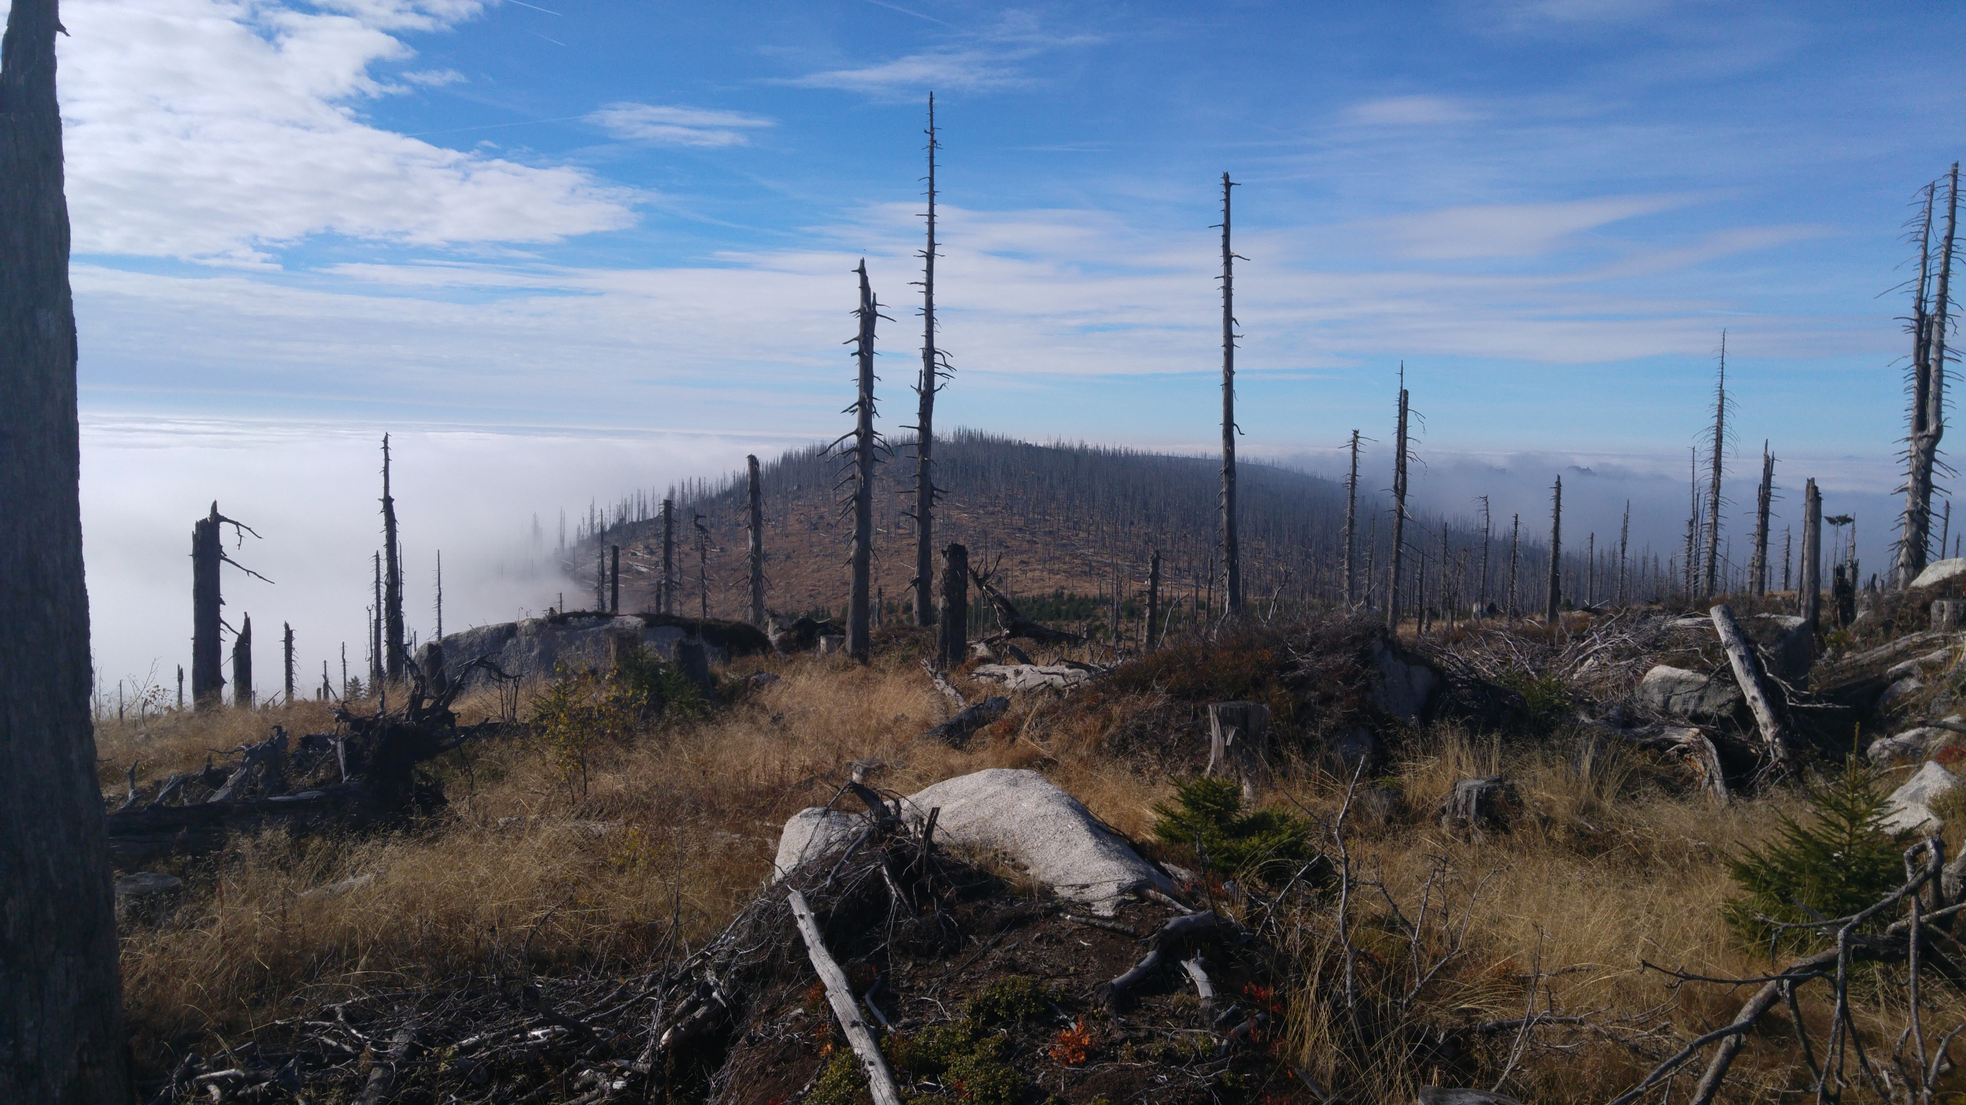
Thank you for your attention

